Slide 1
Healing with HERBS
By
Dr. A. A. Gadwal
S.S.A’s Arts and Commerce College, Solapur.

Slide 2
Medicinal Herbs
Ayurveda is an alternative medicine system with historical roots in the Indian subcontinent. Ayurveda is heavily practiced in India and Nepal, where around 80% of the population report using it. Therapies include herbal medicines, special diets, meditation, yoga, massage, laxatives, enemas, and medical oils. Ayurvedic preparations are typically based on complex herbal compounds, minerals, and metal substances. Ayurveda has eight ways to diagnose illness, called Nadi (pulse), Mootra (urine), Mala (stool), Jihva (tongue), Shabda (speech), Sparsha (touch), Druk (vision), and Aakruti (appearance). Ayurvedic practitioners approach diagnosis by using the five senses.[55] For example, hearing is used to observe the condition of breathing and speech. The study of the lethal points or marman marma is of special importance.
The vast majority (90%) of Ayurvedic remedies are Herbal or plant based. Plant-based treatments in Ayurveda may be derived from roots, leaves, fruits, bark, or seeds; some examples of plant-based substances include cardamom and cinnamon. In the 19th century, William Dymock and co-authors summarized hundreds of plant-derived medicines along with the uses, microscopic structure, chemical composition, toxicology, prevalent myths and stories, and relation to commerce in British India. Triphala, an herbal formulation of three fruits, Amalaki, Bibhitaki, and Haritaki, is one of the most commonly used Ayurvedic remedies. The herbs Withania somnifera (Ashwagandha) and Ocimum tenuiflorum (Tulsi) are also routinely used in Ayurveda.

Slide 3
Objectives of the paper
Treatment with Herbs is the basic method in Ayurveda,the researcher by this papers aim to acknowledge the people that, India is the host of herbal medicinal plants, treatment with herbs is the oldest method of treating and healing the illness. It further aims to educate people on cultivation, environment and appearance of the medicinal plants, fruits, roots and flowers. The herbal medicine is easily available in India further any long treatment with Herbs do not leave any negative side effect.

Slide 4
Significance of the study:
Significance of the study: Treatment with herbal plants, fruits, roots and oil is within the reach of every stake holder, all herbs and associates are available in all parts of India with small investment. Not only the Vedacharya but also the Naturpathist and common man with the knowledge of Herbal medicinal plants can treat in emergency. Further the government on its part is encouraging the the cultivation of medicinal plants and the treatment with Ayurveda medicinal plants and all methods of healing are patronized by the government.

Slide 5
Methodology adapted:
The Researcher is more inquisitive and eager to know the magic of medicinal plants. Man is the component of the wide ecosystem of the earth; herbs, flowers, plants, bark, seed oil, roots are the other components to complete the ecosystem, nobody is autonomous, all the interdependent, their existence, nature and functions are for each-other; naturally all herbs and medicinal plants are for healing the human ills and injuries. The researcher collected the plants, fruits, roots and bark of the medicinal plants, studied their medicinal and healing nature. Ayurveda literature, discussion with Vaidyas, news paper cutting and self experiment are the sources of data. Different herbs are applied for different ills with a variation in quantity and method of intake and applying on on the target and they are healing the illness and injuries.

Slide 6
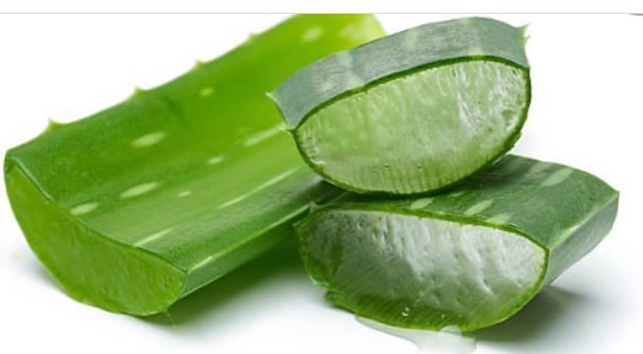
Data Presentation
1] Aloe Vera: the herbal plant Aloe vera, sometimes described as a “wonder plant,” The leaves of Aloe vera are succulent, erect, and form a dense rosette. Many uses are made of the gel obtained from the plant’s leaves. According to Kew Gardens, England’s royal botanical center of excellence, Aloe vera has been used for centuries and is currently more popular than ever. It is cultivated worldwide, primarily as a crop for “Aloe gel,” which comes from the leaf.
Aloe vera is widely used today in:
•Food – it is approved by the FDA as a flavoring.
•Cosmetics.
•Food supplements.
•Herbal remedies.
The earliest record of a human use for Aloe vera comes from the Ebers Papyrus (an Egyptian medical record) from the16th century BC. According to a study published in the Indian Journal of Dermatology, in ancient Egypt, they called Aloe vera “that plant of immortality.” The authors added that the plant has been used therapeutically for many centuriesTrusted Source in China, Japan, India, Greece, Egypt, Mexico, and Japan.

Slide 7
Medicinal Use of the Plant:
The medicinal claims made about Aloe vera, as with many herbs and plants, are endless. Some are backed by rigorous scientific studies while others are not. This article focuses mainly on those that are backed by research.
1. Teeth and gums
A study published in General Dentistry reported that Aloe vera in tooth gels is as effective as toothpaste in fighting cavities.
The researchers compared the germ-fighting ability of an Aloe vera tooth gel with two popular toothpastes. They found that the gel was just as good, and in some cases even better than the commercial toothpastes at controlling cavity-causing oral bacteria.
The authors explain that Aloe latex contains anthraquinones, compounds that actively heal and reduce pain through natural anti-inflammatory effects.
The scientists warned that not all gels they analyzed contained the proper form of Aloe vera – they must contain the stabilized gel that exists in the center of the plant to be effective.
2. Constipation
Germany’s regulatory agency for herbs – Commission E – approved the use of Aloe vera for the treatment of constipation. Dosages of 50-200 milligrams of Aloe latex are commonly taken in liquid or capsule form once daily for up to 10 days.
The U.S. Food and Drug Administration (FDA) ruled in 2002 that there is not enough data on the safety and efficacy of Aloe products; so, in the U.S., they cannot be sold to treat constipation.

Slide 8
3. Diabetes-induced foot ulcers
A study carried out at the Sinhgad College of Pharmacy, India, and published in the International Wound JournalTrusted Source looked at Aloe’s ability to treat ulcers.
They reported that a “gel formed with carbopol 974p (1 percent) and Aloe vera promotes significant wound healing and closure in diabetic rats compared with the commercial product and provides a promising product to be used in diabetes-induced foot ulcers.”
4. Antioxidant and possible antimicrobial properties
Share on PinterestAloe vera may be used on skin conditions or superficial cuts for its antimicrobial and antioxidant properties.
Researchers at the University of Las Palmas de Gran Canaria, Spain, published a study in the journal Molecules.
The team set out to determine whether the methanol extract of leaf skins and flowers of Aloe vera might have beneficial effects on human health. The scientists focused on the extract’s possible antioxidant and antimycoplasmic activities.
Mycoplasma is a type of bacteria that lack a cell wall; they are unaffected by many common antibiotics. Antimycoplasmic substances destroy these bacteria.
They reported that both Aloe vera flower and leaf extracts had antioxidant properties, especially the leaf skin extract. The leaf skin extract also exhibited antimycoplasmic properties.
The authors concluded that “A. Vera extracts from leaf skin and flowers can be considered as good natural antioxidant sources.”

Slide 9
Antioxidant and possible antimicrobial properties
Share on PinterestAloe vera may be used on skin conditions or superficial cuts for its antimicrobial and antioxidant properties.
Researchers at the University of Las Palmas de Gran Canaria, Spain, published a study in the journal Molecules.
The team set out to determine whether the methanol extract of leaf skins and flowers of Aloe vera might have beneficial effects on human health. The scientists focused on the extract’s possible antioxidant and antimycoplasmic activities.
Mycoplasma is a type of bacteria that lack a cell wall; they are unaffected by many common antibiotics. Antimycoplasmic substances destroy these bacteria.
They reported that both Aloe vera flower and leaf extracts had antioxidant properties, especially the leaf skin extract. The leaf skin extract also exhibited antimycoplasmic properties.
The authors concluded that “A. Vera extracts from leaf skin and flowers can be considered as good natural antioxidant sources.”

Slide 10
5. Protection from ultraviolet (UV) irradiation
Scientists at Kyung Hee University Global Campus, South Korea, wanted to determine whether baby Aloe shoot extract and adult Aloe shoot extract might have a protective effect on UVB-induced skin photoaging; in other words, whether they could protect the skin from the aging effects of sunlight.
Baby Aloe shoot extract (BAE) comes from 1-month old shoots while adult Aloe shoot extract (AE) comes from 4-month old shoots.
In an article published in Phytotherapy Research, the authors concludedTrusted Source: “Our results suggest that BAE may potentially protect the skin from UVB-induced damage more than AE.”

Slide 11
6. Protection from skin damage after radiation therapy
A study carried out at the University of Naples, Italy, tested five different topical creams to see how effective they might be in protecting the skin of breast cancer patients receiving radiation therapy. One of these creams contained Aloe.
They divided 100 patients into five groups of 20; each was prescribed a different topical treatment. They applied the creams twice daily, starting 15 days before radiation therapy treatment, and carried on for 1 month afterward.
During the 6-week period, the participants underwent weekly skin assessments.
In the journal Radiation Oncology, the scientists reported that the preventive use of the topical hydrating creams reduced the incidenceTrusted Source of skin side effects in the women treated with radiation therapy for breast cancer, none performed significantly better.
“All moisturizing creams used in this study were equally valid in the treatment of skin damage induced by radiotherapy.”

Slide 12
7. Depression, learning, and memory – an animal experiment
A study published in Nutritional Neuroscience found that Aloe vera reduced depressionTrusted Source and improved memory in mice.
After carrying out experiments on laboratory mice, they concluded: “Aloe vera enhances learning and memory, and also alleviates depression in mice.”
Further studies are needed to establish whether humans might also receive the same benefits.

Slide 13
8. Wounds from second-degree burns
A team of plastic surgeons compared Aloe vera gel to 1 percent silver sulphadiazine cream for the treatment of second-degree burn wounds.
They reported in the Journal of Pakistan Medical Association that the burn wounds among the patients treated with Aloe vera healed significantly quicker compared with those treated with 1 percent silver sulfadiazine (SSD).
The researchers added that those in the Aloe vera group experienced significantly more and earlier pain relief than those in the SSD group.
The authors wrote: “Thermal burns patients dressed with Aloe vera gel showed advantage compared to those dressed with SSD regarding early wound epithelialization, earlier pain relief, and cost-effectiveness.”

Slide 14
9. Irritable bowel syndrome (IBS)
A randomized, double-blind human trial carried out at St. George’s Hospital Medical School, London, United Kingdom investigated Aloe and IBS. Their results were published in the International Journal of Clinical Practice. Participants with IBS were given either Aloe vera or a placebo. After 3 months, there were no significant differences in symptoms of diarrhea.
However, the researchers wroteTrusted Source:
“There was no evidence that AV [Aloe vera] benefits patients with IBS. However, we could not rule out the possibility that improvement occurred in patients with diarrhea or alternating IBS whilst taking AV. Further investigations are warranted in patients with diarrhea predominant IBS, in a less complex group of patients.”

Slide 15
Aonla: Aonla or Indian gooseberry (Emblica officinalis) is regarded as Amritphal. It is an indigenous fruit to Indian subcontinent. Its fruits are a rich source of vitamin ‘C’. Fruits have been reported to be useful in haemorrhages, diarrhoea, dysentery, anaemia, jaundice, dyspepsia and cough. Trifala and chavanprash are well-known indigenous medicines in Ayurvedic system prepared from aonla. Besides fruits, leaves bark and even seeds are being used for various purposes. Though aonla is not utilized as table fruit it is commercially utilized for processing industries and products like morabba, chatni, squash, candy, toffee shreds, sauce are prepared besides used in cosmetic industries as shampoo, hair oil, dyes, etc.
In India its commercial cultivation is very common in Uttar Pradesh. Its intensive plantation is being done in the salt- affected areas of Utter Pradesh. Aonla cultivation is spreading rapidly in the semi-arid regions of Maharashtra, Gujarat, Rajasthan, Andhra Pradesh, Karnataka,Tamil Nadu and Himachal Pradesh. Though aonla is not commercially cultivated in the North Eastern, it is commonly found either in homestead or growing in wild which indicates its adaptability. However, there are variation in existing natural population with respect to tree vigour, fruiting behaviour, yield and quality characters.

Slide 16
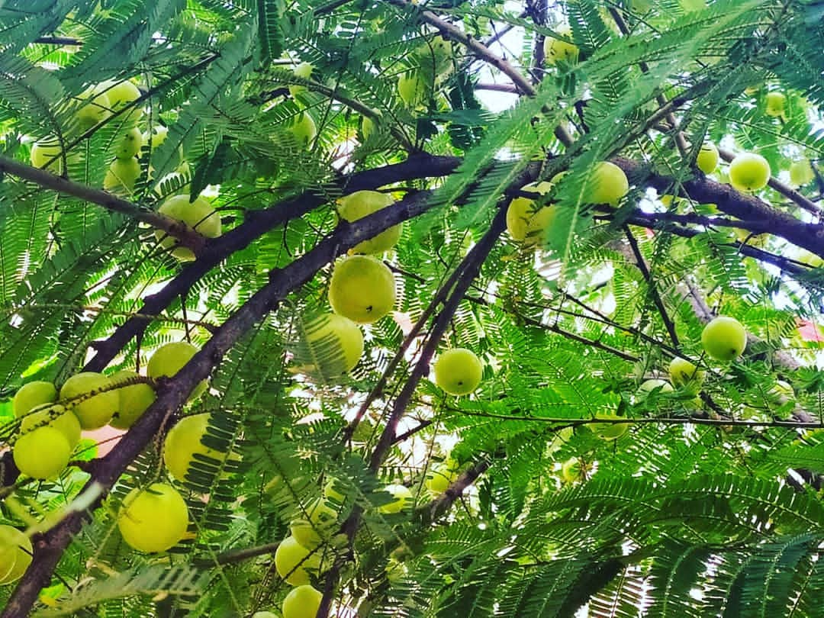
1: Amla and Hypertension
Amla is a rich source of various antioxidants. It is a known antioxidant property to scavenge the free radicals produced by the human body during stress. Along with antioxidants, Amla contains a notable amount of potassium. Therefore, due to potassium’s ability to regulate blood pressure, it has been used regularly in the diet of patients suffering from blood pressure problems. The major mechanism involved in managing hypertension by Potassium is by dilating blood vessels, which further reduces the chances of blood pressure. In this situation, the drinking of Amla juice could be effective.

Slide 17
2: Amla in Diabetes: Traditionally, Amla is used as a home remedy to regulate or control diabetes. The main reason behind diabetes is stress conditions. Amla is a good source of vitamin C. It is a powerful antioxidant that will help reverse the free radical generation and the effect of oxidative stress. The consumption of Amla products regularly can prevent the chances of diabetes. In another mechanism, Amla’s fibres can help absorb the excess sugar in the body to regular blood sugar levels. So, including alma in your Diabetes Diet Plan can help in the effective management of diabetes.

Slide 18
3: Amla and digestion: Amla berries contain enough soluble dietary fibres. The fibre has a role in regulating bowel movements, which could help relieve irritable bowel syndrome. Due to the higher amount of vitamin C in Amla, it also helps absorb a good amount of essential minerals. Therefore it has synergism with different health supplements.

Slide 19
4: Amla and mental health: Amla berries’ antioxidants have a strong free radical quenching ability, which can help avoid brain cells’ damage and enhance memory. This could be the reason that Amla is effective in treating patients who have dementia. 5: Amla and weight loss: The reason for the fat accumulation could be a slow metabolism. Irregular eating habits can lead to the fat formation in unwanted places. Amla helps prevent the fat formation and helps in flushing out the toxins from the body. Generally, eating raw Amla, candies, and Amla powder with lukewarm water is recommended for weight loss.

Slide 20
6: Amla oil and hair health: Amla oil is used for a long-time as a home remedy to enhance the growth of the hair. Better hair growth can be achieved when a mixture of coconut oil and Amla is regularly used for hair massage. Amla oil can stimulate follicles of hair for their better growth. The length and volume of hair get improved when treated using Amla oil. It contains vitamin C, which helps increase collagen levels. This directly impacts the growth of new hairs by replacing dead hair cells on the scalp. Amla not only helps in growing the hairs but also prevents dandruff problems by hydrating the scalp. Vitamin C, due to its strong anti-inflammatory and anti-bacterial, prevents hair from itching and scaling. Ayurveda says the reason behind premature greying is due to excessive pitta. Therefore, Amla helps to reduce the pitta to retard the process of hair greying. This is the reason Amal is found in different hair colourant formulations.

Slide 21
7: Healthier Eyes: Amla is also a good source of A, which is known to enhance eye health. Vitamin A of Amla berries helps improve vision. This can also reduce the risk of macular degeneration and conjunctivitis, which comes with ageing. 8: Amla and Polycystic ovary syndrome: Amla can help in flushing toxins from the body during the menstrual cycle and maintains the hormonal balance, which will automatically improve women’s fertility. 9: Amla and skin health: Amla contains a natural blood purifier, and the regular intake of such products can help in skin glow. The Amla products can also help in fighting different allergies related to the skin. 10: Amla products and their recommended dosages: The ayurvedic dosage of Amla varies according to its variants. Different forms of Amla products

Slide 22
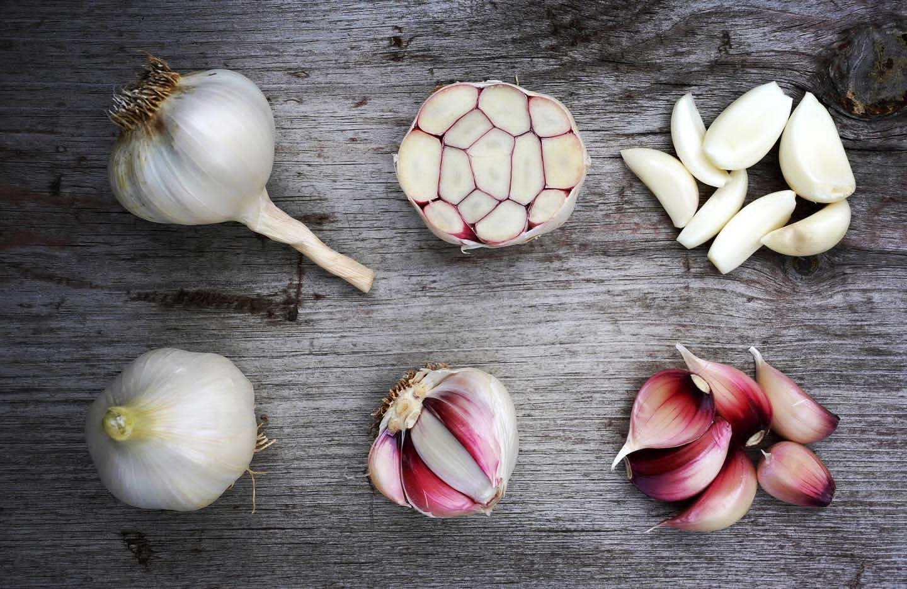
Garlic:Garlic has been part of the kitchens for centuries. This herb has curative and medicinal properties because of its antibacterial and antiseptic nature. The beneficial properties of garlic are because of a compound, Allicin. It is rich in minerals like phosphorus, zinc, potassium, and magnesium. Vitamins C, K, Folate, niacin and thiamine also are found abundantly in garlic.
Garlic Nutritional Chart
Here is the nutritional chart for 100 grams of raw garlic. Note that 1 medium to large garlic clove weighs between 3-8 grams each.

Slide 23
The Health Benefits of Eating Garlic are:
1. Wards Off Cough and Cold
Raw garlic has the potential to ward off cough and cold infections. Eating two crushed garlic cloves on an empty stomach has the maximum benefit. For kids and babies, hanging garlic cloves in a thread around their necks is supposed to relieve congestion symptoms.
2. Good for Cardiac Health
Allicin, a compound found in garlic stops the oxidizing of LDL (bad cholesterol). This reduces cholesterol levels and improves heart health. Regular consumption of garlic reduces the incidence of blood clots and thus helps prevent thromboembolism. Garlic also lowers blood pressure so is good for patients with hypertension. Read more on How to control high blood pressure.
Also Read: 2o Essential Tips for a Healthy Heart

Slide 24
3. Improves Brain Functioning
Garlic promotes brain health because of its antioxidant and anti-inflammatory properties. It is effective against neurodegenerative diseases like Alzheimer’s and dementia. Also, read more on the best brain foods to include in your diet.
4. Improves Digestion
Digestive problems improve with the inclusion of raw garlic in the diet. It benefits the intestines and reduces inflammation. Eating raw garlic helps to clear out intestinal worms. The good thing is that it destroys the bad bacteria and protects the good bacteria in the gut.
5. Balances Blood Sugar
Those who suffer from diabetes observe their blood sugar levels regulating the consumption of raw garlic.
Also, read 10 harmful effects of sugar.

Slide 25
6. Boosts Immunity
Garlic protects against free radicals and prevents damage to the DNA. Zinc in garlic promotes immunity. Vitamin C helps to fight off infections. It is very beneficial against eye and ear infections as it has antimicrobial properties.
7. Improves Skin Health
Garlic helps prevent acne and lightens acne scars. Cold sores, psoriasis, rashes, and blisters can all benefit from the application of garlic juice. It also protects against UV rays and therefore prevents ageing.
Read More: 7 Home Remedies for Glowing Skin
8. Prevents Cancer and Peptic Ulcer
Because of a high amount of antioxidants, garlic protects the body against lung, prostate, bladder, stomach, liver and colon cancer. The antibacterial action of garlic prevents peptic ulcers as it eliminates the contagion from the gut.

Slide 26
9. Good for Weight Loss
Garlic reduces the expression of genes responsible for the formation of adipose cells which store fat. It also increases thermogenesis in the body and leads to the burning of more fat and the lowering of LDL (bad cholesterol).
Apart from the fact that it is good for weight loss, garlic is highly nutritional. In fact, one clove of raw garlic, which is around 3 grams, contains:
•Manganese
•Vitamin B6
•Vitamin C
•Selenium
•Fiber
Amounts of calcium, copper, potassium, iron, etc.

Slide 27
10. May Improve Athletic Performance
Garlic is considered one of the best “performance enhancing” substances. In olden times, the item was used to treat fatigue and improve the work capacity of labourers. Studies on rodents suggest consuming garlic helps in improving exercise performance. People who had heart disease consumed garlic for 6 weeks and this resulted in a 12% reduction in their heart rate and better exercise capacity.
11. Fights UTI and Improves Renal Health
Fresh garlic juice has the potential to reduce the growth of E. Coli bacteria that cause urinary tract infection (UTI). It also helps prevent kidney infections.
Garlic reduces infections on wounds, promotes hair growth, bone health and liver health. Most of the home remedies are effective only if garlic is consumed raw.
12. Reduces Exercise Fatigue
According to studies from Japan, raw garlic when aged in a mixture of water and alcohol may have significant effects on exercise endurance. Human studies have also been conducted that have shown that garlic can indeed improve the symptoms of exercise fatigue.
13. Reduces Blood Toxicity
For people who are susceptible to lead poisoning due to occupational hazards, garlic may be the best organic solution. Studies conducted in 2012 have revealed that garlic is in fact, safer and better at reducing lead poisoning of the blood than d-Penicillamine, which is the common drug used to treat the same.

Slide 28
14. Overcome Oestrogen Deficiency
The period of menopause for older women has often been associated with a lack of the female hormone known as oestrogen due to irregular production of a protein known as a cytokine. Consumption of garlic has been seen to regulate this to some extent and therefore, may be effective in overcoming oestrogen deficiency after menopause.
15. Reduce Effects or Onset of Osteoarthritis
Consuming garlic in your regular diet can also help to prevent or reduce the onset of osteoarthritis. Research has shown that garlic contains a compound known as diallyl disulphide which helps to maintain bone density and therefore can potentially delay the onset of bone-related ailments like osteoarthritis.
16. Prevent Heart Blockages
Garlic is also believed to help reduce the stickiness of the platelets in your blood. These platelets are responsible for the clotting of blood. Consuming a healthy dose of garlic can help reduce the excessive clotting effect of platelets on the blood. Therefore, it may help prevent unnecessary blood clots inside arteries that may reach up to your heart causing a heart attack.

Slide 29
Tulsi or Basil
Tulsi is called the queen of all herbs, it is used widely in Ayurvedic and naturopathic medicines which helps in the healing of the human body in a natural manner. Not only do Tulsi leaves benefit people, but their flowers too. Tulsi can help you get rid of many health problems ranging from fever to kidney stones. Ayurvedic texts have also categorised the wonder herb as a stimulant, antipyretic and aromatic in nature.
In the Hindu religion, holy basil is both a religious symbol as well as a good medical remedy. Religiously speaking, holy basil is worshipped in the mornings and evenings by Hindus throughout India and medically speaking it is used to treat common ailments in the ancient Ayurvedic healthcare system.
Did you ever know that tulsi tea aids in quick weight loss and reduces anxiety disorder? It is also used as a herb to treat thyroid and diabetes. Just as powerful as the tulsi flowers, its leaves are also equally powerful. Tulsi leaves can be added to hot water and it will help you when you are steaming to get rid of a bad cold or sinus.

Slide 30
Benefits of Using Tulsi:
Western medicine gives you instant relief but comes with a lot of side effects. Holy basil or Tulsi offers slow relief but you can be sure that there are no side effects and that is the reason why it is called the wonder herb. A single Tulsi plant can help you get rid of many health issues such as.
1. Tulsi for Skin:
Tulsi is proven to be the safest skin cream that can be used and the benefits are massive. Tulsi reflects on your skin when you consume it as well as applied. This wonder herb is used to treat acne, skin infections, lighten dark spots and improve skin texture. Here is a list of benefits that tulsi does to your skin.
•Tulsi helps in skin brightening.
•Tulsi helps in curing acne face marks.
•Tulsi mixed with eggs and mixed can help in tightening skin pores.
•Tulsi helps in curing skin infections and any sort of skin allergies.

Slide 31
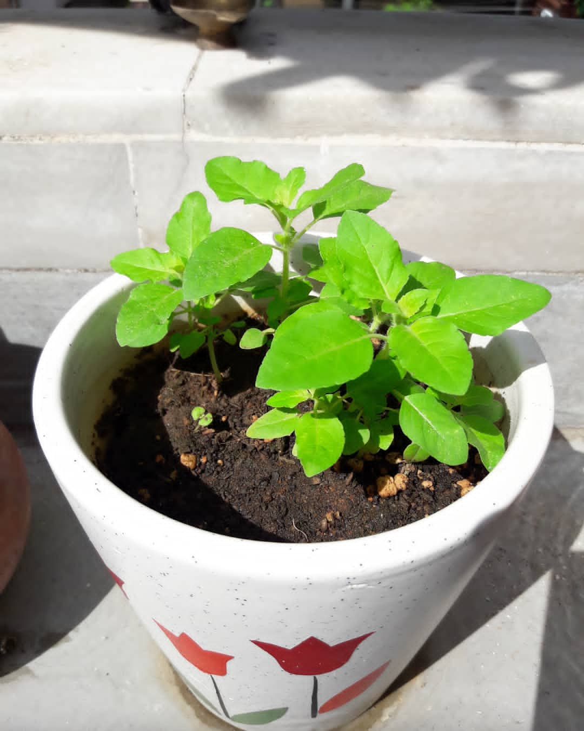
2. Tulsi for Hair:
Holy Basil can be applied to your hair for multiple reasons and all that it does is it makes your hair look better in all ways. Here are some of the ways in which tulsi can benefit your hair.
•Tulsi can help prevent hair fall.
•Tulsi can reduce greying of the hair and keep it thick and black.
•Tulsi can reduce dandruff.
•Tulsi can help prevent dry scalp.

Slide 32
3. Tulsi for Weight Loss:
Tulsi is a natural ingredient that aids weight loss. If you’re wondering how to burn fat in a quick way without any side effects, then you need to opt for drinking tulsi tea. Two cups a day will make a difference. Also, you need to keep in mind that drinking tulsi tea will act more efficiently only if you work out. Of course without exercising tulsi tea can slim you down, but exercising will make the process faster. Here are some ways in which tulsi can help you lose weight.
•Tulsi tea controls your metabolism and helps your body absorb essential nutrients.
•Tulsi tea helps boost your digestive system which is important for losing weight quickly.
•Tulsi tea has zero calories that boost your stamina.

Slide 33
4. Tulsi for Eyes:
Your eyes are prone to a lot of dust and pollution every day. Thus most people develop eye-related problems and Tulsi acts as an immediate cure for eye-related problems such as:
•Tulsi soothes the eyes.
•Tulsi leaves left in boiled water overnight can be used to wash your eyes.
•Tulsi eyewash can also reduce strain on your eyes.
Most importantly, it reduces the strain on your eyes and makes them feel relaxed. Tulsi eyewash can also help you prevent many other eye-related problems such as conjunctivitis and boils.

Slide 34
5. Tulsi Prevents Premature Ageing:
Vitamin C & A and phytonutrients are essential oils that are found in Tulsi, which are used as excellent antioxidants that protect the body from premature ageing. If herbal tea is said to make you feel and look young, imagine what Tulsi can do. Consuming 2 cups of Tulsi tea can help you look younger and prevent premature ageing.
6. Tulsi To Quit Smoking:
Tulsi leaves help fight cancer and prevents it from attacking you. The best aid to stop smoking is by munching tulsi leaves and this help get the nicotine content off your body. It helps in the purification of blood. Here are some ways in which tulsi can help you stop smoking.

Slide 35
•Every time you get the urge to smoke, chew Tulsi leaves.
•Make it a point to drink tulsi tea.
Tulsi can definitely help you stop smoking, provided you learn ways to deviate and curtail yourself from going against the urge. It’s all in your mind and the power of becoming a deviant from the habit is the 1st step to change the habit.
Medical Use of Tulsi:
Tulsi is called the wonder herb or sometimes the holy herb because of its medicinal properties. There are many diseases that can affect people again after it has left the person. But with the consumption of Tulsi, you can be sure that these diseases cannot affect you. Here are some of the ways in which tulsi can sort out various medical problems.
T

Slide 36
•Tulsi can help cure fever.
•Tulsi leaves are used to treat skin problems like acne, blackheads and premature ageing.
•Tulsi is used to treat insect bites.
•Tulsi is also used to treat heart disease and fever.
•Tulsi is also used to treat respiratory problems.
•Tulsi is used to cure fever, common cold and sore throat, headaches and kidney stones.
•Tulsi helps in treating Asthma.
•
In simple terms, Tulsi is the best natural painkiller and solution to many of your health problems. It can be called the ancient healer of all diseases. It helps generate healthy mother milk during lactation.

Slide 37
Where to Get Tulsi Supplement?
Tulsi, the queen of herbs can be bought from a market near you, but again most of it may not be 100% organic. This is because farmers grow tulsi on soil that may have pre-existing chemicals in it. So, now that tulsi is grown on such chemical soil, is it organic or herbal. This herb is said to produce benefits and no side effects. But if it is grown on soil that’s containing chemicals, what guarantee is there that you won’t develop any side effects.
Our air is filled with a lot of toxins and this can cause cold, cough and fever. The answer to this is Tulsi. We at Medlife have created a 100% herbal tulsi in the form of a tablet that can bid goodbye to your common cold, cough and fever.

Slide 38
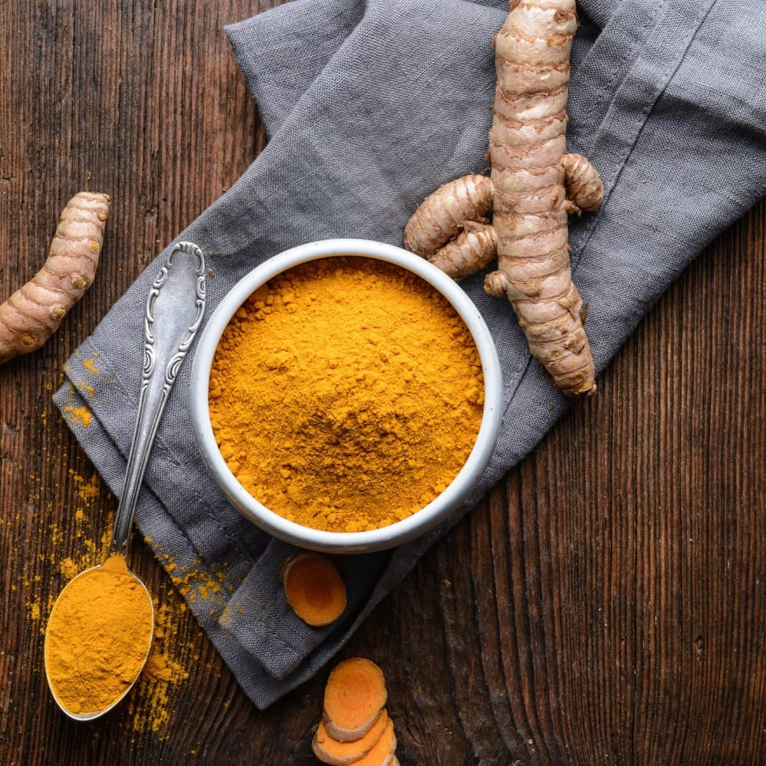
Turmeric
Turmeric is a common spice that comes from the root of Curcuma longa. It contains a chemical called curcumin, which might reduce swelling.
Turmeric has a warm, bitter taste and is frequently used to flavor or color curry powders, mustards, butters, and cheeses. Because curcumin and other chemicals in turmeric might decrease swelling, it is often used to treat conditions that involve pain and inflammation.
People commonly use turmeric for osteoarthritis. It is also used for hay fever, depression, high cholesterol, a type of liver disease, and itching, but there is no good scientific evidence to support most of these uses. There is also no good evidence to support using turmeric for COVID-19.
Don't confuse turmeric with Javanese turmeric root or tree turmeric. Also, don't confuse it with zedoary or goldenseal, which are unrelated plants that are sometimes called turmeric.

Slide 39
10 Proven Health Benefits of Turmeric and Curcumin
The spice known as turmeric may be the most effective nutritional supplement in existence.
Many high-quality studies show that turmeric has major benefits for your body and brain. Many of these benefits come from its main active ingredient, curcumin.
Read on to learn what the science says about turmeric and curcumin as well as their benefits.
HEALTHLINE RESOURCE
Your guide to beauty buzzwords
Confused about which skin care ingredients live up to the hype? You're not alone. Find out which products are worth using or worth skipping.

Slide 40
What are turmeric and curcumin?
Turmeric is the spice that gives curry its yellow color.
It has been used in India for thousands of years as both a spice and medicinal herb. Recently, science has started to back up traditional claims that turmeric contains compounds with medicinal properties (1Trusted Source).
These compounds are called curcuminoids. The most important one is curcumin.
Curcumin is the main active ingredient in turmeric. It has powerful anti-inflammatory effects and is a very strong antioxidant.
Here are the top 10 evidence-based health benefits of turmeric and curcumin.

Slide 41
1. Turmeric contains bioactive compounds with medicinal properties
However, the curcumin content of turmeric isn’t that high. It’s around 3%, by weight (2Trusted Source). Most of the studies on this herb use turmeric extracts that contain mostly curcumin itself, with dosages usually exceeding 1 gram per day.
It would be very difficult to reach these levels just using turmeric as a spice in your foods.
That’s why some people choose to use supplements.
However, curcumin is poorly absorbed into your bloodstream. In order to experience the full effects of curcumin, its bioavailability (the rate at which your body absorbs a substance) needs to improve .

Slide 42
It helps to consume it with black pepper, which contains piperine. Piperine is a natural substance that enhances the absorption of curcumin .
In fact, the best curcumin supplements contain piperine, and this makes them substantially more effective.
Curcumin is also fat soluble, which means it breaks down and dissolves in fat or oil. That’s why it may be a good idea to take curcumin supplements with a meal that’s high in fat.

Slide 43
2. Curcumin is a natural anti-inflammatory compound
Inflammation is incredibly important. It helps fight foreign invaders and has a role in repairing damage in your body.
Although acute, short-term inflammation is beneficial, it can be a concern if it becomes chronic and attacks your body’s own tissues.

Slide 44
3. Turmeric can increase the antioxidant capacity of the body
Oxidative damage is believed to be one of the mechanisms behind aging and many diseases.
It involves free radicals, highly reactive molecules with unpaired electrons. Free radicals tend to react with important organic substances, such as fatty acids, proteins, or DNA.

Slide 45
6. Turmeric may help prevent cancer
Cancer is a disease, characterized by uncontrolled cell growth. There are many different forms of cancer that appear to be affected by curcumin supplements .
Curcumin has been studied as a beneficial herb in cancer treatment and been found to affect cancer growth and development.

Slide 46
Arthritis patients respond well to curcumin supplements
Arthritis is a common problem in Western countries. There are several different types of arthritis, most of which involve inflammation in the joints.
Given that curcumin is a potent anti-inflammatory compound, it makes sense that it may help with arthritis. In fact, several studies show that there is an association.
In a study in people with rheumatoid arthritis, curcumin was even more effective than an anti-inflammatory drug.

Slide 47
Curcumin has benefits against depression
Curcumin has shown some promise in treating depression.
In a controlled trial, 60 people with depression were randomized into three groups. One group took Prozac, another group took 1 gram of curcumin, and the third group took both Prozac and curcumin.
After 6 weeks, curcumin had led to improvements similar to those of Prozac. The group that took both Prozac and curcumin fared best

Slide 48
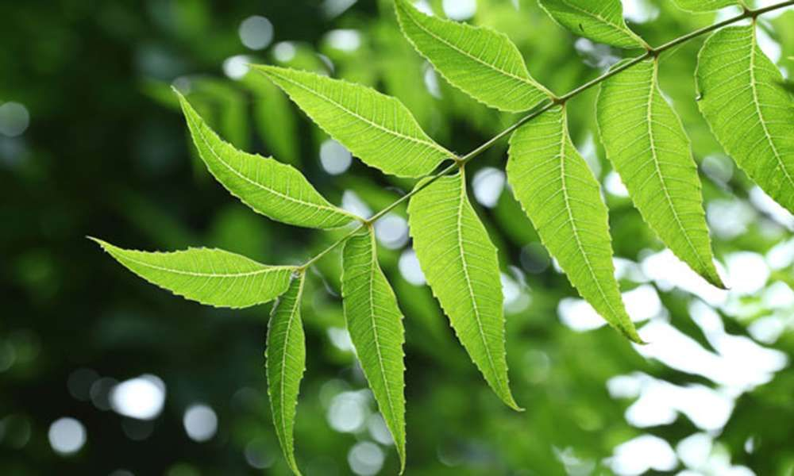
•Neem (Azadirachta indica) is an evergreen tree with a well-earned reputation for being the most potent medicinal flora in the world. The neem tree is known in Ayurveda as nature’s pharmacy. The tree grows predominantly in the Indian subcontinent but is now being cultivated in similar climates all over the world as people are beginning to recognize its usefulness.
•Uses of Neem Leaves, Bark, Root & Fruits
•The neem tree is chock-full of chemical compounds that have been found to be hugely beneficial. From the neem bark to the neem leaves and even the flower, fruit, seed and root – all parts of the neem tree have found widespread use in curing various ailments. According to established research, neem has free radical scavenging properties due to being a rich source of antioxidants and is alsoeffective in the management of cancer through the regulation of cell signaling pathways.Neem also plays a role as an anti-inflammatory substance via regulation of pro-inflammatory enzyme activities including cyclooxygenase (COX) and lipoxygenase (LOX) enzymes.
•

Slide 49
•Uses of Neem Leaves, Bark, Root & Fruits
•The neem tree is chock-full of chemical compounds that have been found to be hugely beneficial. From the neem bark to the neem leaves and even the flower, fruit, seed and root – all parts of the neem tree have found widespread use in curing various ailments. According to established research, neem has free radical scavenging properties due to being a rich source of antioxidants and is alsoeffective in the management of cancer through the regulation of cell signaling pathways.Neem also plays a role as an anti-inflammatory substance via regulation of pro-inflammatory enzyme activities including cyclooxygenase (COX) and lipoxygenase (LOX) enzymes.
•

