Slide 1
AAA-Audit Report
Socio-Economic Criteria
Criteria VI from 1 to 12

Slide 2
1:Alumni Association
SR NO | NAMES OF ALUMNI (GOVERNING BODY)
1 | IMRAN SHAIKH – TEACHER
2 | AKHTAR PATEL – M.R
3 | M.A. ACHKAL – C.A
4 | JAMIR SHAIKH – GOVT SERVANT
5 | AKBAR DANDOTI- TEACHER
6 | AARIF SHAIKH- EX MAYOR
7 | SHAHNAWAZ SHAIKH – LIBRARIAN
8 | TASNEEM WADDO – LECTURER
9 | DR. SUMMAYA BAGWAN – LECTURER SOLAPUR UNIVERSITY
10 | ZAID AHMED SHAIKH- LECTURER
11 | FAROOQ SHAIKH – LECTURER

Slide 3
SR NO | ALUMNI MEMBERS
1 | DR.SHAFI CHOBDAR
2 | ROYAZ KHARADI
3 | DR .GOUS SHAIKH
4 | DR. MUSHTAQUE SHAIKH
5 | DR. J.K.MULLA
6 | NAWAZ LALKOT
7 | WADDO SUMMAYA
8 | WADDO AFRIN
9 | KHANSA MUCHALE
10 | IBRAHIM TARKASH
11 | KABIR NADAF
12 | AZHAR SAYYAD
13 | MD.SADIQUE SHPAI
14 | MIRAJ LALKOT
15 | SAIFAN SHAIKH
16 | MUZZAMIL SHAIKH
17 | SAIFAN SHAIKH (HOTGI)
18 | TAUFIQ SHAIKH

Slide 4
2: Alumni Meeting Organized Once In A Year
SR NO | MEETING DATES | YEARS
1 | 7-8-2016 8-1-2017 | 2016-17
2 | 8-8-2017 8-1-2018 | 2017-18
3 | 10-8-2018 10-1-2019 | 2018-19
4 | 8-8-2019 10-1-2020 | 2019-20
5 | 10-1-2020 | 2020-21

Slide 5
3: Contribution Of Alumni In Development Of College
( Funding/ Sponsorship Etc)
SR NO | NAME OF STUDENT | CONTRIBUTION
 | GULAMGOUS. M . SAYYED ABDUL VASI SUFIYAN SHAIKH | DICE/ LECTURE STAND TO ENGLISH DEPARTMENT
1 | GEOGRAPHY DEPT | PROJECTOR TO GEOGRAPHY DEPARTMENT
2 | GEOGRAPHY DEPT | GLOB TO GEOGRAPHY DEPARTMENT
3 | MAULANA .A. SHAIKH (C.A) | FURNITURE FOR FUNCTION HALL
4 | M.A. ACHKAL (C.A) | DICE / LECTURE STAND FOR FUNCTION HALL
5 | SHAHBAZ MANIYAR | DICE/ LECTURE STAND TO URDU DEPARTMENT
6 | RIYAZ KHARADI ( CORPORATOR) | OPEN GYM FOR GIRLS

Slide 6
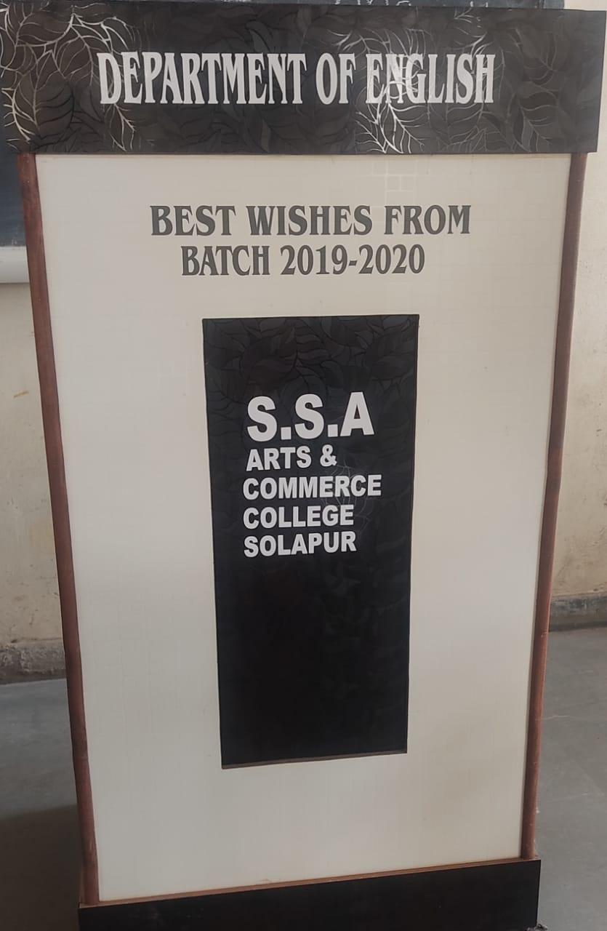
DICE / LECTURE STAND FOR ENGLISH DEPARTMENT

Slide 7
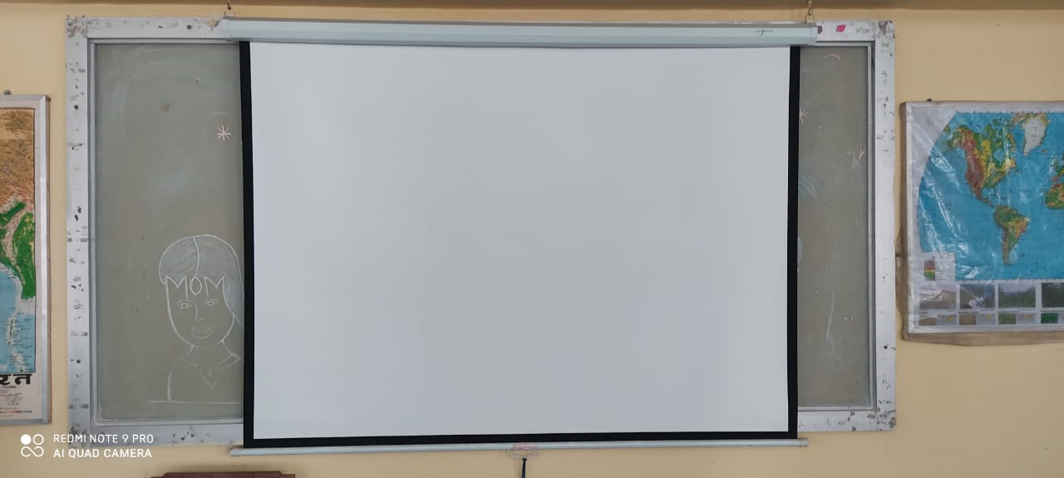
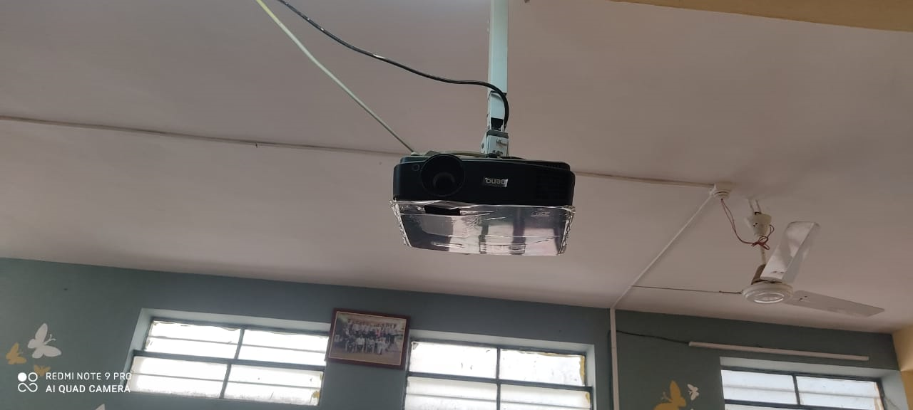
PROJECTOR FOR GEOGRAPHY DEPARTMENT

Slide 8
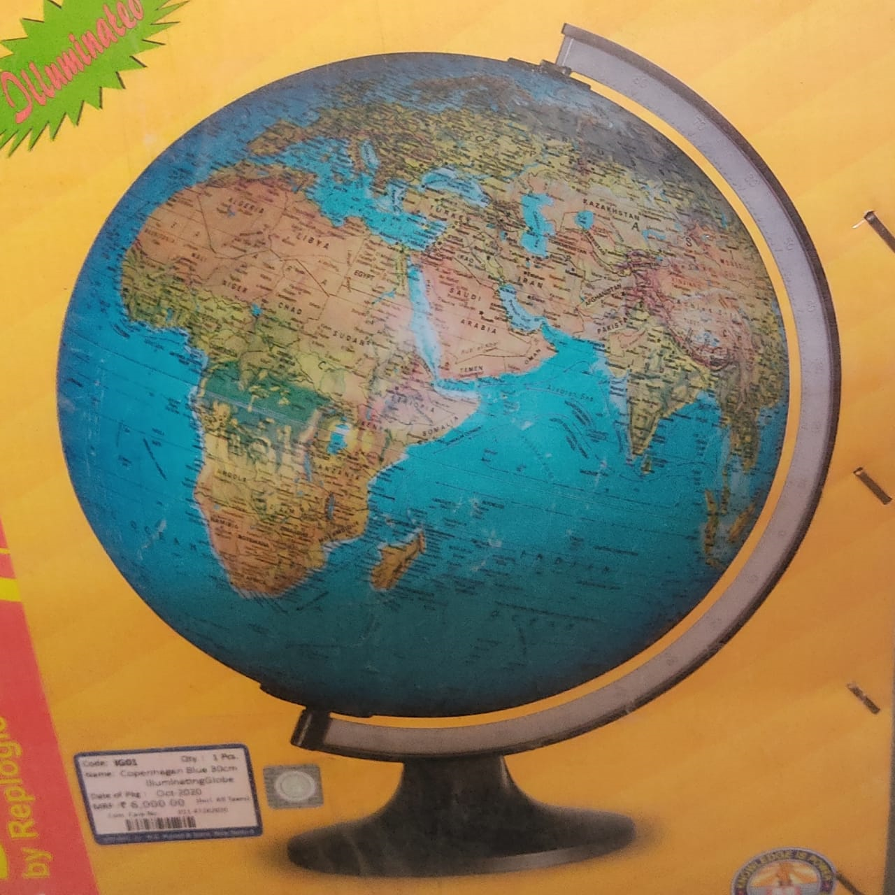
GLOB TO GEOGRAPHY DEPARTMENT

Slide 9
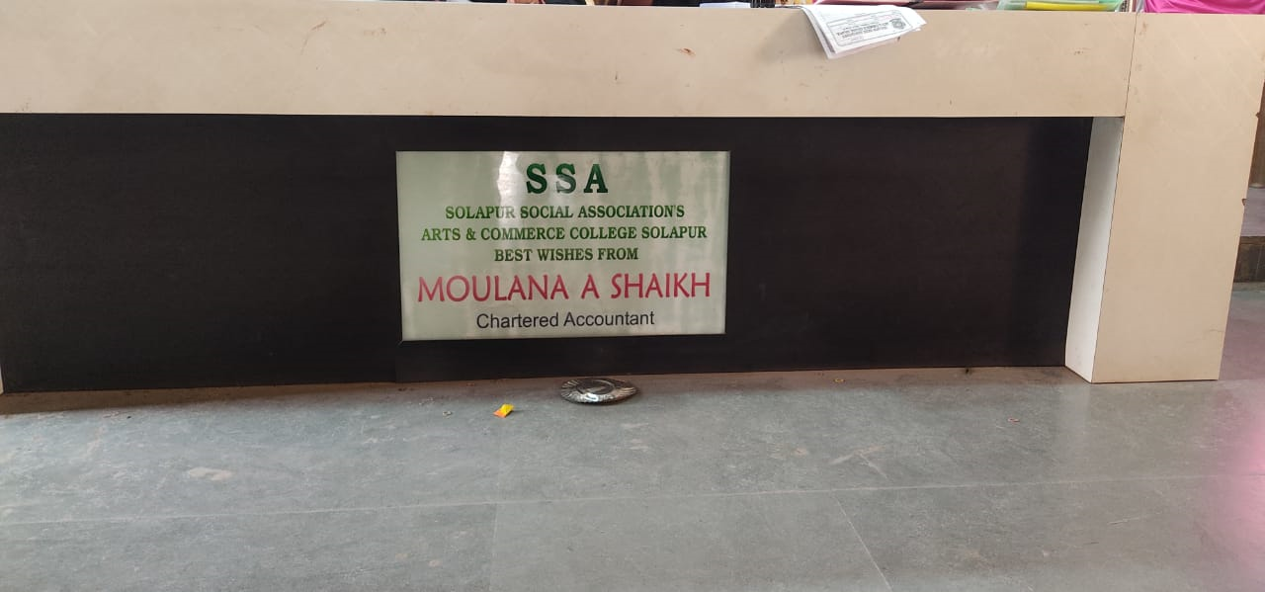
FURNITURE FOR FUNCTION HALL

Slide 10
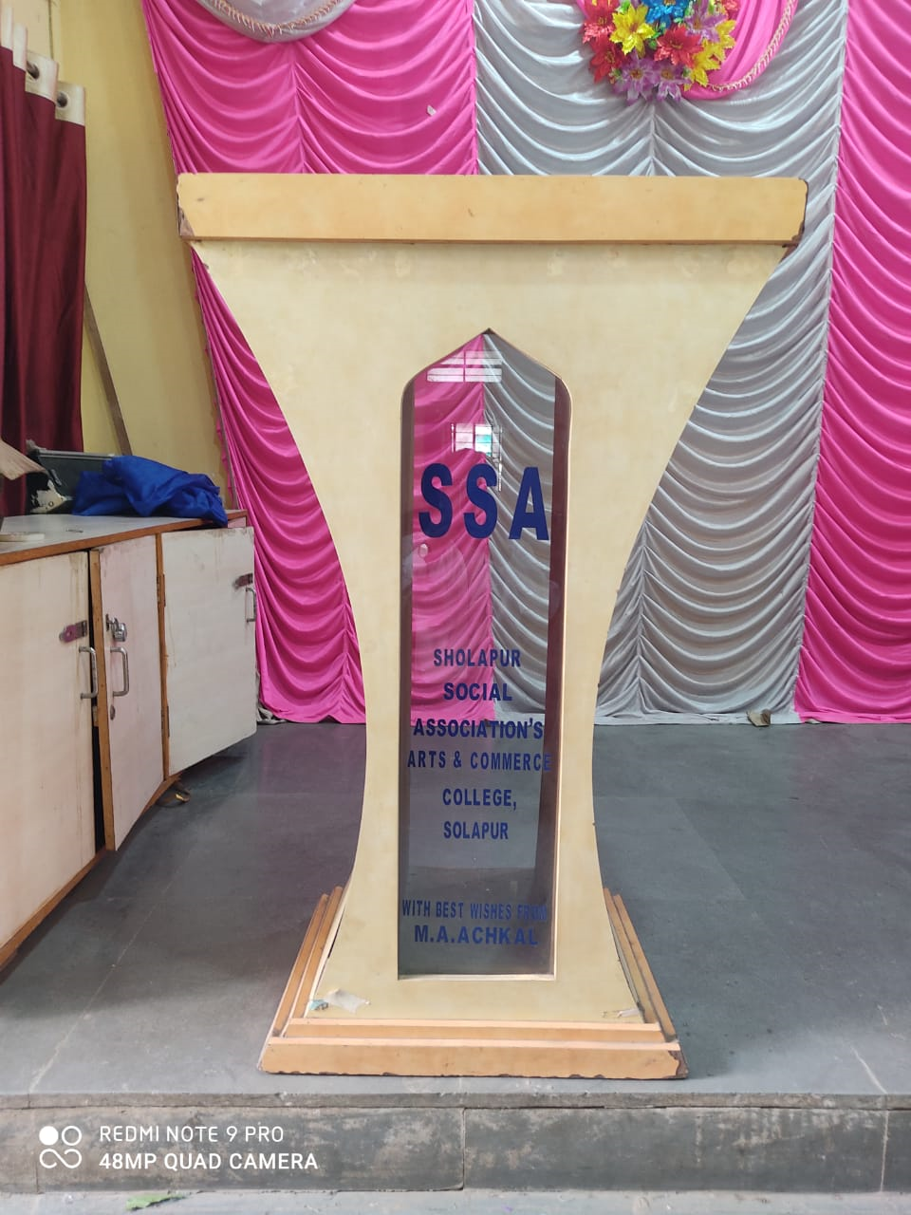
DICE/LECTURE STAND FOR FUNCTION HALL

Slide 11
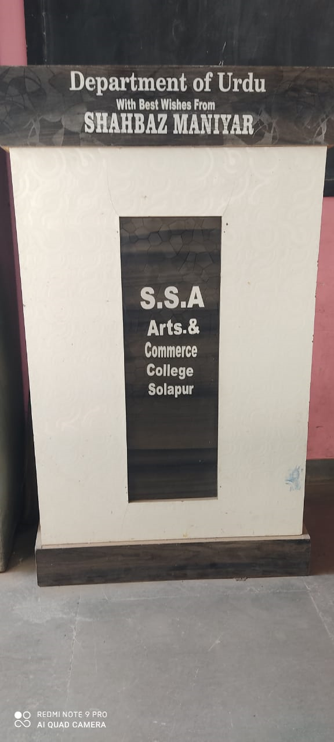
DICE/ LECTURE STAND FOR URDU DEPARTMENT

Slide 12
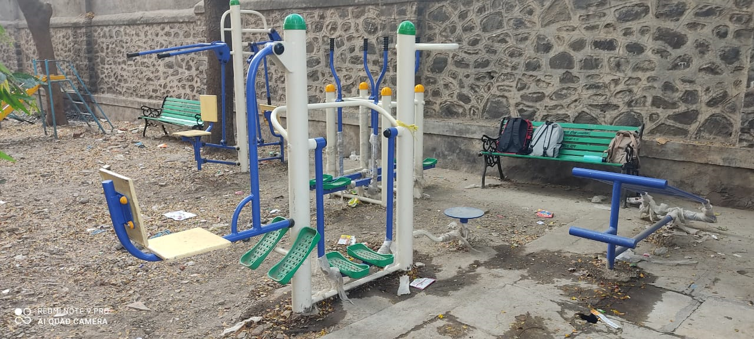
OPEN GYM FOR GIRLS

Slide 13
4: Number of MOU/Linkage with industry, NGO or Govt.

Slide 14
5: Blood Donation Camp Organized During Last 3 Years
2016-2022
College has been conducting blood donation camp regularly since many years in collaboration with
“ Athar Blood Bank”.
Students, teaching staff, honourable principal sir, NCC Candidates, NSS candidates as well as ex students of college participate actively in the camp.

Slide 15
COMMITTEE MEMBERS
SR NO | NAMES | DESIGNATION
1 | Dr. D. S. Narayankar | NSS coordinator
2 | Dr. Ladaf | NSS coordinator
3 | Dr. Gaus.N.Shaikh | NCC
4 | Dr. J.K. Mulla | IQAC- Co- Ordinator

Slide 16
SIX YEARS DATA
SR NO | DATE | ORGANISED IN COLLABORATION WITH | NUBER OF DONORS | CO-ORDINATOR
1 | 5/12/2016 | Athar Blood Bank | 20 | Dr.D. S. Narayankar
2 | 28/11/2017 | Athar Blood Bank | 15 | Dr.D. S. Narayankar
3 | 20/12/2018 | Athar Blood Bank | 18 | Dr.D. S. Narayankar
4 | 23/12/2019 | Athar Blood Bank | 17 | Dr.D. S. Narayankar
5 | 10/12/2020 | Athar Blood Bank | 70 | Dr.D. S. Narayankar
6 | 23/12/2021 | Athar Blood Bank | 21 | Dr.D. S. Narayankar

Slide 17
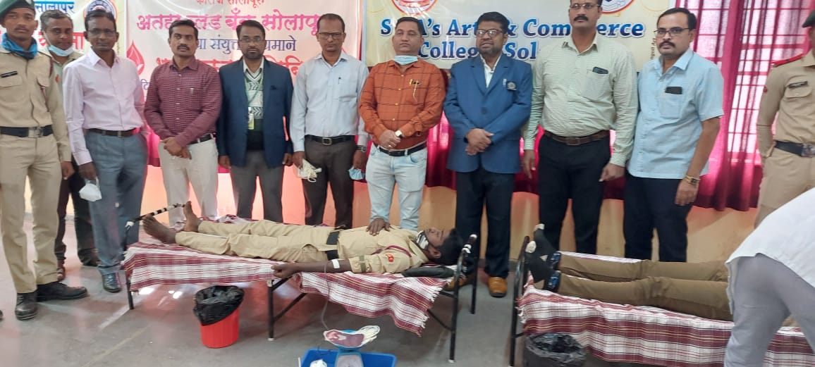
NCC CANDIDATES

Slide 18
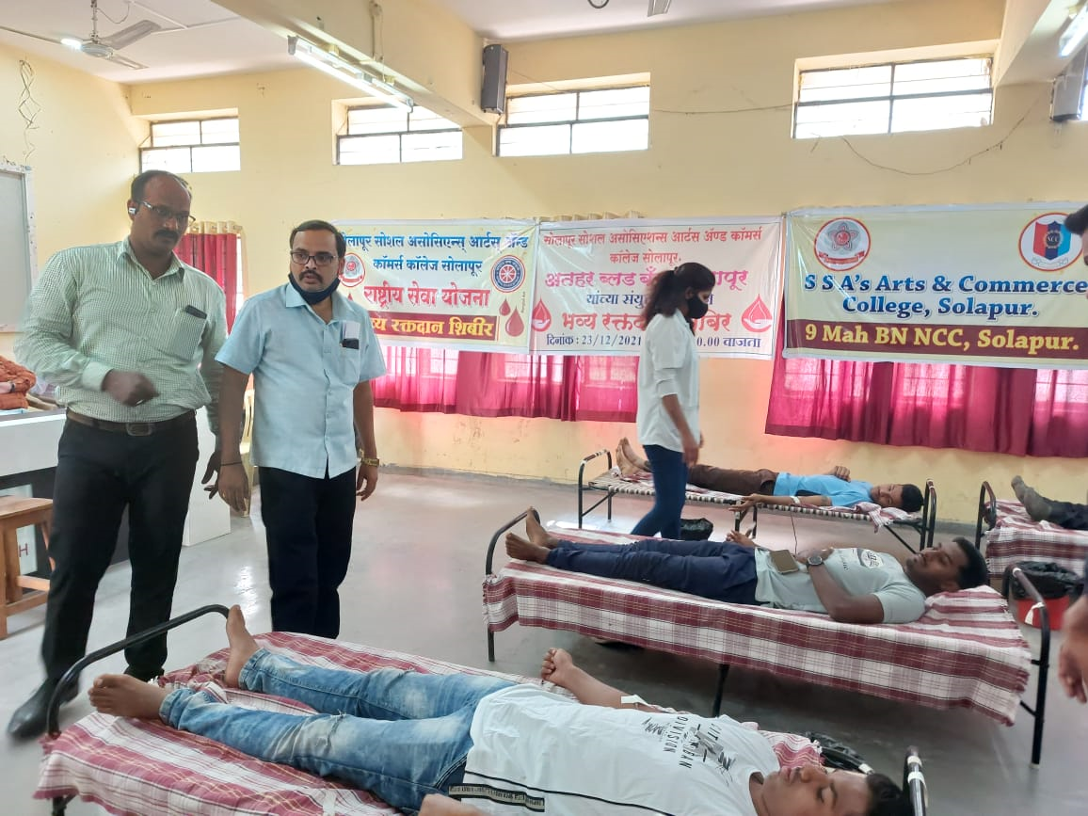
NSS CANDIDATES

Slide 19
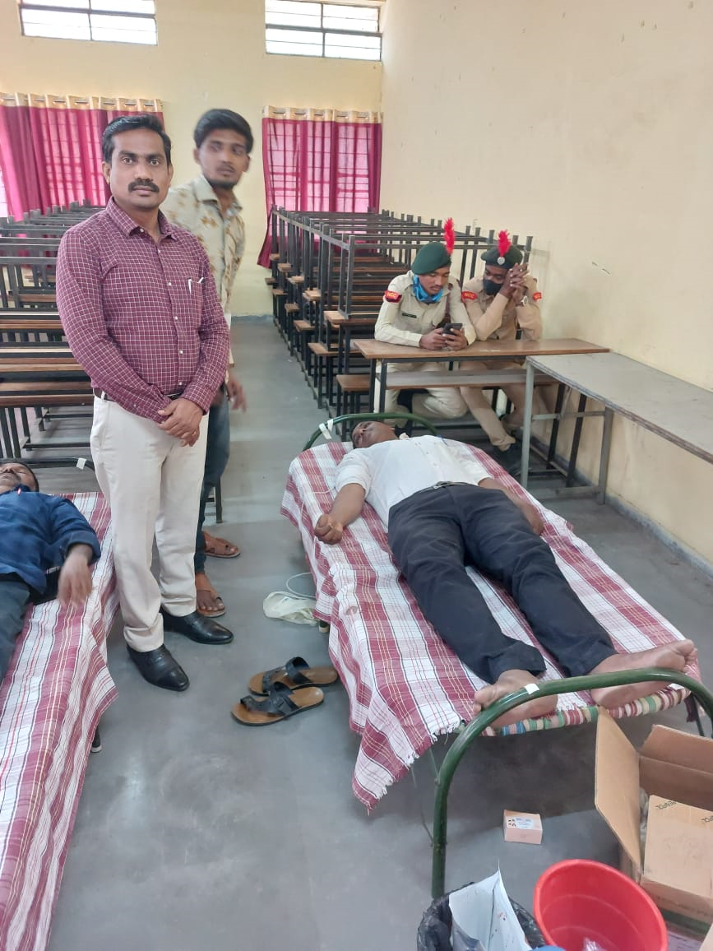
PREVIOUS YEARS STUDENTS

Slide 20
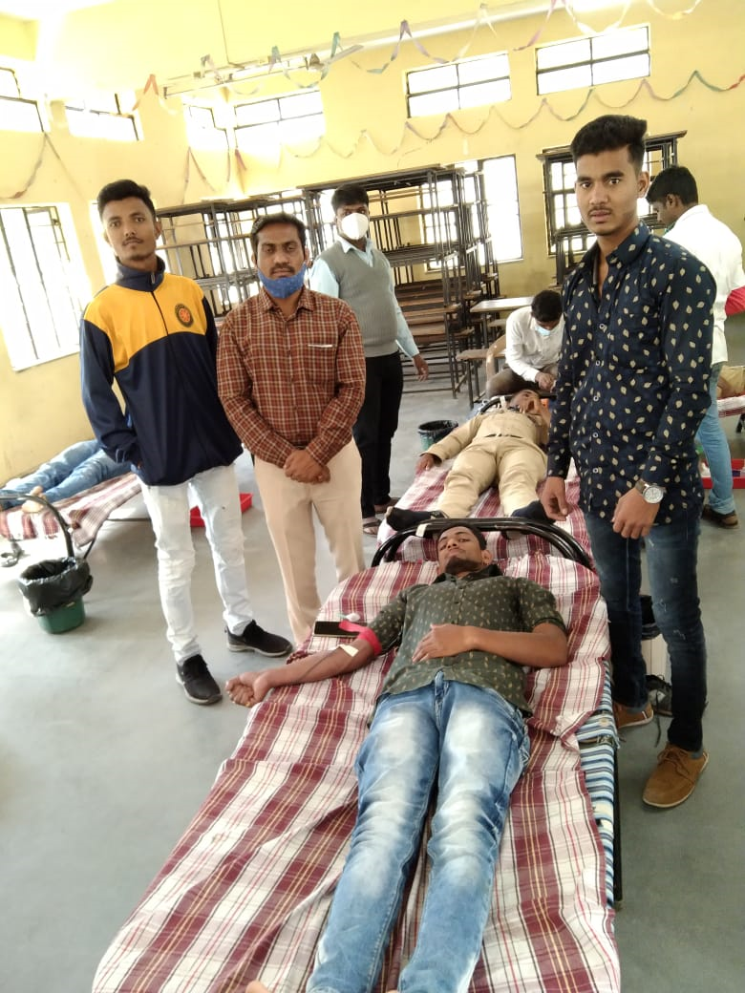
SPORTS CANDIDATES

Slide 21
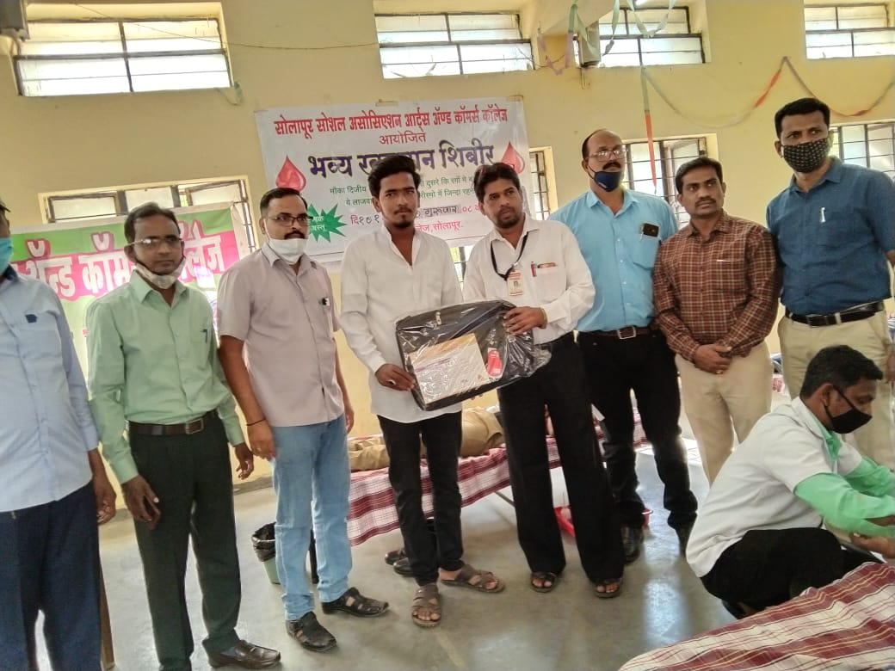
STUDENTS RECEIVING BAGS AFTER DONATING BLOOD

Slide 22
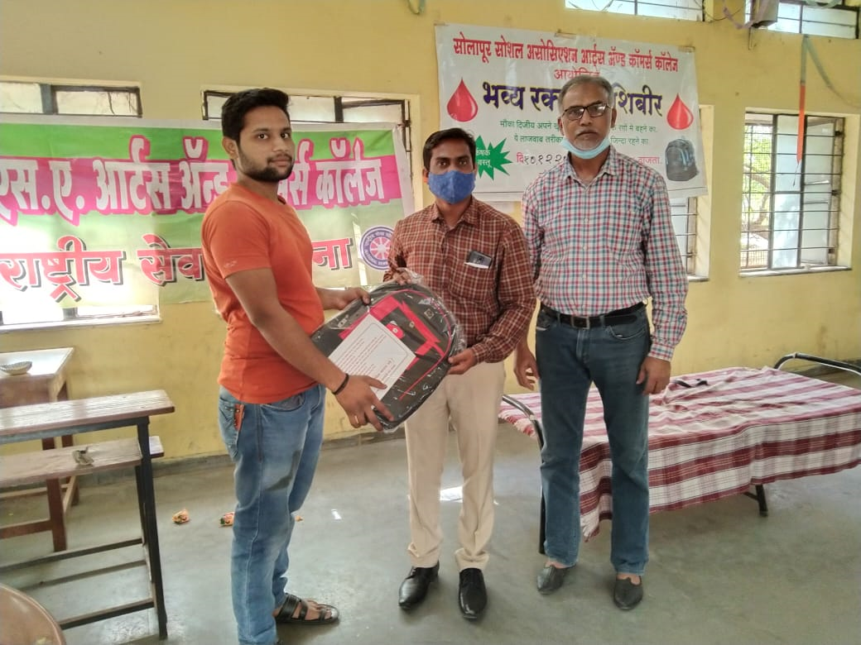
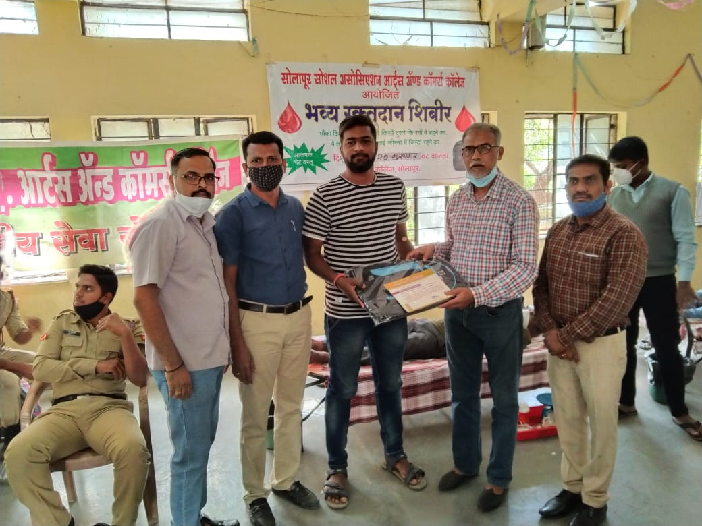

Slide 23
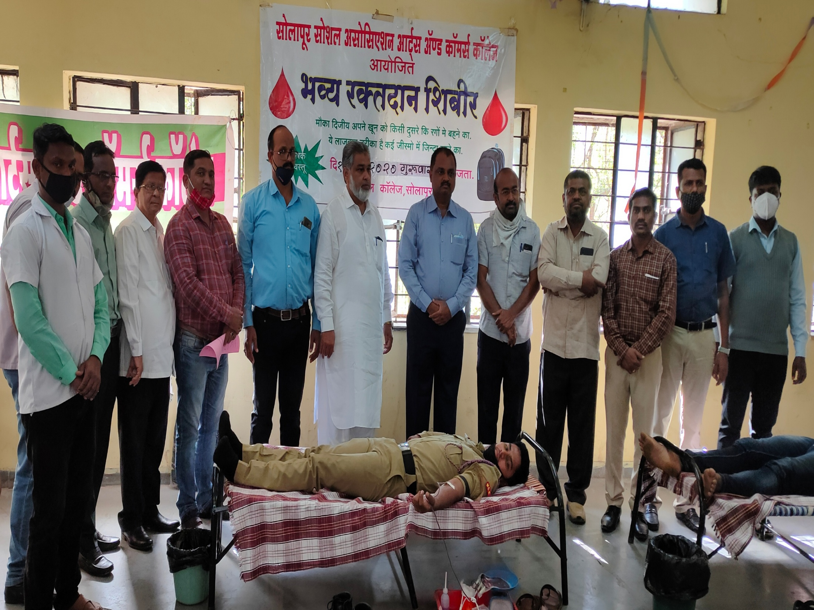

Slide 24
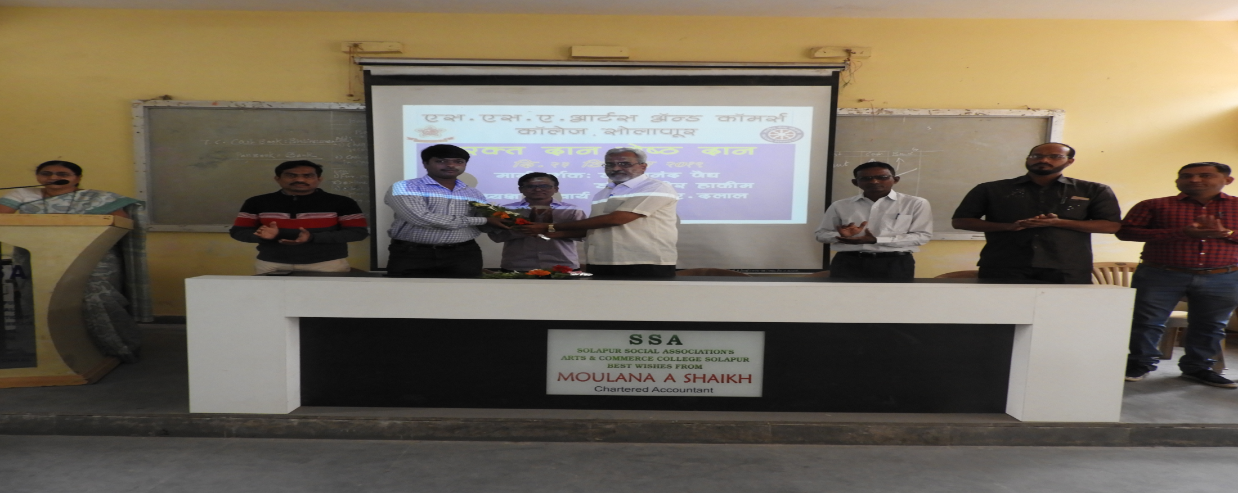
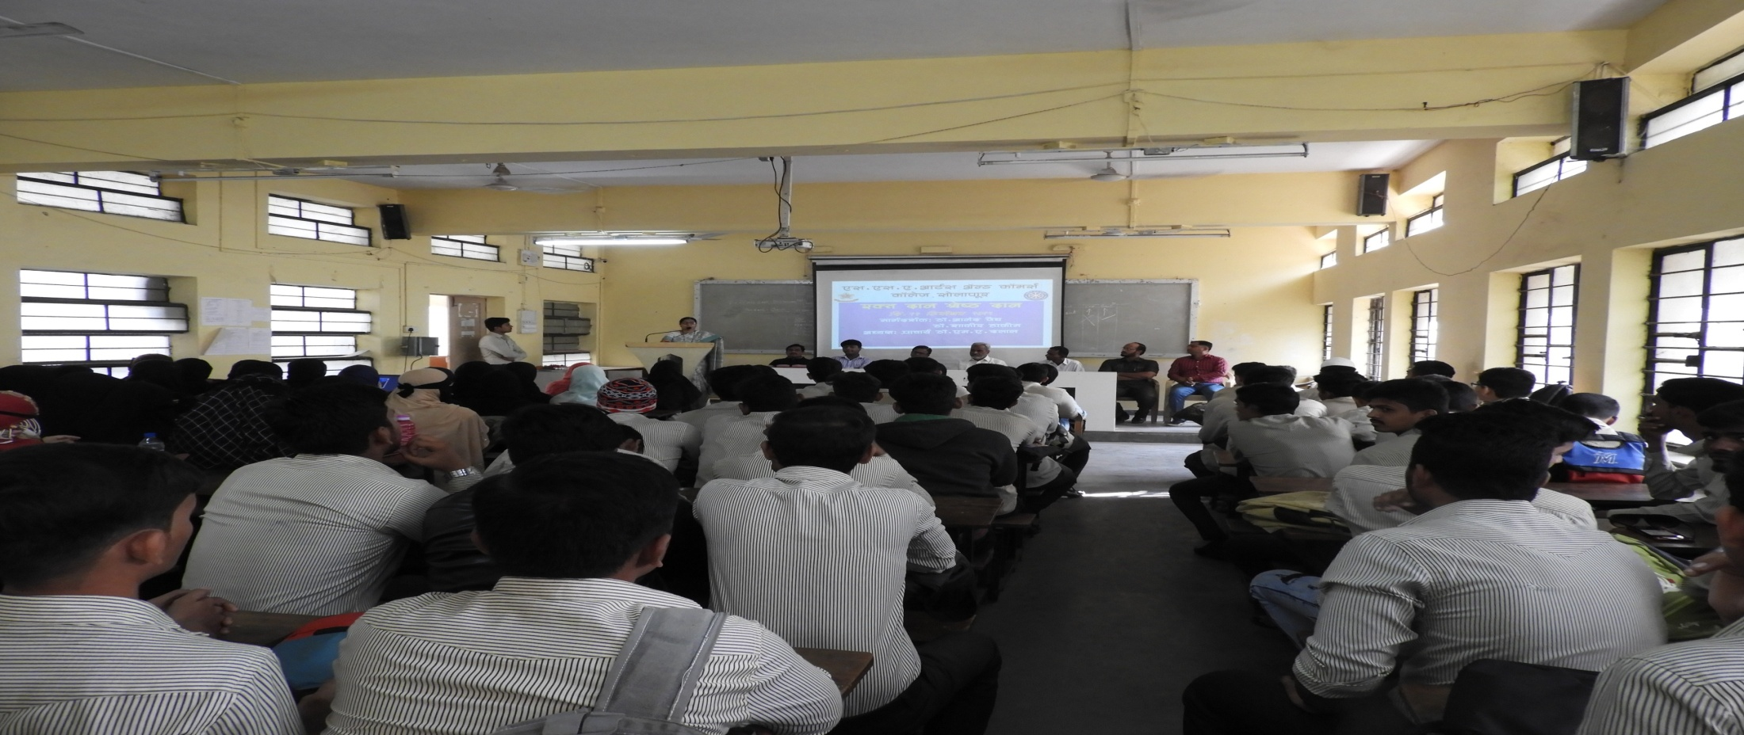

Slide 25
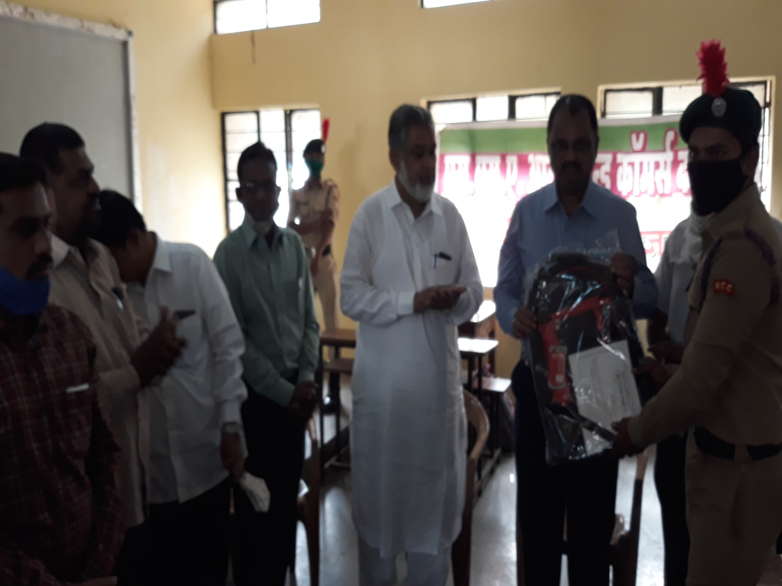

Slide 26
6: Programmes Conducted for Environmental Awareness
Various programmes are conducted for creating Environmental Awareness among the students, in particular on behalf of NSS .
Swachchata Abhiyan is followed diligently in the college as well as in areas near college.( Check file)
Swachhata Pandharwada and Hagandari Mukt Solapur movements are followed and valuable work is done regarding the related issues.
List of the programmes is given.

Slide 27
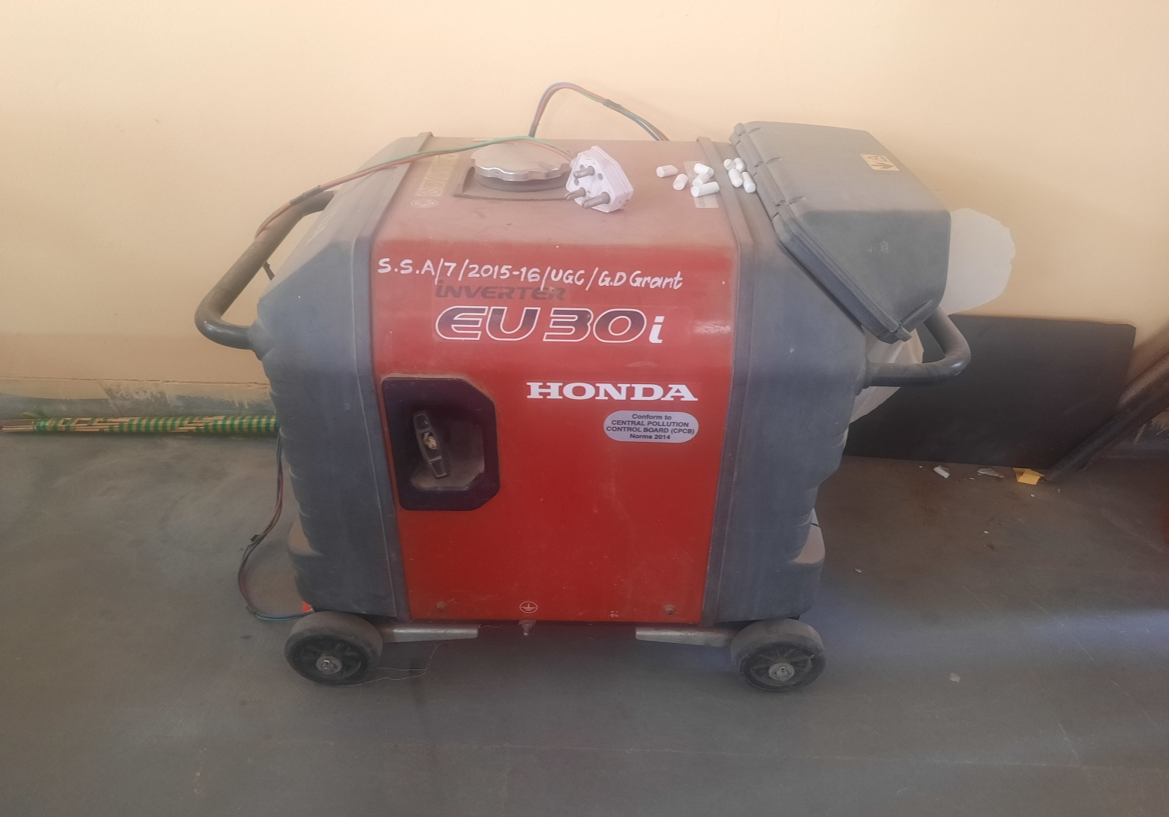
8- Energy audit power generator
The college makes use of the power generator.

Slide 28
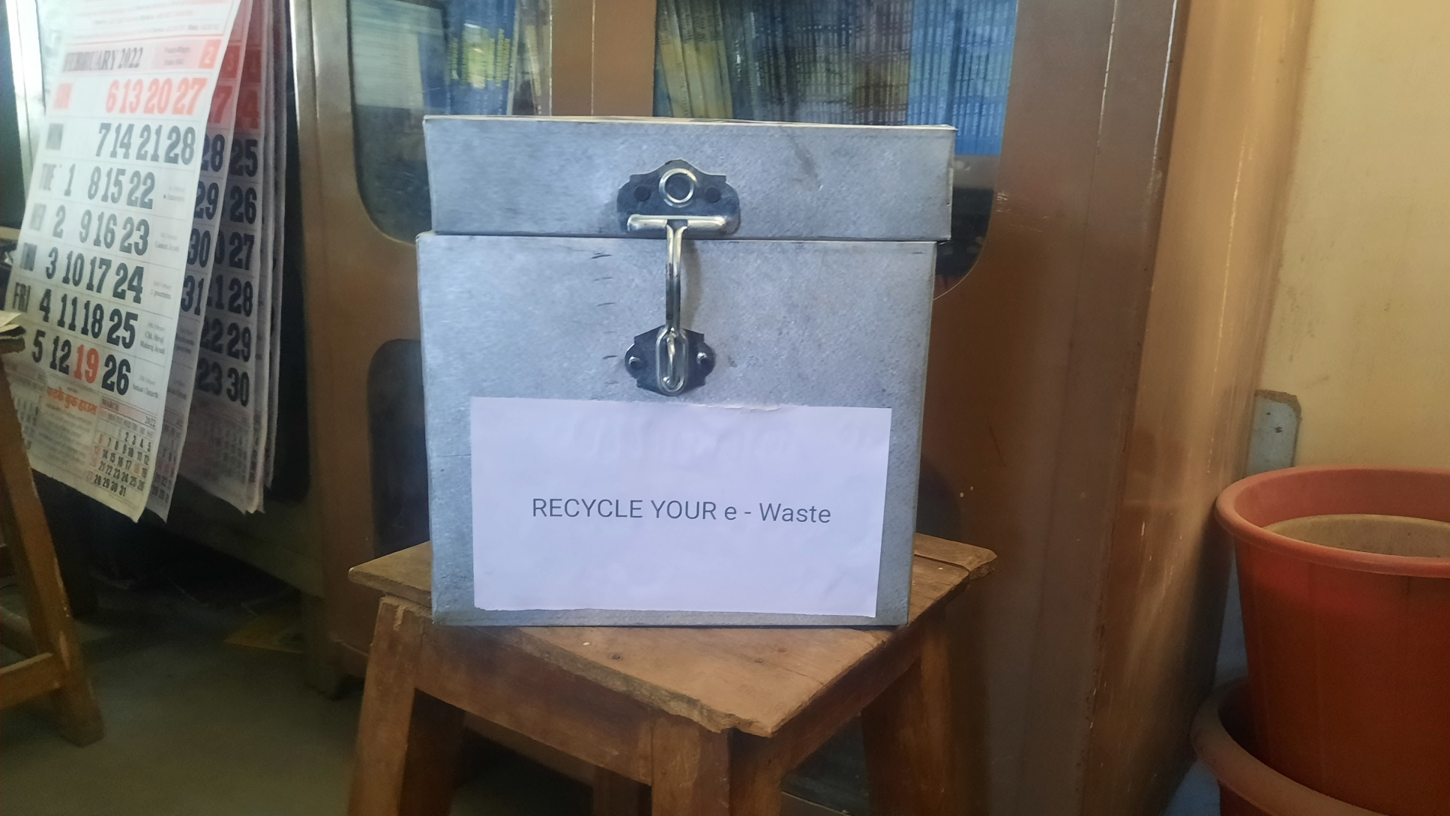
Hazardous E waste is collected here.

Slide 29
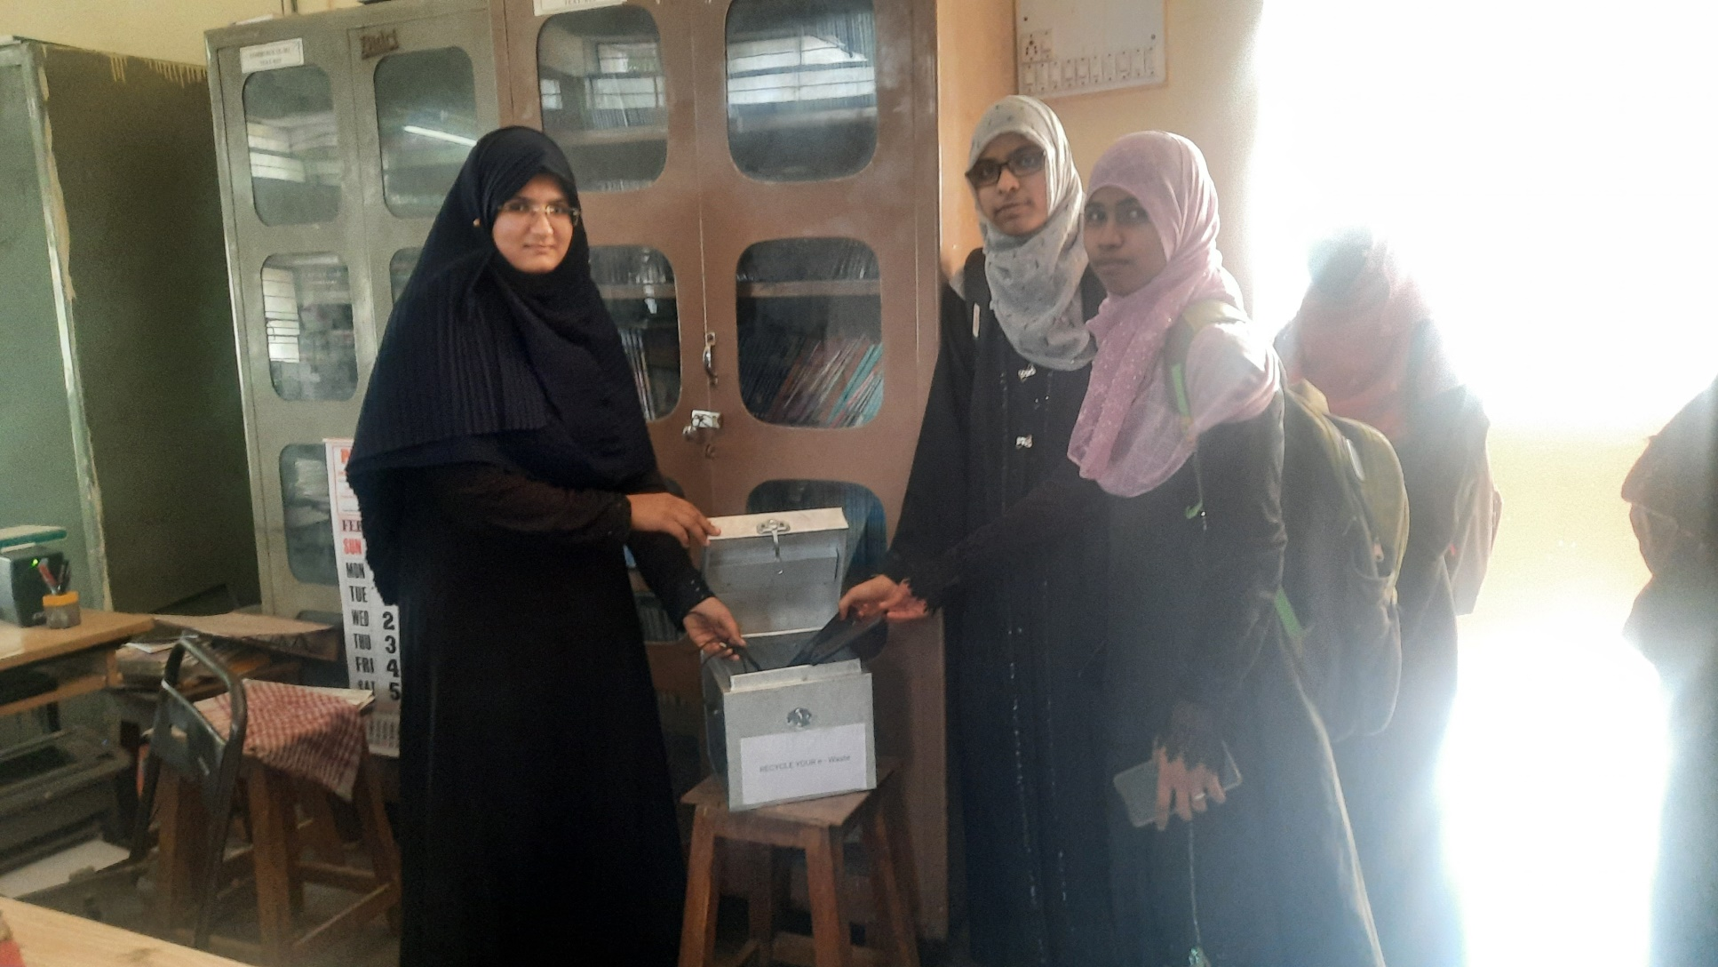

Slide 30
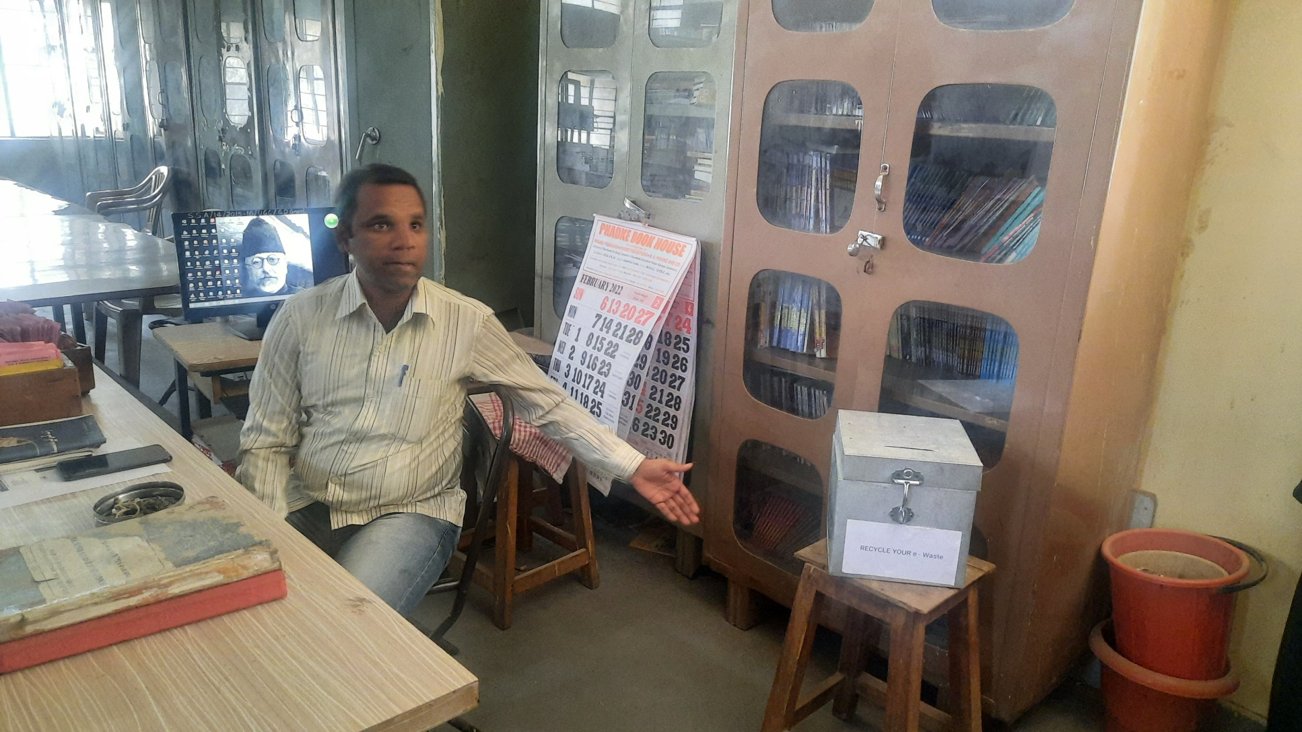

Slide 31
9: Green Audit
For keeping the college campus green , work is carried out on different levels.
A: Waste Management:
After cleaning the campus the waste is collected and buried in the dumps to make
compost.
Waste water is used for watering the plants running from the water tap spots in both the gents/male sections.

Slide 32
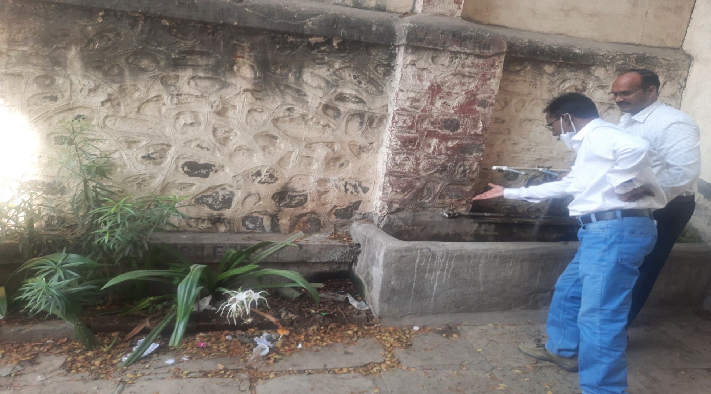
Dr.Gouse Ahmed and Dr.A.A.Gadwal showing how the waste water system works and is ‘re used’ for watering the plants.

Slide 33
B: Noise Pollution.
We are aware of the harmful effects of noise pollution on the students and how it
hampers their ability to focus and to learn in appropriately healthy ways. We have
put up relevant quotes on sign boards all over the campus for awareness purposes
and for not contributing to the noise pollution. You can speak and be heard without
raising your voice, they are told. We ask our students to switch off their mobile
phones when they are in the class attending the lectures and only make essential
use of their cell phones even when outside in the campus. The students are
sensitized about the harmful effects of radiation from mobile phones and towers.
Considering the obsession of our youth with these modern gadgets that is seriously
hampering their intellectual/emotional growth and ability to focus leading to
decline on various scales and parameters of the learning curve and emotional well
being. A unique workshop for them titled, Mobile Fasting’ was conducted. Under
this novel initiative we asked our students to switch off their phones for the
duration of three hours and packed their phones in paper envelopes especially
designed for the purpose. During those three hours we asked them to spend time
‘old style’ like face to face talk, listening to friends, reciting poems, reading
leisurely or just doing nothing. The detailed report is available here. This initiative
was found to have helped them know, what it means to be without the cell phones
and yet be calm happier and productive. That there is life beyond the cell phones
was got to be acknowledged

Slide 34
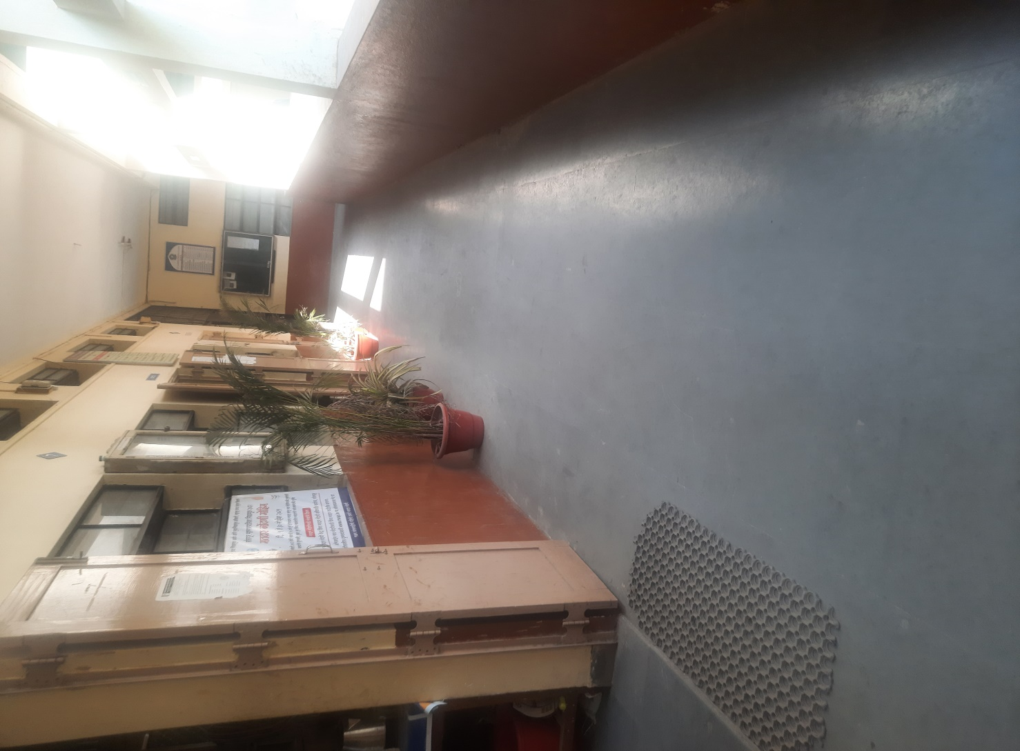
C: Planting trees/Making College Campus Green

Slide 35
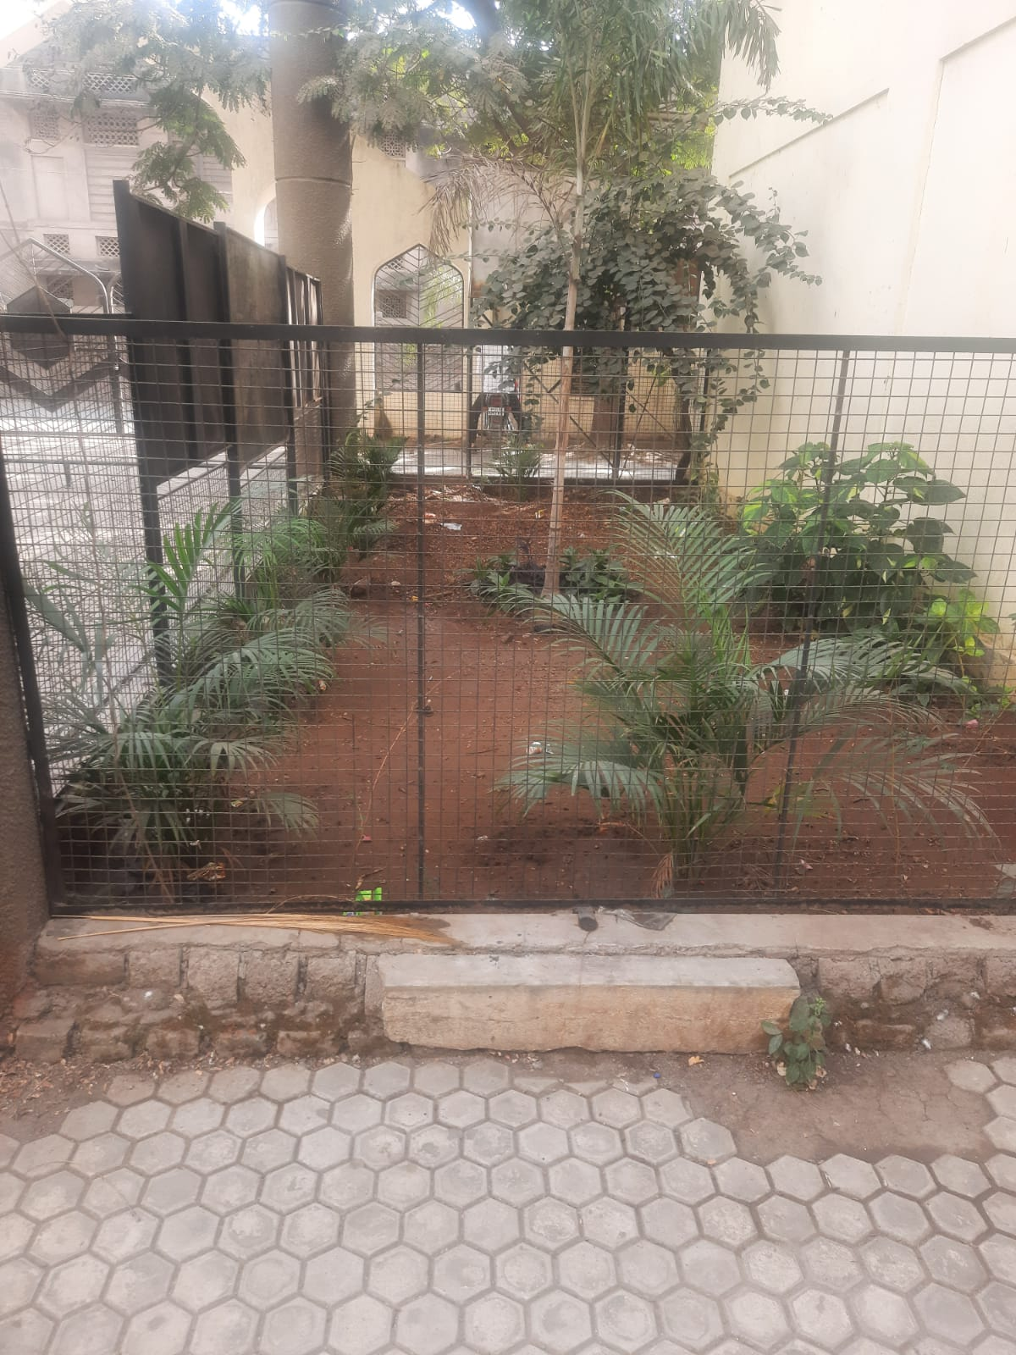

Slide 36
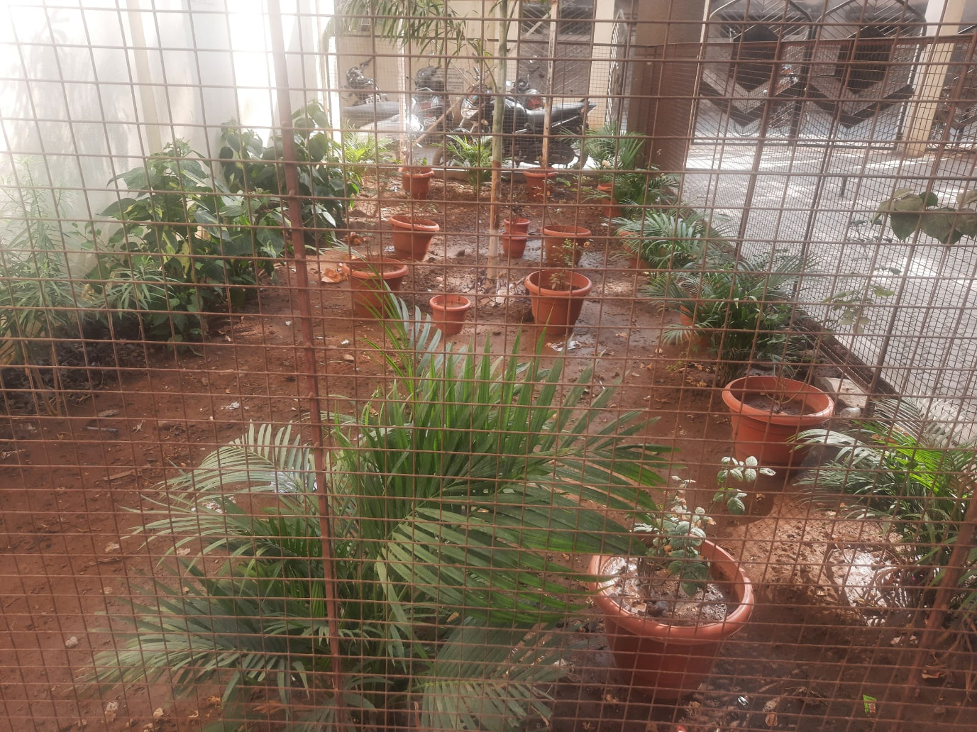

Slide 37
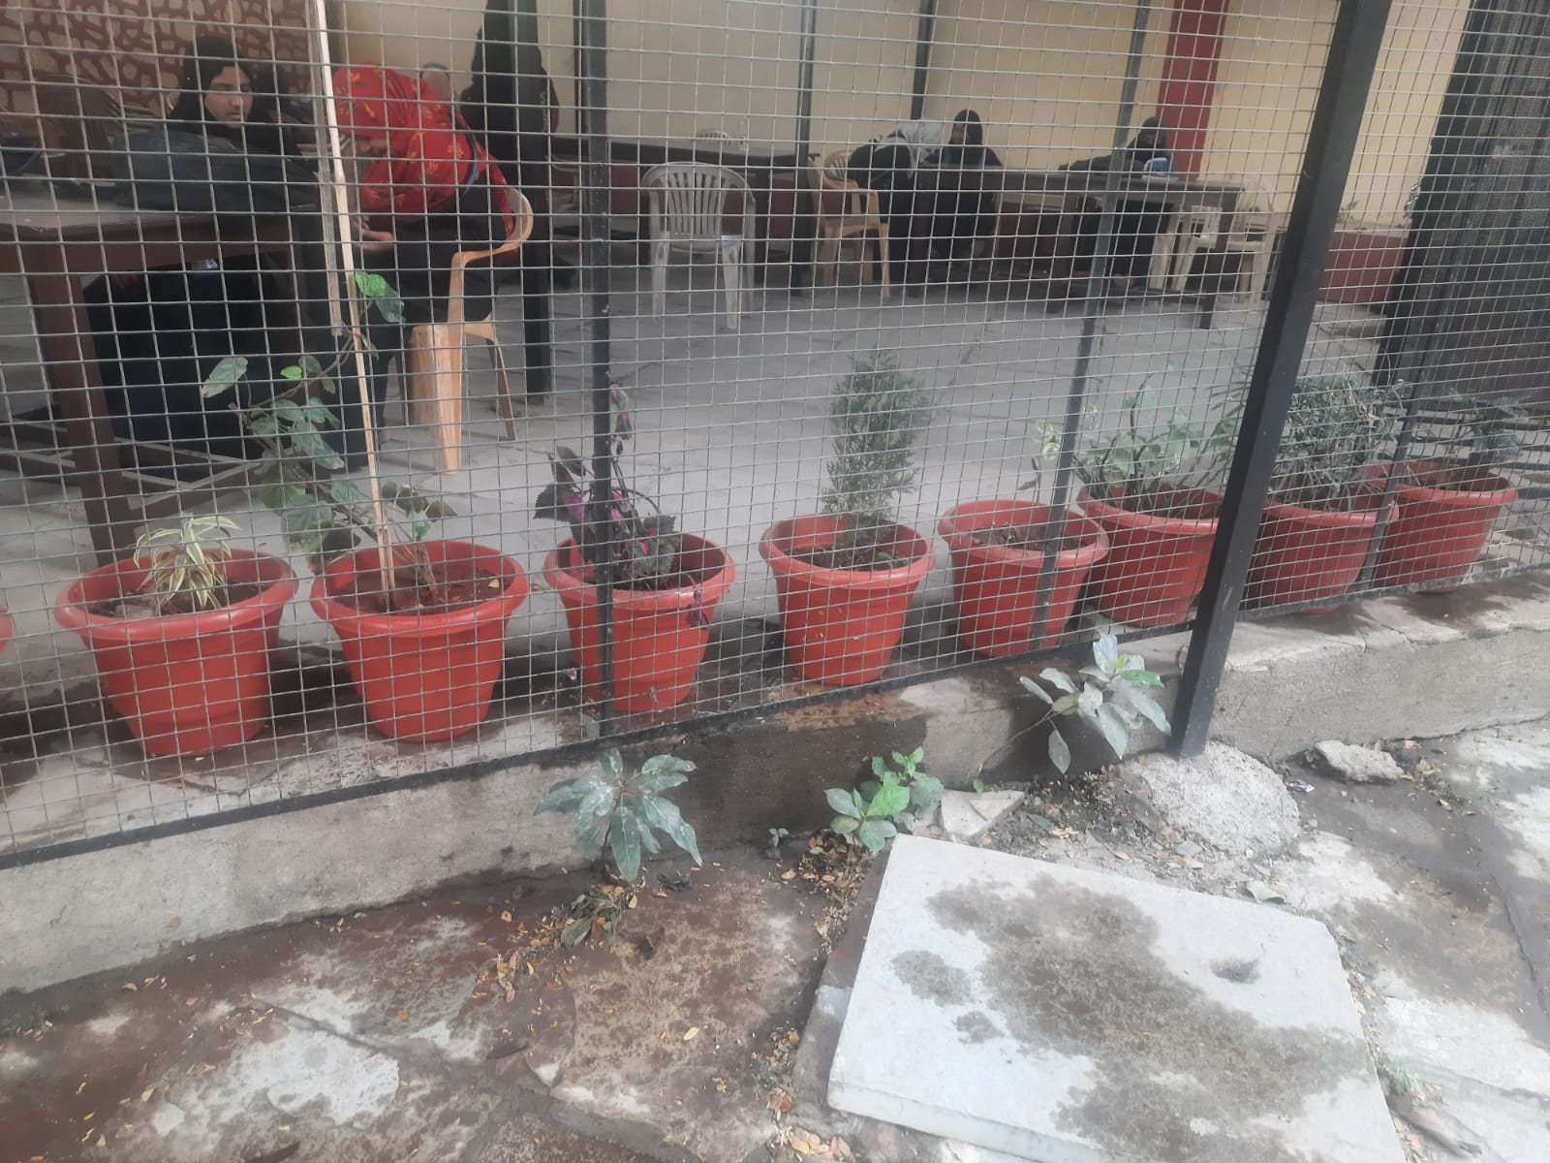

Slide 38
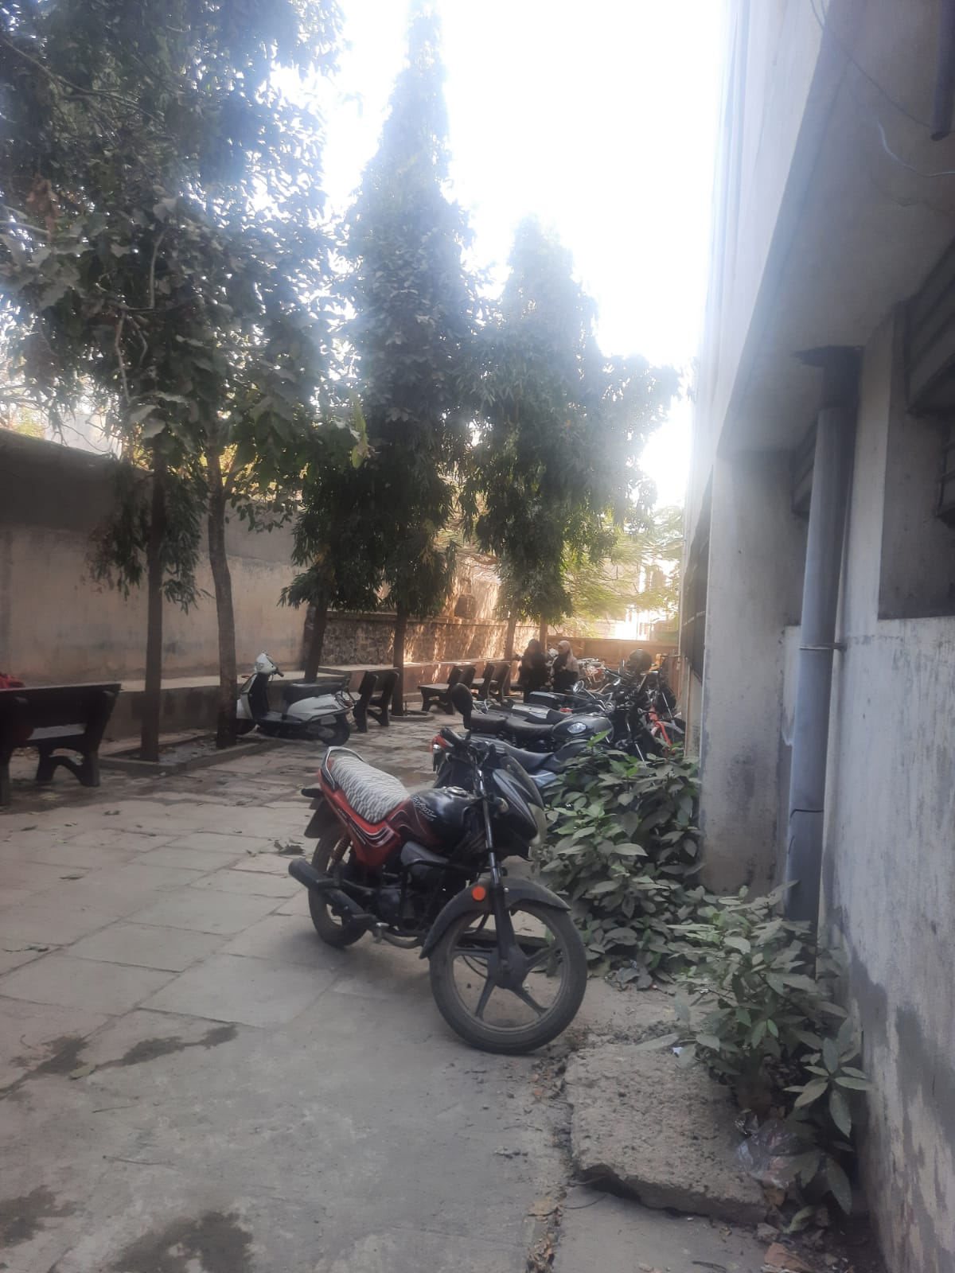

Slide 39
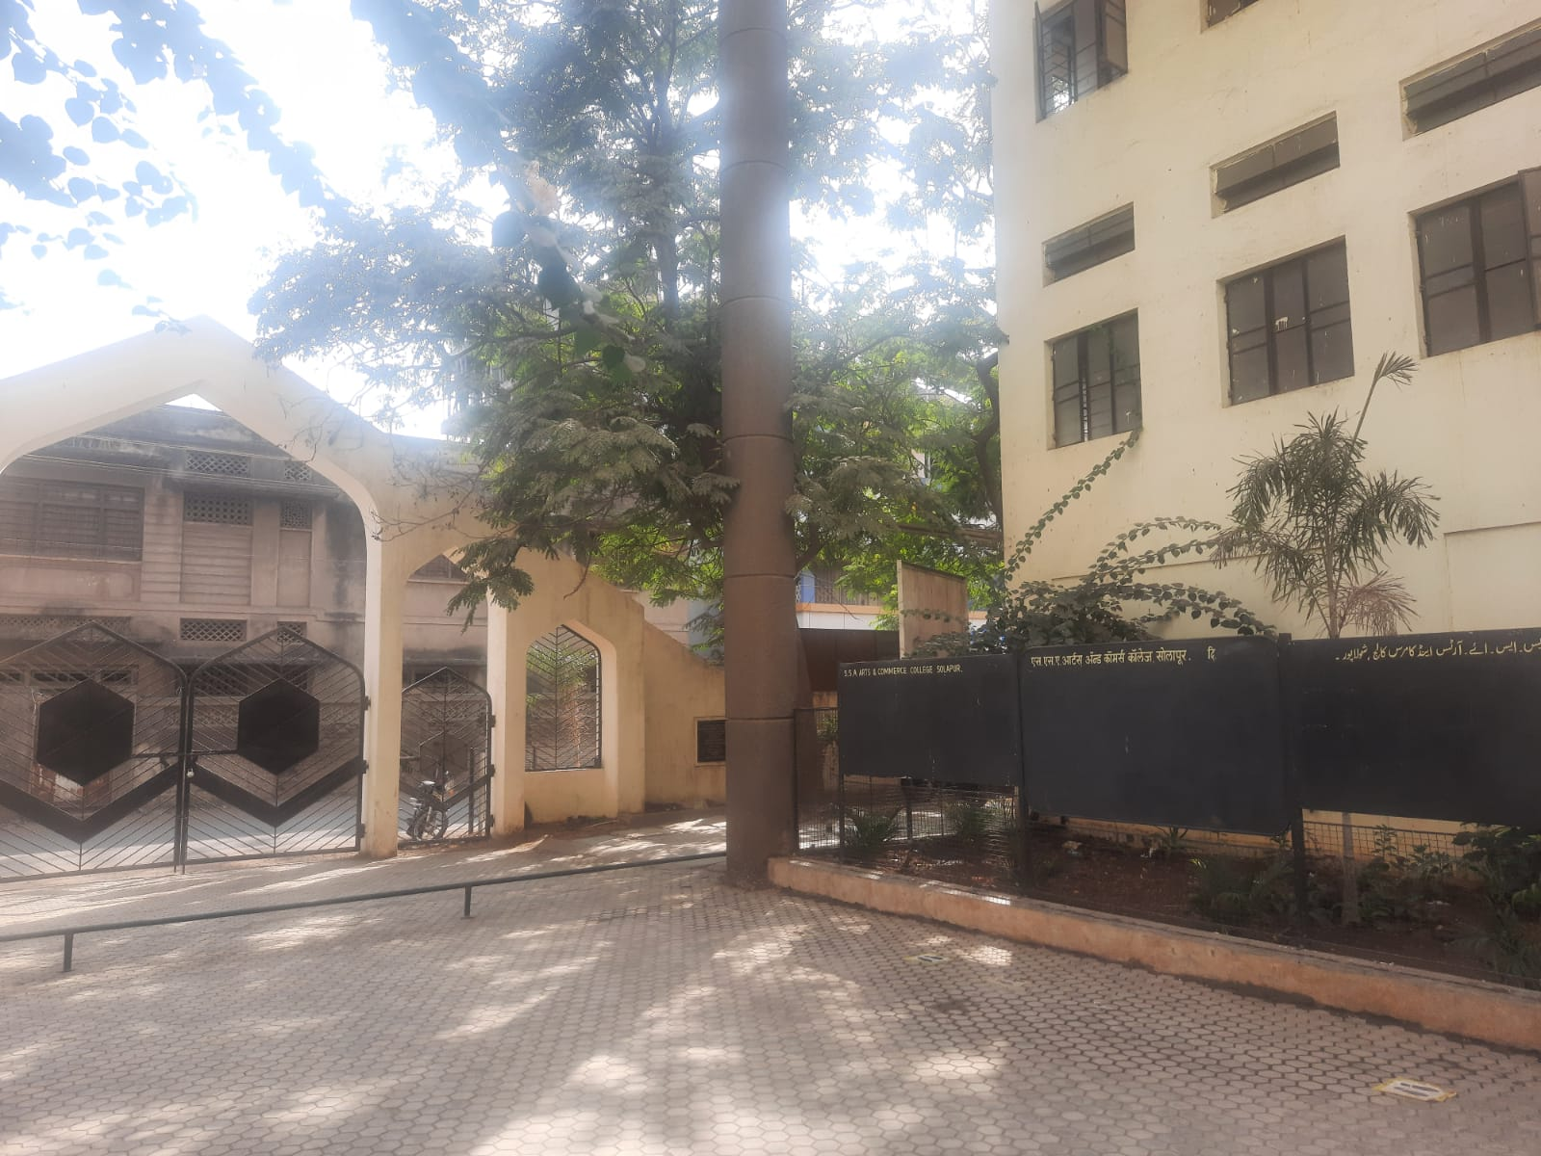

Slide 40
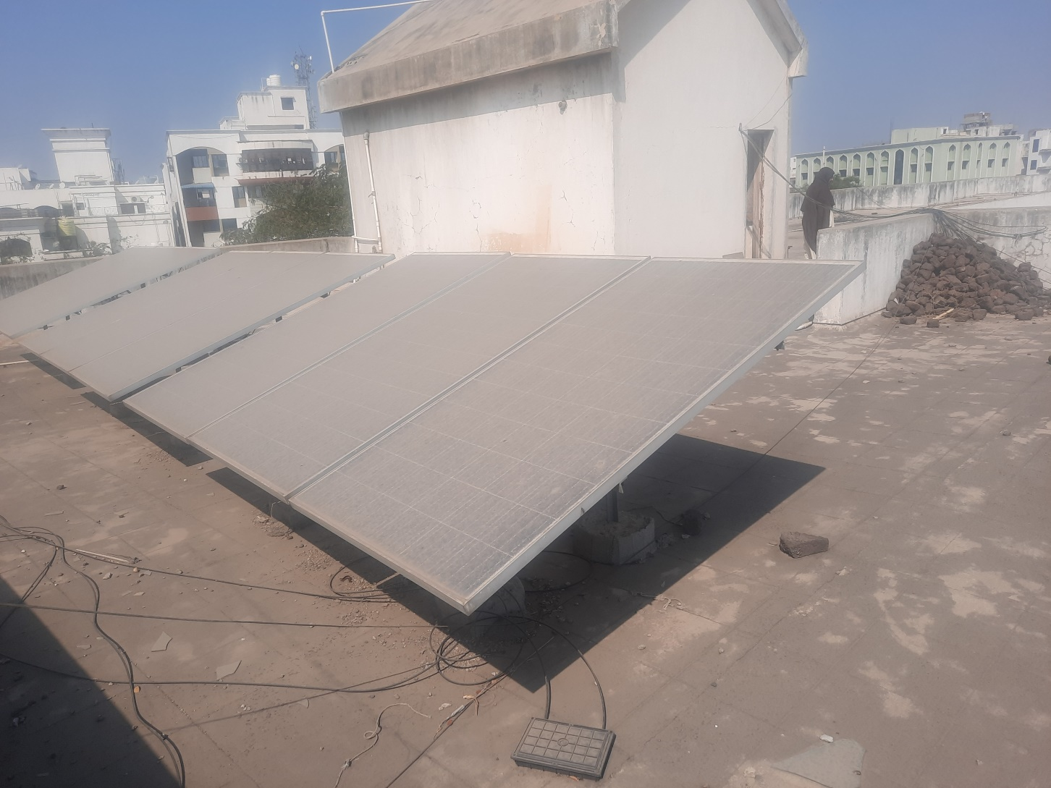
11: Renewable Power Resources:
We have a solar system put up on the roof of our college.

Slide 41
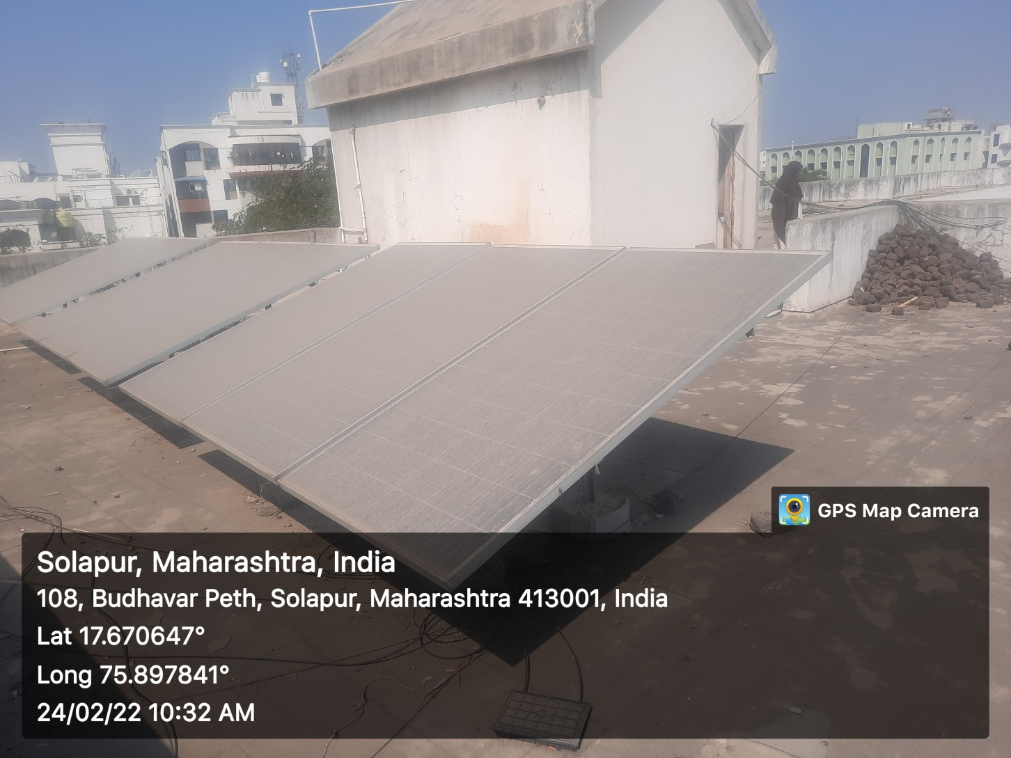

Slide 43
