Slide 1
The Lotus
By Toru Dutt
PPT by Prof. Vaibhav Bhalerao

Slide 2
POEM INTRODUCTION:
The Lotus is from the collection of poetry, Ancient Ballads and Legends of Hindustan
by Toru Dutt. The volume was published in London in 1882, with an introductory memoir
by Mr. Edmund Gosse. The quotation from Sir Philip Sidney’s Apologie for English Poetry is
inscribed in the book. For the first time in literature, a book struck a genuinely Indian note that reveals the sincerity of a mind proud of the intellectual traditions of its native land.
The poem is a sonnet that has 14 lines.

Slide 3
POEM:
Love came to Flora asking for a flower
That would of flowers be undisputed queen,
The lily and the rose, long, long had been
Rivals for that high honour. Bards of power
Had sung their claims. “The rose can never tower
Like the pale lily with her Juno mien”-
“But is the lily lovelier?” Thus between
Flower-factions rang the strife in Psyche’s bower.
“Give me a flower delicious as the rose
And stately as the lily in her pride”-
“But of what colour?”- “Rose-red,” Love first chose,
Then prayed, -“No, lily-white,-or, both provide”;
And Flora gave the lotus, “rose-red” dyed,
And “lily-white,”- the queenliest flower that blows.

Slide 4
The Poet personifies ‘Love’, Love asks Flora, the Greek Goddesses of Nature to provide a flower, a flower that has an undeniable ability to be the Queen of all the flowers in the world. Among the flowers, there has been a well-known, long-standing rivalry between ‘the Lily’ and ‘the Rose’.
Popular Poets claimed their beauty through songs (both got equal praises). They both have their own uniqueness, both couldn’t beat the other. A Rose cannot be pale or tower splendid like a Lily and a Lily cannot be as lovely as a Rose (Lily is sacred to Juno, the wife of Jupiter, Goddess of fertility and protection. Rose is associated with the Greek Goddess Psyche).
Considering all these factors Love claims a flower that has both Lily and Rose’s unique qualities together- A flower that is as lovely as a Rose and as stately as a Lily with pride. Flora, listening to his queries asks a question “But of what colour?” At first, Love chooses red (Rose- red) then he prays for white (Lily- white). Finally, he asks for both the colours and so, Flora gave him the beautiful, elegant, pale, Rose-red and Lily-white dyed Queenliest of all flowers- Lotus in his hands.

Slide 5
Lotus:
The lotus was chosen as the national flower because it enjoyed a significant presence in ancient traditions, scriptures and mythology. The Bhagavad Gita considers it a metaphor for detachment: Just as the lotus remains untouched by the muddy waters in which it grows, human beings should rise above worldly attachments. The lotus also symbolises knowledge and beauty as Saraswati, the goddess of learning, is depicted as seated on it.

Slide 6
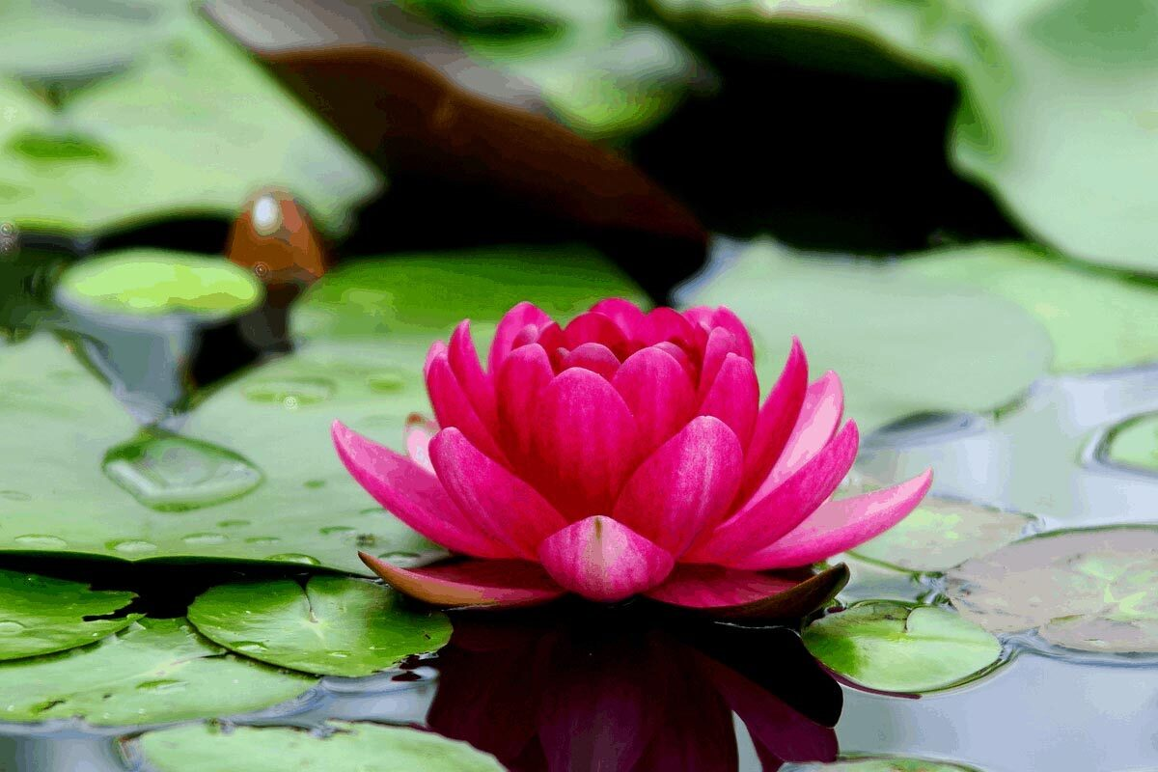
Thank you

