Slide 1
WILL INDIA BECOME SUPERPOWER IN 2020?
Introduction:-
Over a period of him, Indians have develop a mindset which inhibits them to accept new ideas (any were from the world)modify and/or develop them to suit our local requirements.

Slide 2


Slide 3

If nation like USA, EUROPE, CHINA, SOUTH KORIA ,ISREAL, MALAYSIA ,and SINGAPUR can transform themselves as developed nations, why not INDIA?
DEFINATION OF SUPERPOWER:-
A country that has the capacity to project dominating power and influence anywhere in the world, ganarally characterized by strong growth rate,defense power and forign influence.

Slide 4
OBJECTIVES
-To understand the concept of vision 2020.
-Finding the opinion of Indian peoples about 2020.
-To come with finding and solution based on research.
METHODOLOGY OF STUDY
This is the case study method for this study primary and secondary data have been collected from various sources like sample size 100 people.
I AM RESEARCH FOR 100 PEOPLES TO FINDING THE SOLUTIONS.
1)Question-Answer type
2)By conducting the interview
3)Magazines, Internate have been used.

Slide 5
DISCUSSION
CURRENT ECONOMICAL POSITION OF INDIA
PARTICULARES | % IN RATE(OUT OF) | YEAR
GLOBALIZATION INDEX | 107/184 | 2015
FM GLOBAL RELISILIENCE INDEX | 119/130 | 2015
GDP GROWTH RATE | 5/215 10.365% | 2015
IT INDUSTRY COMPLITIVENESS | 18/66 | 2015
LILERACY RATE | 168/234 | 2015
HUMAN DEVELOPMENT | 130/187 | 2015

Slide 6
SUPER POWER WHAT TO DO?
India vission is a plan proped by former Indian president DR.APJ ABDUL KALAM make india a developed country by 2020.India vission 2020 of transforming india a developed nation can becom a reality only if every student and youth is individually innovation.it involves putting the nation become oneself former president APJ ABDUL KALAM said. The vission for the nation should be based on strong pillars development.it should be focus on reducing the rural urban divide equitable distribution of land to best health care ensuring and secure and terrorism free state.

Slide 7
INDICATORS OF SUPER-POWER
EMPLOYMENT
GOOD INFRA STRUCTURE FACILITY
BEST AND HEIGH TECHNICAL EDUCATION
LITRACY
AVABILITY OF NATURAL SOURCE
STRONG ARMY POWER
DEVELOPMENTS IN ECONOMICAL POSITIONS
CORROPTION
SCIENTIFIC APPROACH
SAPCE BOOM
BEST AGRICULTURE SECTOR
INDUSTRIES DEVELOPMENT
AVAIBILITY OF RESEARCH CENTERS
IMPORT- EXPORT TRANSPORTATION

Slide 8
FINDING
I ask 100 peoples for knowing is india can becom suprpower?
In the 100 peoples 70 was men and 30 was women….

Slide 9
In 70 mens out of 50% mens respons india will becom superpower in 2020.

Slide 10
REASONS
FOR YES
Indian people success to all field
Avaibility of natural resources
Avability of men power
Increases the new technology
Increasing in export import transportation
Now a day India develop to the new technology of agreeculture sector
Todays PM (NARENDR MODI)IS POWER FULL

Slide 11
REASONS
FOR NO
Low human development index
Lack of proper education and technical knowledge
Lack of infra structure facility
Lack of self reliance
Increase in population problem
Lack of idea generation
Corruption
Lack of government contribution
Lack of political promoter
Lack of scintifical approach
River link project

Slide 12
MAY BE
Only 1% men's responses the may be india become super power

Slide 13
OUT OF 30 OF WOMEN 75% AGREE WITH MISSION 2020

Slide 14
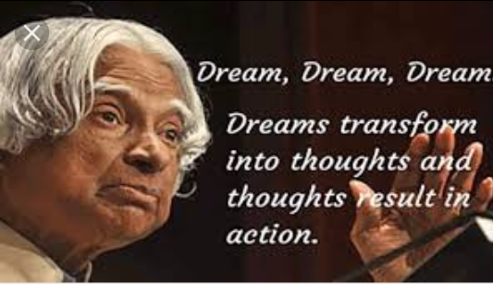
REASON
FOR YES
Increase in women's contribution in all field
Best living standard
Avaibility of natural resources india is very peaceful country
Terrorism

Slide 15
REASONS FOR NO
UNIMPLOYMENT
In india 40% people are under the below poverty line
Lack of infra structure facility
Lack of proper communication

Slide 16
CONCLUSION
After over all information india will become superpower in 2020 because
India has much developed in agreeculture sector
India army is a second largest in the world
India is developing in space research
India is a very rich in natural resources
India should propagate ayurvedic medicine through out of the world
India projected to be worlds 9 largest pharma market in india (2015)
Increase a foreign tread.

Slide 17
SUGGESTION
Education should be technical and commercial rather than classical
People should not be fragmented on basis of religion and cast
India should be emphasized on make in india project
Maximum increase in export tread
Maximum use of government expenditure of education commune harmony
India should be corruption free for the all sector
We have these mission 2020 one of the golden chance to prove in front of all country that the india is the the superpower
Just a meath not a reality should be do as a think about mission 2020.

Slide 18

WELL COME

