Slide 1
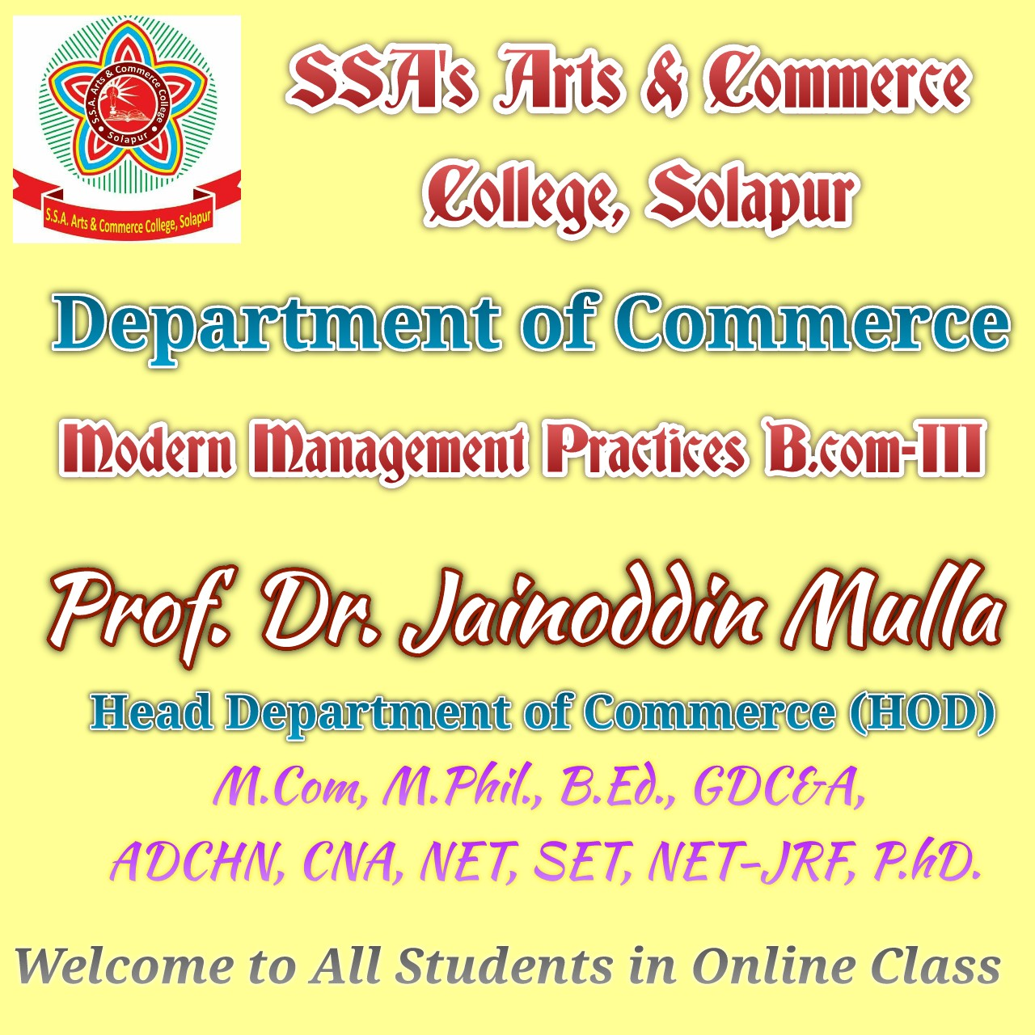

Slide 2
Strategic Management
Presented By
Prof. Dr. Jainoddin K. Mulla,
M.Com., M.Phil., B.Ed., G.D.C&A, ADCHN, CNA, NET, SET, NET-JRF, Ph.D.
Head Department of Commerce,
SSA’s Arts and Commerce College, Solapur.

Slide 3
Defining Strategic Management
Strategic management
  the art and science of formulating, implementing, and evaluating cross-functional decisions that enable an organization to achieve its objectives
Notes:
Strategic management is defined as the art and science of formulating, implementing, and evaluating cross-functional decisions that enable an organization to achieve its objectives

Slide 4
Defining Strategic Management
Strategic management is used synonymously with the term strategic planning.
Sometimes the term strategic management is used to refer to strategy formulation, implementation, and evaluation, with strategic planning referring only to strategy formulation.
Notes:
Strategic management in this text is used synonymously with the term strategic planning
Sometimes the term strategic management is used to refer to strategy formulation, implementation, and evaluation, with strategic planning referring only to strategy formulation.

Slide 5
Defining Strategic Management
A strategic plan is a company’s game plan.
A strategic plan results from tough managerial choices among numerous good alternatives, and it signals commitment to specific markets, policies, procedures, and operations.
Notes:
A strategic plan results from tough managerial choices among numerous good alternatives, and it signals commitment to specific markets, policies, procedures, and operations in lieu of other, “less desirable” courses of action.

Slide 6
Stages of Strategic Management
Strategy formulation
Strategy implementation
Strategy evaluation
Notes:
The strategic-management process consists of three stages: strategy formulation, strategy implementation,
and strategy evaluation.

Slide 7
Stages of Strategic Management
Strategy formulation
  includes developing a vision and mission, identifying an organization’s external opportunities and threats, determining internal strengths and weaknesses, establishing long-term objectives, generating alternative strategies, and choosing particular strategies to pursue
Notes:
Strategy formulation includes developing a vision and mission, identifying an organization’s external opportunities and threats, determining internal strengths and weaknesses, establishing long-term objectives, generating alternative strategies, and choosing particular strategies to pursue

Slide 8
Strategy Formulation
Deciding what new businesses to enter,
What businesses to abandon,
How to allocate resources,
Whether to expand operations or diversify,
Whether to enter international markets,
Whether to merge or form a joint venture,
How to avoid a hostile takeover.
Notes:
Deciding what new businesses to enter,
What businesses to abandon,
How to allocate resources,
Whether to expand operations or diversify,
Whether to enter international markets,
Whether to merge or form a joint venture
How to avoid a hostile takeover.

Slide 9
Stages of Strategic Management
Strategy implementation
  requires a firm to establish annual objectives, devise policies, motivate employees, and allocate resources so that formulated strategies can be executed
  often called the action stage
Notes:
Strategy implementation requires a firm to establish annual objectives, devise policies, motivate employees, and allocate resources so that formulated strategies can be executed and is often called the action stage

Slide 10
Stages of Strategic Management
Strategy evaluation
  reviewing external and internal factors that are the bases for current strategies, measuring performance, and taking corrective actions
Notes:
Strategy evaluation is defined as reviewing external and internal factors that are the bases for current strategies, measuring performance, and taking corrective actions

Slide 11
Stages of Strategic Management
Strategy formulation, implementation, and evaluation activities occur at three hierarchical levels in a large organization: corporate, divisional or strategic business unit, and functional
Strategic management helps a firm function as a competitive team
Notes:
Strategy formulation, implementation, and evaluation activities occur at three hierarchical levels in a large organization: corporate, divisional or strategic business unit, and functional
Strategic management helps a firm function as a competitive team

Slide 12
Integrating Intuition and Analysis
Most organizations can benefit from strategic management, which is based upon integrating intuition and analysis in decision making
Intuition is particularly useful for making decisions in situations of great uncertainty or little precedent
Notes:
Most organizations can benefit from strategic management, which is based upon integrating intuition and analysis in decision making
Intuition is particularly useful for making decisions in situations of great uncertainty or little precedent

Slide 13
Adapting to Change
The second-largest bookstore chain in the United States, Borders Group, declared bankruptcy in 2011 as the firm had not adapted well to changes in book retailing from traditional bookstore shopping to customers buying online, preferring digital books to hard copies
Borders was on the brink of financial collapse before being acquired in July 2011 by Direct Brands

Slide 14
Key Terms in Strategic Management
Competitive advantage
  anything that a firm does especially well compared to rival firms
Strategists
  the individuals who are most responsible for the success or failure of an organization
Notes:
Competitive advantage is anything that a firm does especially well compared to rival firms
Strategists are the individuals who are most responsible for the success or failure of an organization.

Slide 15
Key Terms in Strategic Management
Vision statement
  answers the question “What do we want to become?”
  often considered the first step in strategic planning
Notes:
The Vision statement answers the question “What do we want to become?” and is often considered the first step in strategic planning

Slide 16
Key Terms in Strategic Management
Mission statements
  enduring statements of purpose that distinguish one business from other similar firms
  identifies the scope of a firm’s operations in product and market terms
  addresses the basic question that faces all strategists: “What is our business?”
Notes:
Mission statements are enduring statements of purpose that distinguish one business from other similar firms.
It identifies the scope of a firm’s operations in product and market terms and addresses the basic question that faces all strategists: “What is our business?”

Slide 17
Key Terms in Strategic Management
External opportunities and external threats
  refer to economic, social, cultural, demographic, environmental, political, legal, governmental, technological, and competitive trends and events that could significantly benefit or harm an organization in the future
Notes:
External opportunities and external threats refer to economic, social, cultural, demographic, environmental, political, legal, governmental, technological, and competitive trends and events that could significantly benefit or harm an organization in the future

Slide 18
Some Opportunities and Threats
Computer hacker problems are increasing.
Intense price competition is plaguing most firms.
Unemployment and underemployment rates remain high.
Interest rates are rising.
Product life cycles are becoming shorter.
State and local governments are financially weak.
Notes:
• Availability of capital can no longer be taken for granted.
• Consumers expect green operations and products.
• Marketing moving rapidly to the Internet.
• Commodity food prices are increasing.
• Political unrest in the Middle East is raising oil prices.
• Computer hacker problems are increasing.
• Intense price competition is plaguing most firms.
• Unemployment and underemployment rates remain high.
• Interest rates are rising.
• Product life cycles are becoming shorter.
• State and local governments are financially weak.
• Turmoil and violence in Mexico is increasing.
• Winters are colder and summers hotter than usual.
• Home prices remain exceptionally low.
• Global markets offer the highest growth in revenues.

Slide 19
Key Terms in Strategic Management
Internal strengths and internal weaknesses
  an organization’s controllable activities that are performed especially well or poorly
  determined relative to competitors
Notes:
Internal strengths and internal weaknesses are an organization’s controllable activities that are performed especially well or poorly
and are determined relative to competitors

Slide 20
Key Terms in Strategic Management
Objectives
  specific results that an organization seeks to achieve in pursuing its basic mission
  long-term means more than one year
  should be challenging, measurable, consistent, reasonable, and clear
Notes:
Objectives are specific results that an organization seeks to achieve in pursuing its basic mission.
Long-term means more than one year
They should be challenging, measurable, consistent, reasonable, and clear

Slide 21
Key Terms in Strategic Management
Strategies
  the means by which long-term objectives will be achieved
  may include geographic expansion, diversification, acquisition, product development, market penetration, retrenchment, divestiture, liquidation, and joint ventures
Notes:
Strategies are the means by which long-term objectives will be achieved.
They may include geographic expansion, diversification, acquisition, product development, market penetration, retrenchment, divestiture, liquidation, and joint ventures.

Slide 22
Key Terms in Strategic Management
Annual objectives
  short-term milestones that organizations must achieve to reach long-term objectives
  should be measurable, quantitative, challenging, realistic, consistent, and prioritized
  should be established at the corporate, divisional, and functional levels in a large organization
Notes:
Annual objectives are short-term milestones that organizations must achieve to reach long-term objectives.
They should be measurable, quantitative, challenging, realistic, consistent, and prioritized
They should be established at the corporate, divisional, and functional levels in a large organization.

Slide 23
Key Terms in Strategic Management
Policies
  the means by which annual objectives will be achieved
  include guidelines, rules, and procedures established to support efforts to achieve stated objectives
  guides to decision making and address repetitive or recurring situations
Notes:
Policies are the means by which annual objectives will be achieved.
They include guidelines, rules, and procedures established to support efforts to achieve stated objectives
Policies are guides to decision making and address repetitive or recurring situations

Slide 24
The Strategic-Management Model
Where are we now?
Where do we want to go?
How are we going to get there?
Notes:
These are three important questions to answer in developing a strategic plan:
Where are we now?
Where do we want to go?
How are we going to get there?

Slide 25
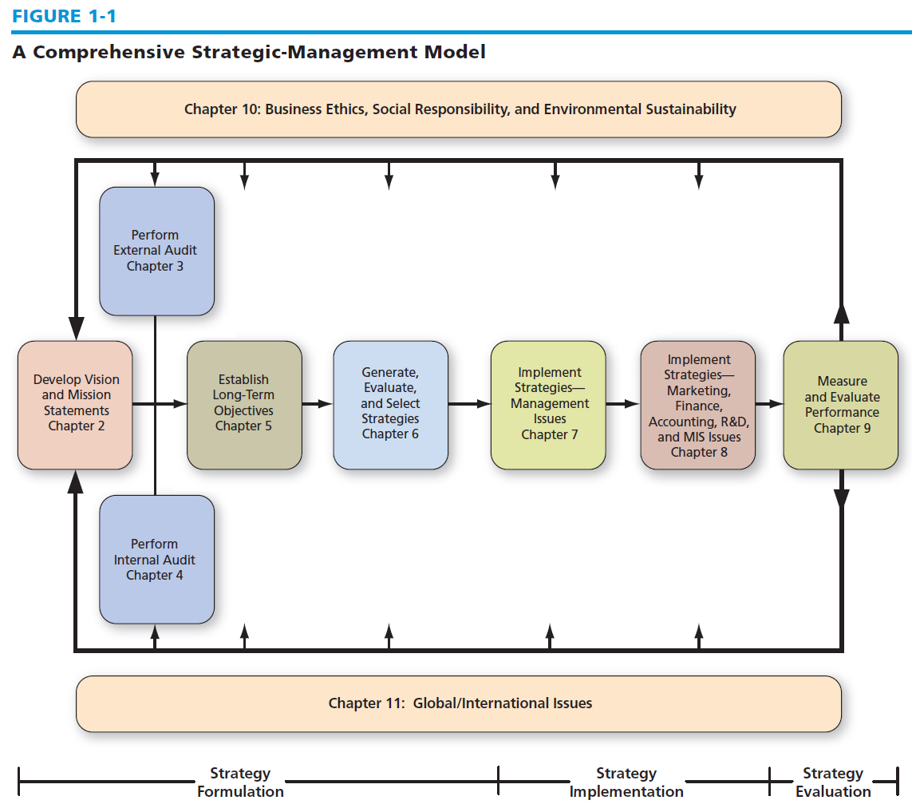
A Comprehensive Strategic-Management Model
Notes:
The framework illustrated in Figure 1-1 is a widely accepted, comprehensive
model of the strategic-management process.12 This model does not guarantee success, but
it does represent a clear and practical approach for formulating, implementing, and evaluating strategies.
Relationships among major components of the strategic-management process are shown in the
model, which appears in all subsequent chapters with appropriate areas shaped to show the particular
focus of each chapter.

Slide 26
Benefits of Strategic Management
Historically, the principal benefit of strategic management has been to help organizations formulate better strategies through the use of a more systematic, logical, and rational approach to strategic choice
Notes:
Historically, the principal benefit of strategic management has been to help organizations formulate better strategies through the use of a more systematic, logical, and rational approach to strategic choice

Slide 27
Benefits of Strategic Management
Communication is a key to successful strategic management
Through dialogue and participation, managers and employees become committed to supporting the organization

Slide 28
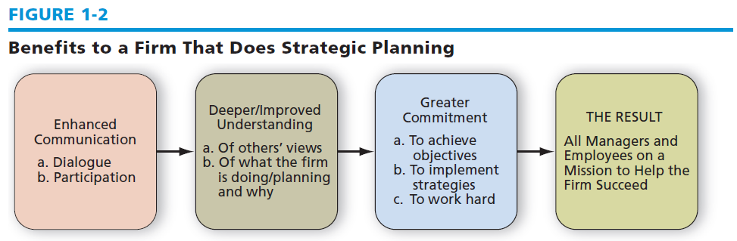
Benefits to a Firm That Does Strategic Planning
Notes:
Figure 1-2 illustrates this
intrinsic benefit of a firm engaging in strategic planning. Note that all firms need all employees on a
mission to help the firm succeed.

Slide 29
Financial Benefits
Businesses using strategic-management concepts show significant improvement in sales, profitability, and productivity compared to firms without systematic planning activities
High-performing firms seem to make more informed decisions with good anticipation of both short- and long-term consequences
Notes:
Businesses using strategic-management concepts show significant improvement in sales, profitability, and productivity compared to firms without systematic planning activities
High-performing firms seem to make more informed decisions with good anticipation of both short- and long-term consequences

Slide 30
Nonfinancial Benefits
It allows for identification, prioritization, and exploitation of opportunities.
It provides an objective view of management problems.
It represents a framework for improved coordination and control of activities.
It minimizes the effects of adverse conditions and changes.
Notes:
It allows for identification, prioritization, and exploitation of opportunities.
It provides an objective view of management problems.
It represents a framework for improved coordination and control of activities.
It minimizes the effects of adverse conditions and changes.

Slide 31
Nonfinancial Benefits
It allows major decisions to better support established objectives.
It allows more effective allocation of time and resources to identified opportunities.
It allows fewer resources and less time to be devoted to correcting erroneous or ad hoc decisions.
It creates a framework for internal communication among personnel.
Notes:
It allows major decisions to better support established objectives.
It allows more effective allocation of time and resources to identified opportunities.
It allows fewer resources and less time to be devoted to correcting erroneous or ad hoc decisions.
It creates a framework for internal communication among personnel.

Slide 32
Why Some Firms Do No
Strategic Planning
Lack of knowledge in strategic planning
Poor reward structures
Firefighting
Waste of time
Too expensive
Laziness
Content with success
Notes:
• Lack of knowledge or experience in strategic planning—No training in strategic planning.
• Poor reward structures—When an organization assumes success, it often fails to reward
success. When failure occurs, then the firm may punish.
• Firefighting—An organization can be so deeply embroiled in resolving crises and firefighting
that it reserves no time for planning.
• Waste of time—Some firms see planning as a waste of time because no marketable product
is produced. Time spent on planning is an investment.
• Too expensive—Some organizations see planning as too expensive in time and money.
• Laziness—People may not want to put forth the effort needed to formulate a plan.
• Content with success—Particularly if a firm is successful, individuals may feel there is no
need to plan because things are fine as they stand. But success today does not guarantee
success tomorrow.

Slide 33
Why Some Firms Do No
Strategic Planning
Fear of failure
Overconfidence
Prior bad experience
Self-interest
Fear of the unknown
Honest difference of opinion
Suspicion
Notes:
• Fear of failure—By not taking action, there is little risk of failure unless a problem is
urgent and pressing. Whenever something worthwhile is attempted, there is some risk of
failure.
• Overconfidence—As managers amass experience, they may rely less on formalized
planning. Rarely, however, is this appropriate. Being overconfident or overestimating
experience can bring demise. Forethought is rarely wasted and is often the mark of
professionalism.
• Prior bad experience—People may have had a previous bad experience with planning, that
is, cases in which plans have been long, cumbersome, impractical, or inflexible. Planning,
like anything else, can be done badly.
• Self-interest—When someone has achieved status, privilege, or self-esteem through effectively
using an old system, he or she often sees a new plan as a threat.
• Fear of the unknown—People may be uncertain of their abilities to learn new skills, of
their aptitude with new systems, or of their ability to take on new roles.
• Honest difference of opinion—People may sincerely believe the plan is wrong. They may
view the situation from a different viewpoint, or they may have aspirations for themselves
or the organization that are different from the plan. Different people in different jobs have
different perceptions of a situation.
• Suspicion—Employees may not trust management

Slide 34
Pitfalls in Strategic Planning
Using strategic planning to gain control over decisions and resources
Doing strategic planning only to satisfy accreditation or regulatory requirements
Too hastily moving from mission development to strategy formulation
Failing to communicate the plan to employees, who continue working in the dark
Top managers making many intuitive decisions that conflict with the formal plan
Notes:
Using strategic planning to gain control over decisions and resources
Doing strategic planning only to satisfy accreditation or regulatory requirements
Too hastily moving from mission development to strategy formulation
Failing to communicate the plan to employees, who continue working in the dark
Top managers making many intuitive decisions that conflict with the formal plan

Slide 35
Pitfalls in Strategic Planning
Top managers not actively supporting the strategic-planning process
Failing to use plans as a standard for measuring performance
Delegating planning to a “planner” rather than involving all managers
Failing to involve key employees in all phases of planning
Failing to create a collaborative climate supportive of change
Notes:
Top managers not actively supporting the strategic-planning process
Failing to use plans as a standard for measuring performance
Delegating planning to a “planner” rather than involving all managers
Failing to involve key employees in all phases of planning
Failing to create a collaborative climate supportive of change

Slide 36
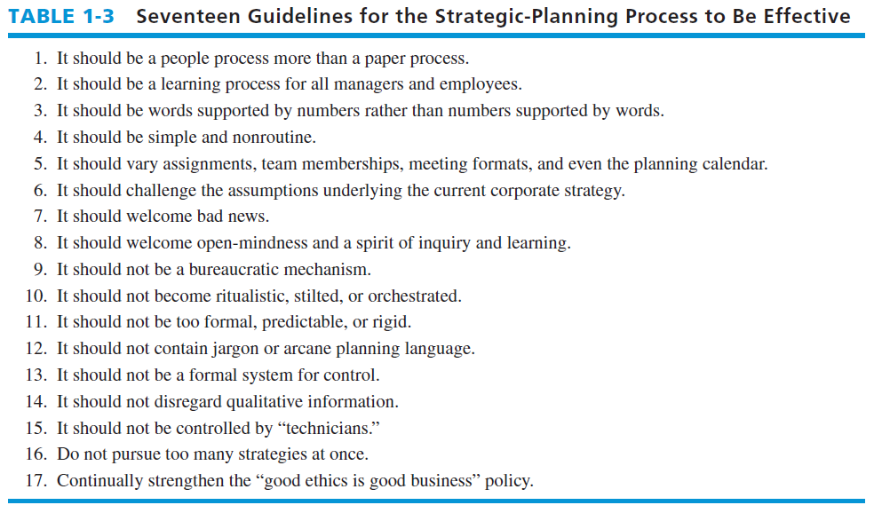
Guidelines for Effective Strategic Management
Notes:
Table 1-3
summarizes important guidelines for the strategic-planning process to be effective.

