Slide 1
Span of control
Prof. Baiju B.S
HOD, Dept. of Applied Sciences
MEA Engineering College
bsbaiju@gmail.com

Slide 2
Organization Levels & span of control
Organization levels or hierarchy and span of control
  The relationships between the span of management is associated with few organization levels, narrow span, with many levels.
Span of control or span of management or span supervision
  The number of subordinates reporting to a given manager also called span of control or span of management.

Slide 3
Factors effecting Span of Management
Capacity of superior.
Capacity of subordinate.
Nature of work.
Degree of decentralization.
Degree of planning.
Communication technique.
Use of staff assistance.
Supervision from others.

Slide 4
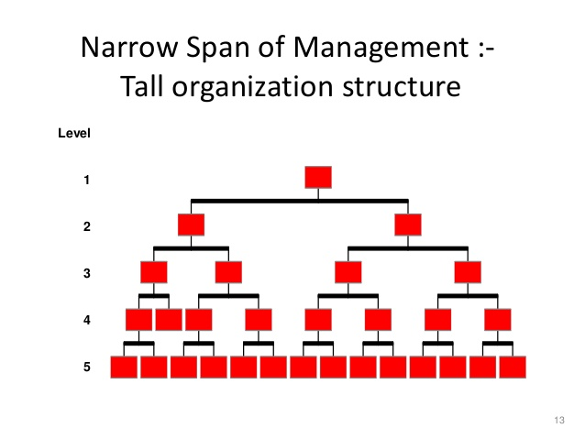
Narrow span of management
A single manager or supervisor over sees few subordinates. This gives rise to tall organizational structure.

Slide 5
Narrow span of management
Advantages
Within tall organisational structure there is a close supervisory control because of the low span of managers.
It is more authorised structure.
In a tall structure the responsible person is other accountable to the higher authority.
This structure enhances the control of the top regulation over the organization.
Disadvantages
Employees are less motivated within this structure.
Verdict making is slow.
Tall structure creates communication barriers between the upper and lower management.
Less benefit and rewards are given to the body in the tall organisation.

Slide 6
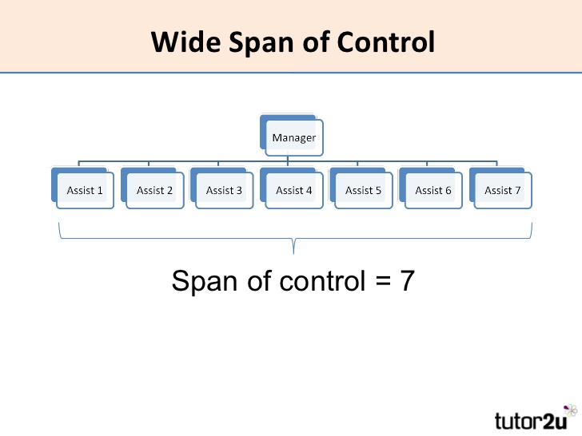
Wide span of management
This means a single manager or supervisor oversees a large number of subordinates. This gives rise to flat organizational structure.

Slide 7
Wide span of management
Advantages
Flat organization is less costly.
Quick decision and action can be taken.
Communication will be fast and clear
Subordinates are free from close and strict supervision and control.
Superior may not be too dominating because of large number of subordinates.
Disadvantages
There are chances for weaker controls over subordinates because of many are under one manager.
The discipline in the organisation may not be under control
The relation between the superior and subordinate may not be healthy
Close and informal relation may not be possible.
Organization may not be in a position to maintain quality and performance

Slide 8
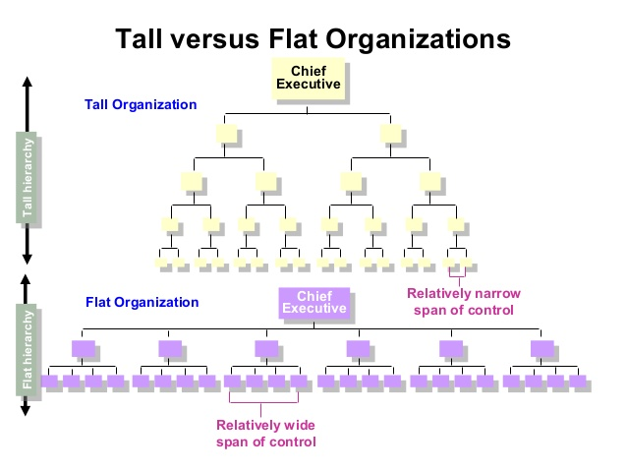
Tall span Vs wide span

