Slide 1
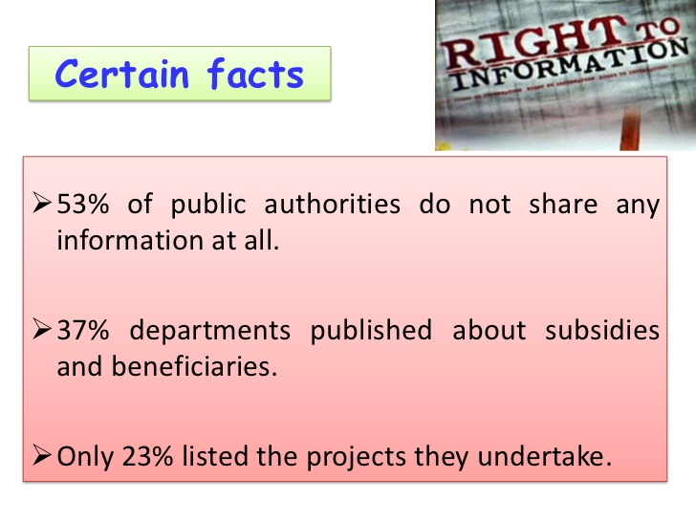
RIGHT TO INFORMATION ACT, 2005- ITS IMPLEMENTATION & EVALUATION.
S.S.A.ART’S & COMMERCE COLLEGE, SOLAPUR.

Slide 2
INTRODUCTION
Citation – act no.22 of 2005.
The RTI act 2005 was enacted by permission and authority of His Excellency, President of India. This act was enacted by the parliament on 15 June,2005 and notified in the Gazette of India dated 21 June, 2005.
It extends to the whole of India except the State of Jammu and Kashmir.
Important sections..
The RTI Act has more than 30 sections and it’s subsections. In order to get response every time one must study all sections and amendment in the act from time to time.
Section 3: All citizens have the right
Section 4: Proactive disclosures by authorities
Section 6: Request for obtaining information
Section 7: How your request will be treated
Section 8: Exemptions
Section 19(1): First appeal
Section 19(3): Second appeal
Section 20: Penalties and disciplinary action

Slide 3
OBJECTIVES
To understand the concept of RTI.
How we can use RTI; Use of RTI in India.
Awareness of RTI in India.
Reason behind why people no using the RTI.
Finding effective measures for running RTI.

Slide 4
METHODOLOGY.
Primary data- Primary data conducting by getting interview and also by questioner.
Secondary data- Secondary data have been collected from various sources. Reference books, Magazines, Government published sources as well as the internet have been used. Methodology is partly descriptive, partly exploratory.

Slide 5
DISCUSSION.
Who can exercise his/her under The RTI Act 2005?
The answer is:
Subject to the provision to this Act, all citizens shall have the right to information.
What is Information?
Information means any material in any form, including records, documents, memos, e-mails, opinions, advices, press, samples, models, data material held in any electronic form and information relating to any private body which can be accessed by a public authority under any other law for the time being in force.

Slide 6
What is Record?
Record includes
Any documents, manuscript and file
Any microfilm, microfiche and facsimile copy of a documents
Any reproduction of image or images embodied in such microfilm (whether enlarged or not); and
Any other material produced by a computer or any other device.

Slide 7
Who is public authority?
It is an authority or body or institution of self government established or constituted.
By or under the Constitution
By any other law made by Parliament
By any other law made by State Legislature
By notification issued or order made by the appropriate Government, and includes any-body owned, controlled or substantially financed, non-Government organization substantially financed, directly or indirectly by funds provided by the Government.

Slide 8
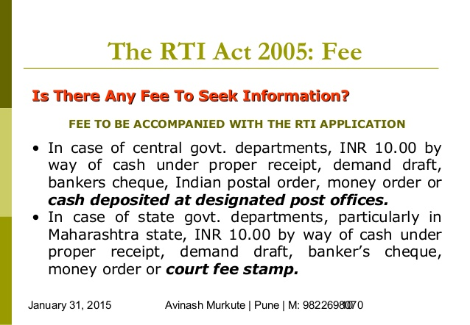
FEE.

Slide 9
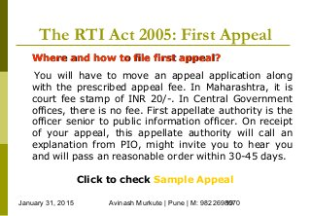
FIRST APPLEA.

Slide 10
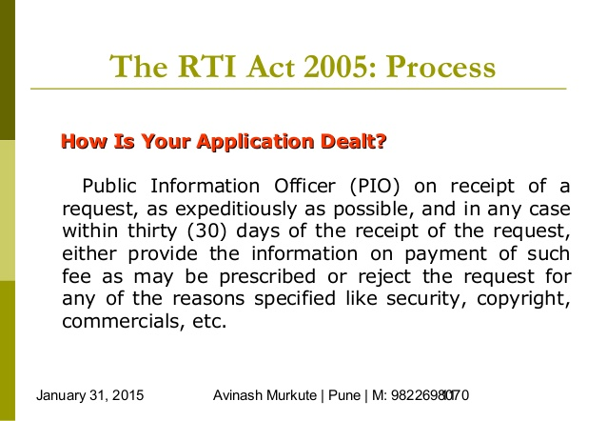
PROCESS.

Slide 11
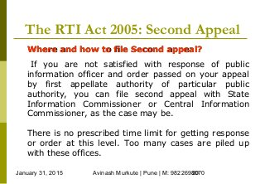
SECOND APPEAL.

Slide 12
The Act specifies time limits for replying to the request.
If the request has been made to the PIO, the reply is to be given within 30 days of receipt.
If the request has been made to an APIO, the reply is to be given within 35 days of receipt.
If the PIO transfers the request to another public authority (better concerned with the information requested), the time allowed to reply is 30 days but computed from the day after it is received by the PIO of the transferee authority.
Information concerning corruption and Human Rights violations by scheduled Security agencies (those listed in the Second Schedule to the Act) is to be provided within 45 days but with the prior approval of the Central Information Commission.
However, if life or liberty of any person is involved, the PIO is expected to reply within 48 hours.

Slide 13
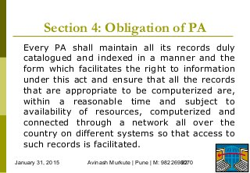
OBLIGATION OF PA.

Slide 14
EXCLUSION..
Central Intelligence and Security agencies specified in the Second Schedule like IB,Directorate General of Income tax(Investigation), RAW, Central Bureau of Investigation (CBI), Directorate of Revenue Intelligence, Central Economic Intelligence Bureau, Directorate of Enforcement, Narcotics Control Bureau, Aviation Research Centre, Special Frontier Force, BSF, CRPF, ITBP, CISF, NSG, Assam Rifles, Special Service Bureau, Special Branch (CID), Andaman and Nicobar, The Crime Branch-CID-CB, Dadra and Nagar Haveli and Special Branch, Lakshadweep Police etc. will be excluded. Agencies specified by the State Governments through a Notification will also be excluded. The exclusion, however, is not absolute and these organizations have an obligation to provide information pertaining to allegations of corruption and human rights violations. Further, information relating to allegations of human rights violation could be given but only with the approval of the Central or State Information Commission.
On 14 July 2016, the nuclear stockpile information including their testing was also removed from RTI purview with inclusion of nuclear strategic command in the exemption list.
If information is not provided within this period, it is treated as deemed refusal. Refusal with or without reasons may be ground for appeal or complaint. Further, information not provided in the times prescribed is to be provided free of charge. Appeal processes are also defined.

Slide 15
FINDINGS.
In our study of RTI, we find the advantages some of them are:
The deprived unveiled scam.
Student got the answers sheet copy.
RTI also exposed the information about political parties, it exposed Qualification of Ministers.
Easy mode of spreading information rightfully.
Reduction in corruption.
Great transparency.

Slide 16
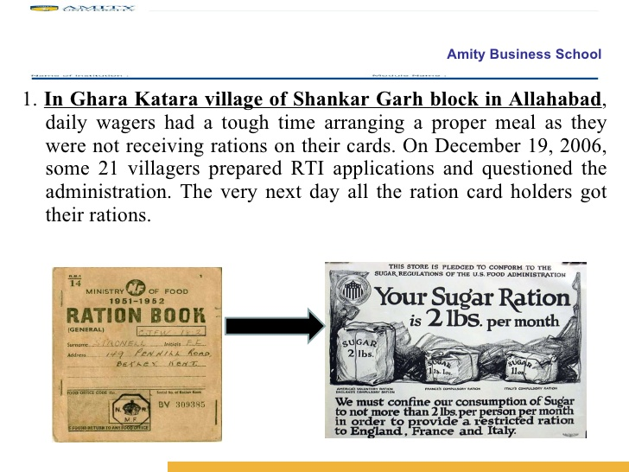
Implementation of filing RTI

Slide 17


Slide 18
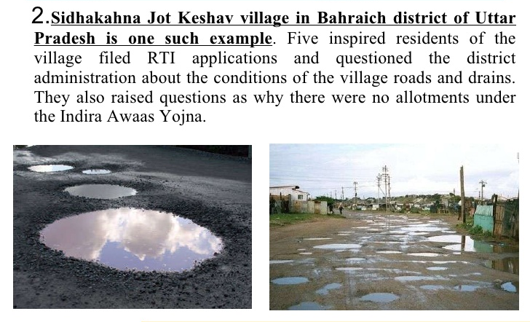

Slide 19
Now, if we talk about the disadvantages or drawbacks of RTI there are some major issues associated with it. They are:
An extra burden to the Authorities.
Multiple Public Information Officers (PIO).
People’s accessibility is hectic and time consuming.
  Similarly CBSE provide answer sheets for Rs. 500 which should not be charged as per RTI norms.
  Advantages and disadvantages are a part and partial of such enactments but the bottom line remains in the fact that the execution must be according to the expected proposal and commitment.

Slide 20
Conclusion & Suggestion
Studying the RTI, we have following suggestions:
Appointing new staff for reducing extra burden to the authorities.
Minimizing the volume of Public Information Officers.
Taking immediate action on appeal.
Charging right amount.
That is some of the suggestions for solving of the problems of RTI.
As RTI Act completed it’s 11 years; it proved to be very beneficial. It helps to public for getting information regarding any matter. It helps to economy by reducing corruption, and also it reduces the gap between Govt. or Public Authorities and public.

Slide 21
THANK YOU.

