Slide 1
MGMT
Management
Chapter 1

Slide 2
Management Is…
Getting work done through others
Efficiency – getting work done with a minimum of effort, waste, or expense
Effectiveness – accomplishing tasks that help fulfill organizational objectives

Slide 3
Henri Fayol
“the success of an enterprise generally depends much more on the administrative ability of its leaders than on their technical ability”
Early 1900s

Slide 4
Four Functions of Management
Planning
  Determining organizational goals and a means for achieving them
  Outcome: companies usually have larger profits and faster growth
Organizing
  Deciding where decisions will be made, who will do what jobs and tasks, and who will work for whom
Leading
  Inspiring and motivating workers to work hard to achieve organizational goals
Controlling
  Monitoring progress toward goal achievement and taking corrective action when needed

Slide 5
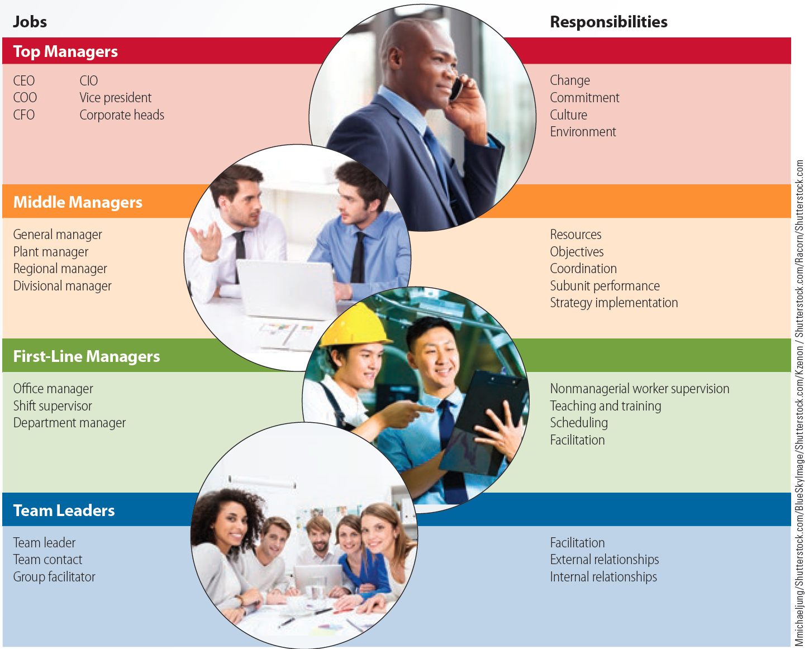
What the Four Kinds of Managers Do

Slide 6
Kinds of Managers
Top managers:
  Executives responsible for the overall direction of the organization
  Responsible for creating:
    Context for change
    Employee buy-in
    Positive organizational culture via language and action

Slide 7
Kinds of Managers
Middle managers
  Responsible for:
    Setting objectives consistent with top management’s goals
    Planning and implementing subunit strategies for achieving the objectives
    Coordinating and linking groups
    Monitoring and managing subunits
    Implementing strategies developed by top managers
  Plant manager, regional manager, or divisional manager

Slide 8
Kinds of Managers
First-Line managers
  Responsible for:
    Managing performance of entry-level employees
    Train/teach, encourage, monitor, and reward
    Scheduling
  Office manager, shift supervisor, department manager

Slide 9
Kinds of Managers
Team Leaders
  Responsible for:
    Facilitating team activities toward goal accomplishment
  Help team members:
    Plan and schedule work
    Learn problem-solving methods
    Work effectively with each other
  Foster internal and external relationships
  Team leader, team contact, group facilitator

Slide 10
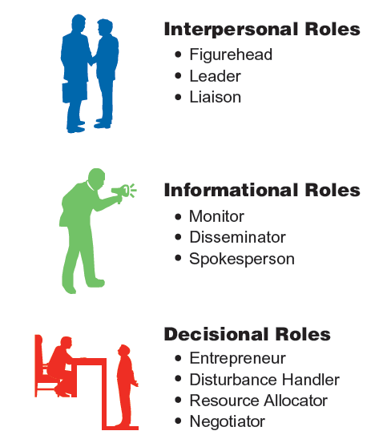
Mintzberg’s Managerial Roles
© 2015 Cengage Learning

Slide 11
Interpersonal Roles - Mintzberg
People intensive! (2/3 – 4/5 of their time)
3 Roles
  Figurehead – public view – ceremonial duties
  Leader – motivate and encourage to accomplish organizational objectives
  Liaison – work w/ outside individuals

Slide 12
Information Roles- Mintzberg
Obtaining & sharing info (40% of time)
3 Roles
  Monitor – scan environment
  Disseminator – share info inside company
  Spokesperson – share info outside

Slide 13
Decisional Roles- Mintzberg
4 Roles
  Entrepreneur – adapts to change
  Disturbance handler – problems that need immediate attention
  Resource allocator -
  Negotiator – schedules, resources, projects, raises, etc.

Slide 14
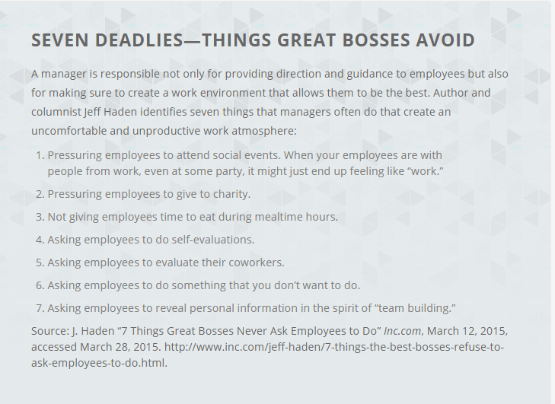

Slide 15
Management Skills
Technical skills: Specialized procedures, techniques, and knowledge required to get the job done
  Essential for team leaders and low-level managers
Human skills: Ability to work well with others
  Essential at all levels of management
Conceptual skills
  Ability to:
    See the organization as a whole
    Understand how the different parts affect each other
    Recognize how the company fits into or is affected by its environment
  Essential for top managers
Motivation to manage
  Assessment of how enthusiastic employees are about managing the work of others

Slide 16
Management Skills - Duplicated
Technical skills: get the job done
  Essential for team leaders and low-level managers
Human skills: work well w/ others
  Essential at all levels of management
Conceptual skills – see the big picture
  Essential for top managers
Motivation to manage

Slide 17
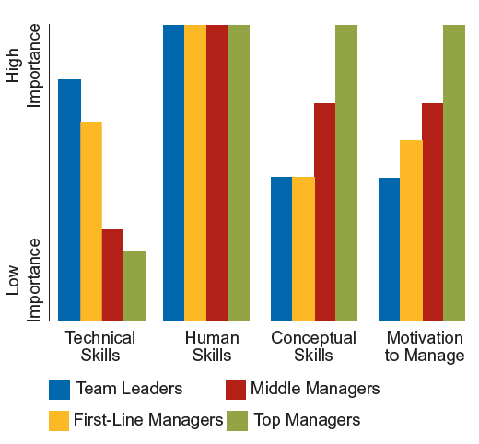
Management Skills

Slide 18
Mistakes Managers Make – Alphabetical
Betray trust
Cold, aloof, arrogant
Insensitive to others: abrasive, intimidating, bullying style
Overdependent on advocate or mentor
Overly ambitious: thinking of next job, playing politics
Overmanaging: unable to delegate or build a team
Specific performance problems with the business
Unable to adapt to boss with different style
Unable to staff effectively
Unable to think strategically

Slide 19
Mistakes Managers Make
Insensitive to others: abrasive, intimidating, bullying style
Cold, aloof, arrogant
Betray trust
Overly ambitious: thinking of next job, playing politics
Specific performance problems with the business
Overmanaging: unable to delegate or build a team
Unable to staff effectively
Unable to think strategically
Unable to adapt to boss with different style
Overdependent on advocate or mentor

Slide 20
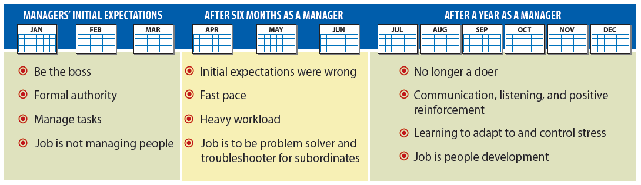
Hill’s Stages in the Transition to Management
© 2015 Cengage Learning

Slide 21
Competitive Advantage Through People
Helps develop workforces that are smarter, better trained, more motivated, and more committed than those of the competitors’
Produces substantial advantages in:
  Sales revenues
  Profits
  Stock market returns
  Customer satisfaction

Slide 22
Competitive Advantage Through People: Management Practices
Employment security
  Ultimate form of commitment company can make to employees.
  Employees can innovate and increase the profitability of an organization without the fear of losing their job
Selective hiring
  Companies need to hire the best talent due to the presence of employment security
Self-managed teams
  Produce high productivity through increased employee commitment and creativity

Slide 23
Competitive Advantage Through People: Management Practices
Decentralization
  Allows employees closest to problems, production, and clients to make timely decisions
High wages contingent on organizational performance
  High remuneration helps an organization attract talented employees and retain existing employees
  High wages indicates the organization values its employees
  Employees who share in financial success more likely to see long-run view of organization

Slide 24
Competitive Advantage Through People: Management Practices
Training and skill development
  Companies need to invest resources in the training employees to ensure skill development
Reduction of status differences
  Leads to employees concentrating on work related issues rather than biases and prejudices of the management
Sharing information
  Helps employees participate in the decision making process

Slide 25
Summary
Functions of management are planning, organizing, controlling, and leading
Kinds of managers are top, middle, first-line, and team leaders
Roles played by managers include interpersonal, informational, and decisional
Technical, human, and conceptual skills are essential for managers

Slide 26
Key Terms
Management
Efficiency
Effectiveness
Planning
Organizing
Leading
Controlling
Top managers
Middle managers
First-line managers
Team leaders
Figurehead role
Leader role
Liaison role
Monitor role
Disseminator role
Spokesperson role
Entrepreneur role
Disturbance handler role
Resource allocator role
Negotiator role
Technical skills
Human skills
Conceptual skills
Motivation to manage

