Slide 1

ECONOMIC EMPOWEREMNT OF WOMEN
FOR
SUSTAINING HUMAN DEVELOPMENT IN INDIA
Ladaf Tajoddin Bashumiyan
S.S.A.ARTS & COMMERCE COLLEGE ,SOLAPUR

Slide 2
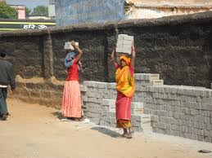
Introduction
India is a country that combines low human development and poor performance towards the Millennium Goals mainly because of two reasons.
1. Existence of socio-economic backward societies- caused by lack of attention by government’s policies and plans, inefficient implementation of development policies, lack of peoples’ participation and less capabilities.
2. Disempowerment of women- women, half part of any society, was not an attentive ends for development activities before; therefore their socio economic condition remained very backward within specific backward society as well as in the entire country. India’s Human Development Status has been low compared to other developing countries. This is, because sources of human backwardness are properly not addressed in time in India. Women and socially backward groups counting 55% of total population (SCs and STs-18%, Minority-13%, Women form other social groups 24 %). Exclusion of this population from the process of human development is the main cause of India’s low human development record.

Slide 3

Objectives of Study
To review of existing approaches to Human Development in India.
2. To study the role of women’s economic empowerment in economic development of marginalized classes.
3. To study the role of socio-cultural factors in the process of human development and women empowerment.
4. To study the factors those determine the participation of women in human development.
5. To check relation between the processes of human development & the process of women's empowerment in India.

Slide 4

Methodology:
This research paper is of exploratory research type. So the question what is? is being answered in reference with most vulnerable masses of our society.
For this study, secondary data have been collected from various sources: Reference books, Magazines, news papers and Government publish sources as well as the internet have been used.

Slide 5
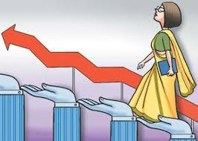
The Concepts:
Human development means improving human productivity by giving access to food, education and health facilities. It is enlargement of choices of people and improvement in their capabilities ( Paul Streeton & Maheboob-ul-Haq)
Women Empowerment means: Providing social, civil and economic rights female at par with male, and improving their capabilities to enjoy these rights.
Women’s Economic Empowerment. women having capabilities to earn and control over income sources of income is known as Women’s Economic Empowerment.

Slide 6
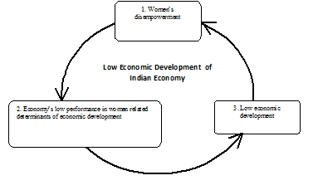
Low Women's Empowerment& Low Human Development in India
Women Disempowerment
Low Human Development
2. Economies‘ Low performance in women related determinants of Human Development
3. Low Human Development

Slide 7
Women's Disempowerment circle
Women’s Disempowerment
1 Backward Socio- Cultural Values, Norms and attitudes
3. Women’s Socio-Political disempowerment
2 Women’s economic disempowerrement

Slide 8
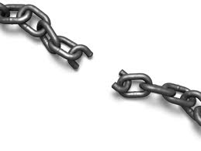
Breaking the circles:
Step I) Initiatives for Women’s Economic Empowerment: Breaking vicious circle of women’s disempowerment can be started by promoting women’s economic empowerment. Various present studies on Self Help Groups and Micro Finance Agencies in Bangladesh and India have witnessed that women’s economic empowerment works as the fuel for their entire empowerment by educating them and organizing them.
Step II) Combine efforts to Women’s overall Empowerment
Once this elimination of women’s disempowerment is started, it will, further, accelerate: country’s human development. Therefore, breaking A circle is helping to break B circle. Hence women empowerment works as a vital way to sustained human development.

Slide 9

Suggestions:
Women of backward classes should have access to institutional credit.
All programmes of National Literacy Mission have to be women centered.
Further the scholarship schemes besides free education should be launched especially all girls.
The reservation policy should be enhanced to women of India.
NGOs have to be promoted to launch sensitization programme for development of women.
Building appropriate communication and information networks especially among women is necessary
Establishment of National Micro Finance Corporation for Women
A development model for backward classes of India in general and women in particular should be developed by more discerning research.

Slide 10

Conclusion
We conclude that without women’s empowerment the process of human development becomes slow; therefore, economy cannot secure progress in human development.
According to Mira Seth, “… the main strategy for women’s development is three fold – education, employment and health. For the first should be considered that economic independence would accelerate improvement in women’s status…” Policies regarding modern education for women are the essential first step towards women’s empowerment.

Slide 11
Bibliography
Apte, S., L., 1995, “Education and Women’s Empowerment,” Indian Journal OF Adult Education, 56(3) July-Sept, p. 27-29.
Bardhan, Kalpana ,1985, ‘Women’s Work, Welfare and Status: Forces of Tradition and Change in India’, Economic and Political Weekly, 20(51), Pp.2261-67.
Batliwala, Srilatha1995, Education for Women's Empowerment, ASPBAE Position Paper for the Fourth World Conference on Women, Beijing, September 1995, New Delhi, Asia-South Pacific Bureau of Adult Education.
Ranjani K Murthy, Building Women’s Capacities-Intervention in Gender Transitions, Sage Pub. New Delhi, PP. 18
Report, Govt. of Maharashtra State , 1997, Status of Women in Maharashtra , A Situational Analysis 1985-1995, Maharashtra State Commission for Women, p. 41.
Talwar Sabanna, 2007, women education, employment and gender-discrimination, serials publications, New Delhi PP 6 – 7
World Bank Report, Women’s Empowerment,
World Bank, 2005, WDR 2006: Equity and Development

Slide 12


