Slide 1
Decision Making
Prof. Baiju B.S
HOD, Dept. of Applied Sciences
MEA Engineering College
bsbaiju@gmail.com

Slide 2
Decision-Making Process
“Decision Making is the process of making choices by setting goals, gathering information, and assessing alternative occupations.”
Step 1: Identify the problem.
Step 2: Gather relevant information.
Step 3: Identify alternatives.
Step 4: Weigh evidence.
Step 5: Choose among alternatives.
Step 6: Take action.
Step 7: Review decision and consequences.

Slide 3
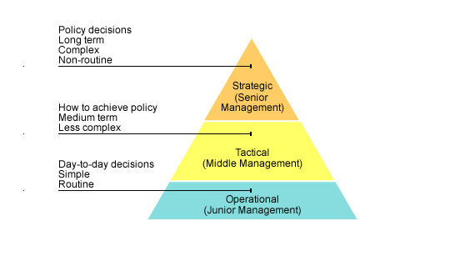
Types of Decisions
Strategic decisions
Tactical decisions
Operational decisions

Slide 4
Types of Decisions
Strategic decisions are long term, complex decisions made by senior management. These decisions will affect the entire direction of the firm. An example may be to become the market leader in their field.
Tactical decisions are medium term, less complex decisions made by middle managers. They follow on from strategic decisions and aim to meet the objectives stated in any strategic decision.
Operational decisions are day to day decisions made by junior managers that are simple and routine. This could involve the regular ordering of supplies or the creation of a staff rotation.

Slide 5
Decision Making Under Certainty, Uncertainty and Risk
Taking Decisions under Certainty
  If the outcomes are known and the values of the outcomes are certain, the task of the decision maker is to compute the optimal alternative or outcome with some optimization criterion in mind.
Taking Decisions under Risk
  The making of decisions under risk is done only when the probabilities of various outcomes are known, is similar to certainty.
Taking Decisions under Uncertainty
  Decisions under uncertainty (outcomes known but not the probabilities) must be handled differently because, without probabilities, the optimization criteria cannot be applied.

Slide 6
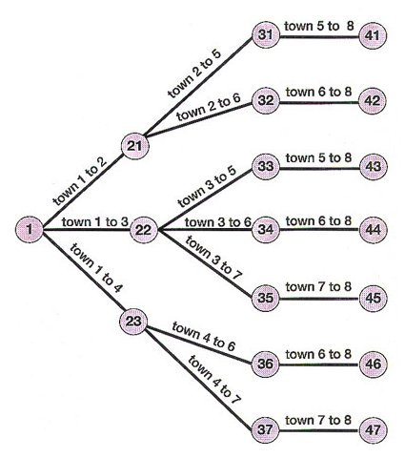
Multistage Decisions &Decision Trees
‘One of the best ways to analyze a decision is to use so-called decision trees. Decision trees depict, in the form of a tree, the decision points, chance events, and probabilities involved in various courses that might be undertaken.’

Slide 7
Programmed & Non-Programmed Decisions
Programmed Decision
Programmed decisions are those that are traditionally made using standard operating procedures or other well-defined methods.
Features
Programmed decisions made using standard operating procedures.
Deals with frequently occurring situations.
In programmed decisions managers make a real decision only once and program itself specifies procedures to follow when similar circumstances arise.
Leads to the formulation of rules, procedures, and policies.

Slide 8
Programmed & Non-Programmed Decisions
Non-Programmed Decision
“Non-programmed decisions are unique. They are often ill-structured, one-shot decisions. Traditionally they have been handled by techniques such as judgment, intuition, and creativity”
Features
Situations for Non-programmed decisions are unique, ill-structured.
Non-programmed decisions are one-shot decisions.
Handled by techniques such as judgment, intuition, and creativity.
A logical approach to deal with extraordinary, unexpected, and unique problems.
Managers take heuristic problem-solving approaches in which logic; common sense and trial and error are used.

