Slide 1
HS300 MODULE 6
Over all Controls & preventive controls
Prof. Baiju B.S
HOD, Dept. of Applied Sciences
MEA Engineering College
bsbaiju@gmail.com

Slide 2
Control of over all performance
“Control devices have been developed for measuring the over all performance of an organization”
Reasons
Just as over all planning must apply to the enterprise, over all control also should be there to analyze the achievements of organizational goals
Decentralization of authority creates semi-independent units, these must be subjected to over all control in order to avoid confusions.
It permits the measurement of an integrated area.
Many over all controls in business are Financial
Finance is the binding force in business.
It accurately indicate the total expense s for resources in reaching the goals
A manager must have a way of knowing what goal achievement has cost in terms of resources.
It has to be tailored to the specific needs of the enterprise or position
A deviation from planned costs, may lead a manager to find the causes in poor planning, inadequate training of employees or other nonfinancial factors.

Slide 3
Profit & loss control
Profit & Loss statement shows all revenues and expenses for a given period.
Profits are a definite standard against which to measure success
It is summary of results of business operations
Each part/division of the enterprise should contribute towards this
Limitations
Cost & Time required is very high
Duplication of records
Difficult to allocate many overhead costs

Slide 4
Control through return on investment
Return on Investment is the rate of return that a company or a division can earn on the capital allocated to it
It shows the relative success of an organization
It recognizes the fundamental fact that capital is a critical factor in any enterprise

Slide 5
Management Audits & Accounting firms
Accounting audit agencies/firms do various types of auditing in companies
It is an independent process, aims at pointing out the inefficiency in the performance of management functions.
It is not compulsory and not enforced by law

Slide 6
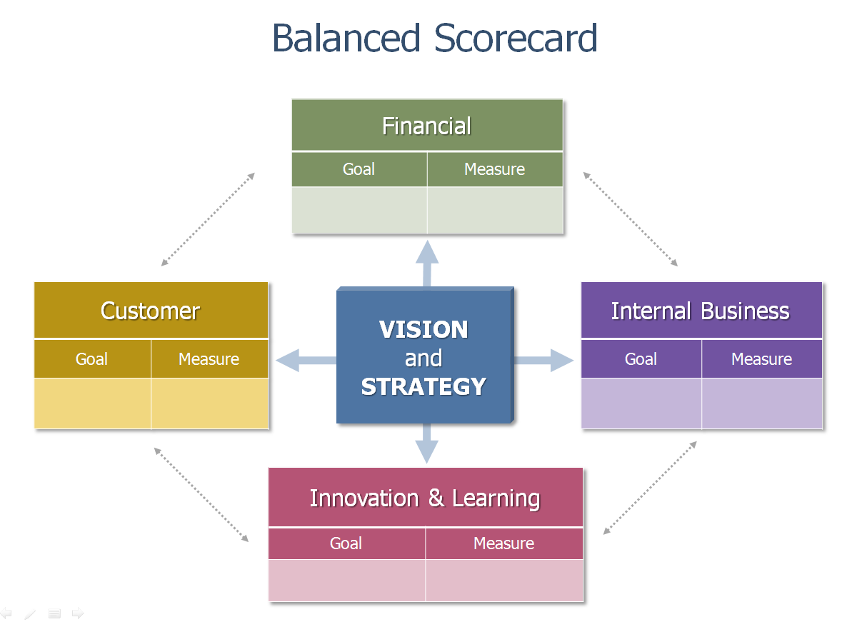
Balanced score card

Slide 7
Bureaucratic & clan control
Bureaucratic control is characterized by the wide use of rules, regulations, policies, procedures and formal authority
Clan control is based on norms, shared values, expected behavior, and other cultural variables

Slide 8
Preventive control
The principle of preventive control states that , the higher the quality of managers and their subordinates, the less will be the need for direct controls.
Assumptions in the Principle of Preventive Control :
Qualified Managers make a minimum errors
Managerial performance can be measured. Concepts, Principles and techniques are useful diagnostic standards in measuring managerial performance
The application of management fundamentals can be evaluated

Slide 9
Advantages of Preventive Control
Greater accuracy is achieved in assigning personal responsibility
Preventive control hasten corrective action and make it more effective
Preventive control lightens managerial burden
Psychological advantage. Subordinate managers know what is expected of them, understand the nature of managing, and feel a close relationship between performance and measurement

