Slide 1
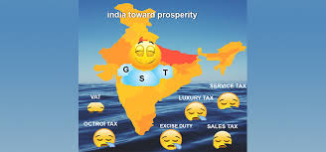
Implementation of GST and its impact on Indian economy

Slide 2

Introduction
Introduction of the Value Added Tax (VAT) at the
Central and the State level has been considered
to be a major step – an important step forward –
in the globe of indirect tax reforms in India. If the
VAT is a major improvement over the pre-existing
Central excise duty at the national level and the
sales tax system at the State level, then the
Goods and Services Tax (GST) will indeed be an
additional important perfection – the next logical
step – towards a widespread indirect tax reforms
in the country. Initially, it was conceptualized that
there would be a national level goods and
services tax, however, with the release of First
Discussion Paper by the Empowered Committee
of the State Finance Ministers on 10.11.2009, it
has been made clear that there would be a “Dual
GST” in India, taxation power – both by the
Centre and the State to levy the taxes on the
Goods and Services.

Slide 3
Objectives of the study
To understand the concept of GST.
To find out the benefits and problems of GST.
To find out the impact of GST on Indian economy.
To draw the suggestion based on the study.

Slide 4
Methodology of study
This study based on the primary data and secondary data. Primary data has been collets from interview of the people and the secondary has been collects from the various sources . Internet has been used to collects this data .

Slide 5
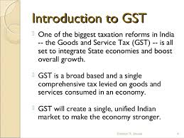
Discussion
What is GST?
GST stands for “ Goods and Services Tax” ,and is proposed to be a comprehensive indirect tax levy on the manufacturing , sale and consumption of goods as well as service at national level. It will replace all indirect taxes levied on the goods and services by the Indian central and state governments.

Slide 6
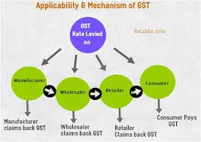

Slide 7
Findings
Benefits problems of GST
Revenue will get a boost: The number of tax exempt goods will decline . Input tax credit will encourage supplier to pay taxes .
Life gets simpler: GST will replace17 indirect tax levied and compliance costs will fall.
A common market : its currently fragmented along states lines, pushing costs up 20-30%
Logistics ,inventory costs will fall: check at state borders slow movement of truck. In India , they travel 280 km a day compared with 800km in US.
Investment boots : expected a 6% rise in capital goods investment ,2% overall.

Slide 8
Problems
The tax on services would go up substantially from 14% to 20%.
Tax on retails would be almost double .
Imported goods would be taxed at higher rate by around 6%
There will be dual control on every business by central and state government .so compliance cost will go up.
All credit available on from online connectivity with GST network .hence small business may find it difficult to use the system.

Slide 9
Impact of GST
Service will become expensive like telecom, banking airline etc.
Being a new tax ,it will take some time for the people to understand its implications.
If actual benefit is not passed to consumer and seller increase his profit margin , the prices of goods can also rise trend.
It is a consumption based tax ,so in case of service the place where services is provided needs to be determined.

Slide 10
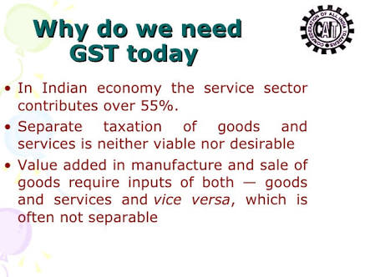

Slide 11
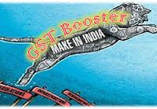
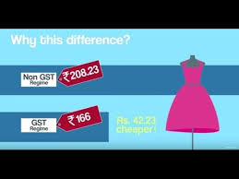

Slide 12
Thank you

