Slide 1

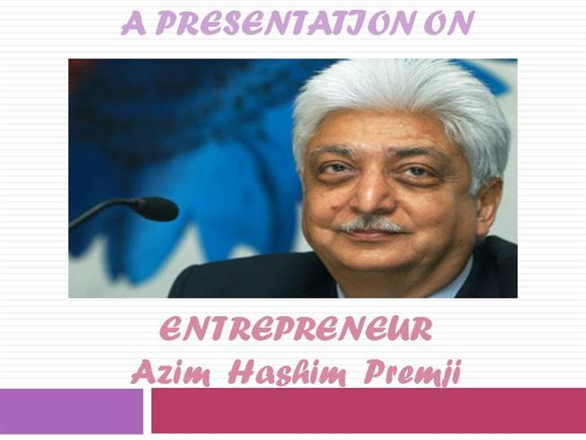
WEL - COME
Power Point Presentation
HIRACHAND NEMCHAND CALLEGE OF CAMMERCE
B.COM (II)

Slide 2

CONTENTS
EARLY LIFE
EDUCATION
ENTRY IN –WIPRO
ACHIEVEMENTS
AWARDS
LESSONS OF AZIM PREMJI
  TAKE CHARGE
  EARN YOUR HAPPINESS
  NOTHING SUCCEEDS LIKE FAILURE
  THERE HAS TO BE A BETTER WAY
  NOTHING FAILS LIKE SUCCESS
  RESPOND AND NOT REACT
  REMAIN PHUSICALLY ACTIVE
  NEVER COMPROMISE ON YOUR VALUES
  PLAY TO WIN
  GIVE BECK TO SOCIETY

Slide 3


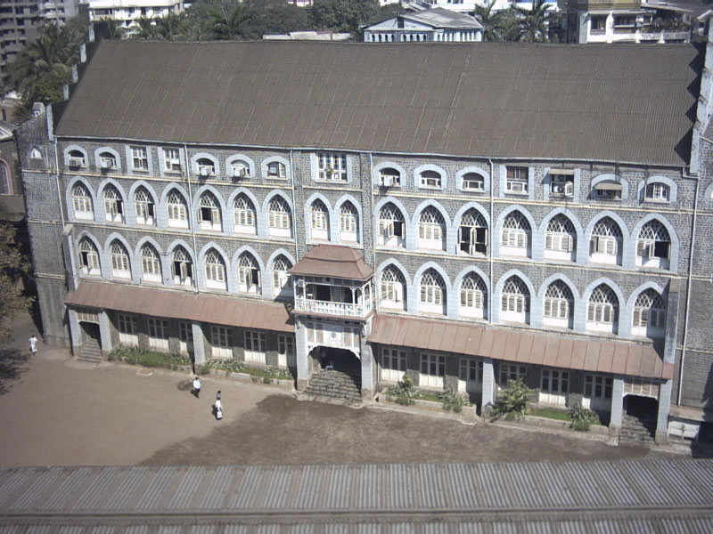
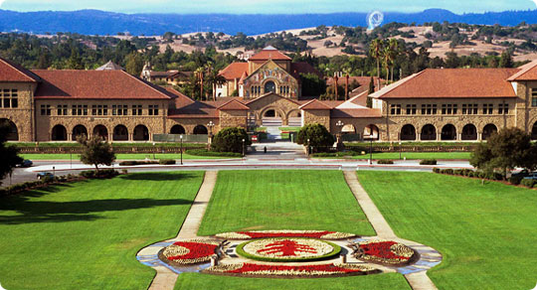

St. MARY’S SCHOOL
IN MUMBAI.
AZIM PREMJI WAS BORN ON
24TH JULY 1945

Slide 4
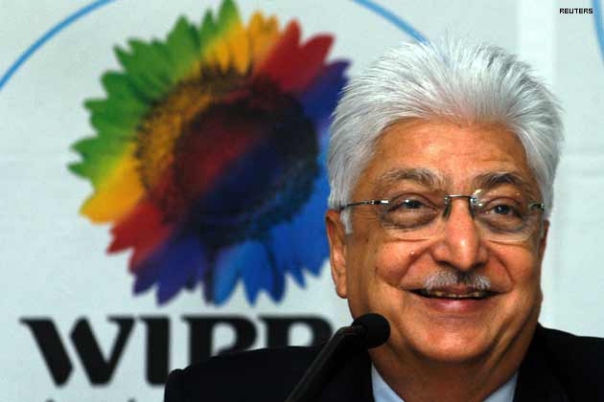
AJIM PREMJI WAS ENTERED
IN BUSINESS IN 1966.

Slide 5
ACHIEVENMENTS
AWARDS OF AZIM PREMJI
He is 3rd richest man in India.
Transformed WIPRO OILS into a large WIPRO SOFTWARE COMPANY.
In 2001 Premji established a FOUNDATION FOR POOR STUDENTS.
He is member of PM’s Committee for trade and industry in India.
He has made WIPRO the biggest BPO service provider in India.
Premji awarded with BUSINESSMAN OF THE YEAR in 2000.
He was awarded with BUSINESS LEADER OF THE YEAR in 2004.
Government of India awarded him the PADAMBHUSHANA.
Azim premji got DOCTORATE from MUSLIM ALIGARH UNIVERSITY in 2008

Slide 6
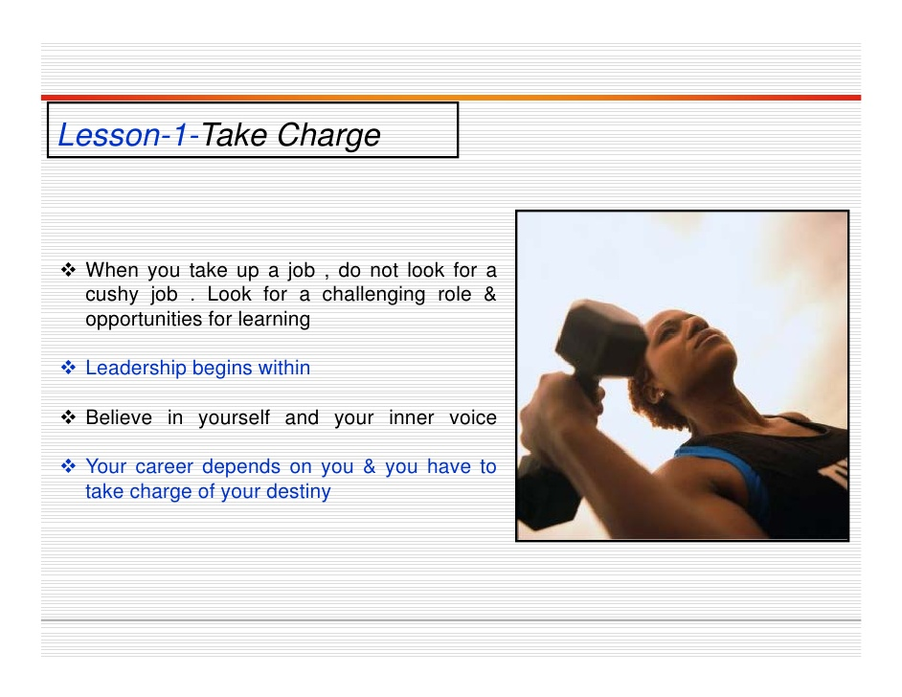

Slide 7

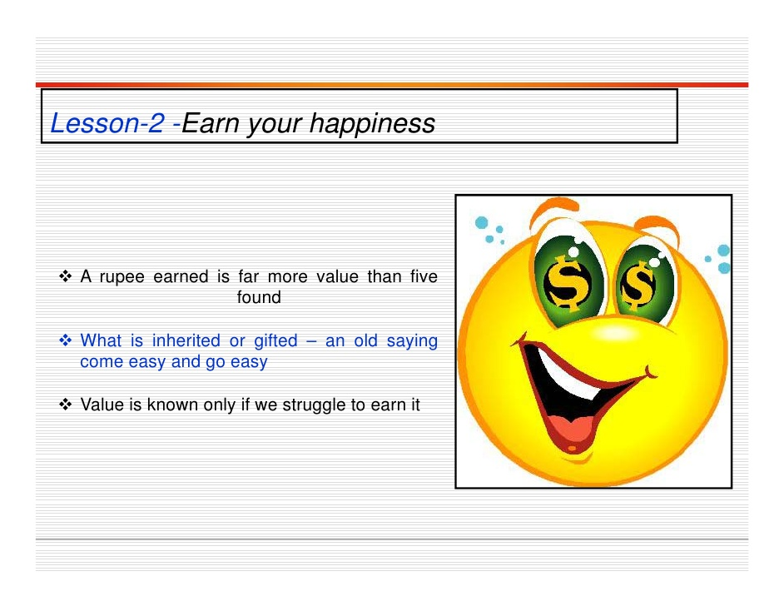

Slide 8
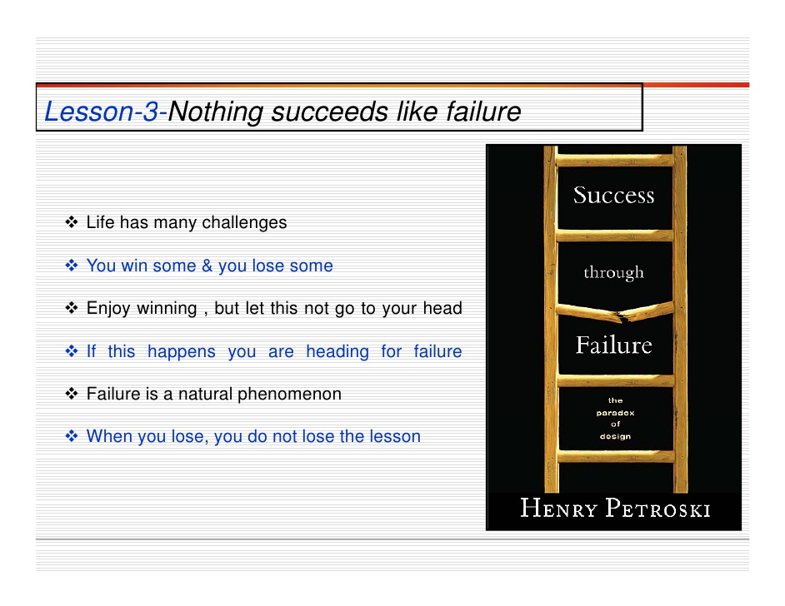

Slide 9
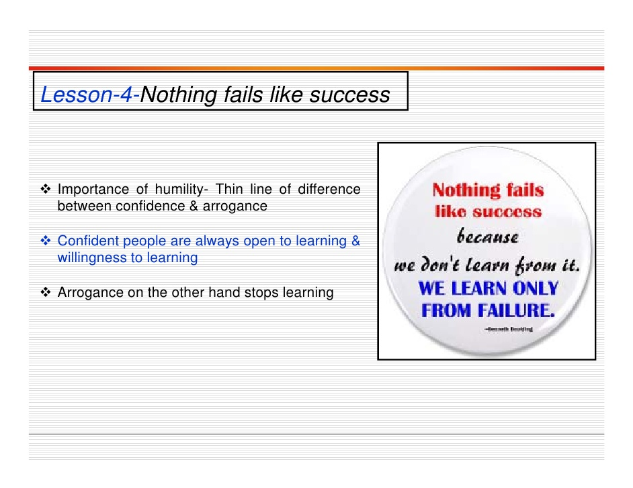

Slide 10
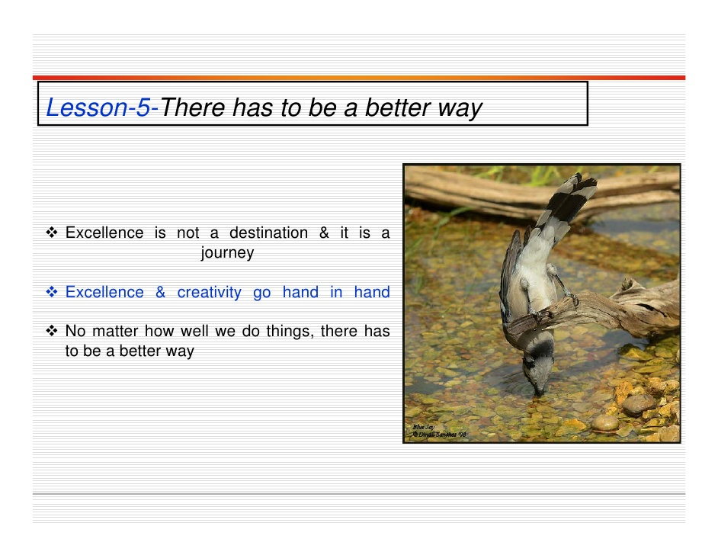

Slide 11

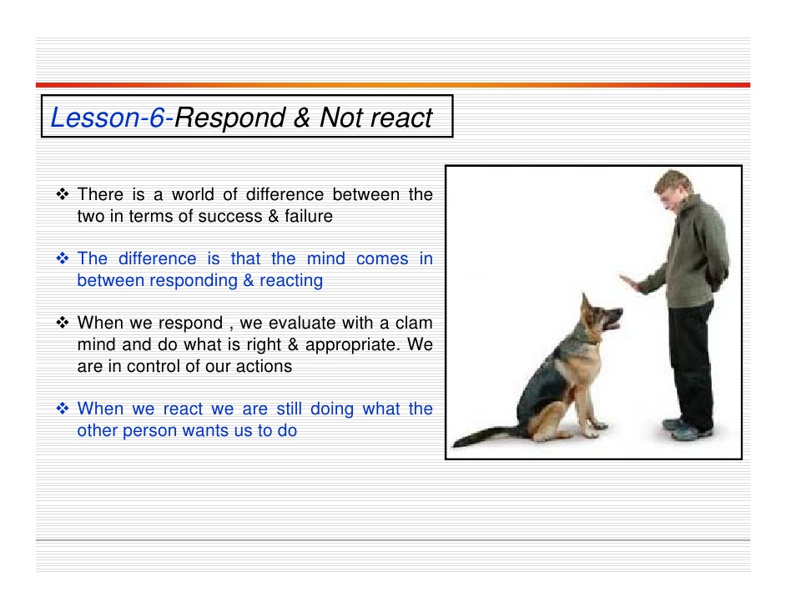

Slide 12
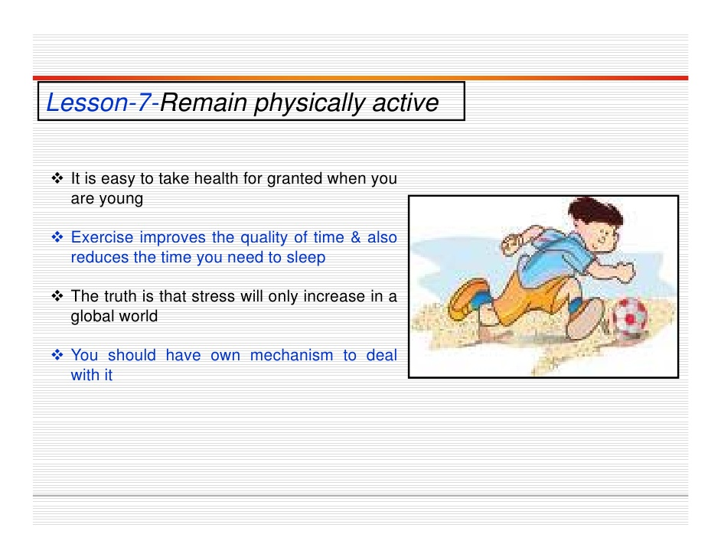

Slide 13
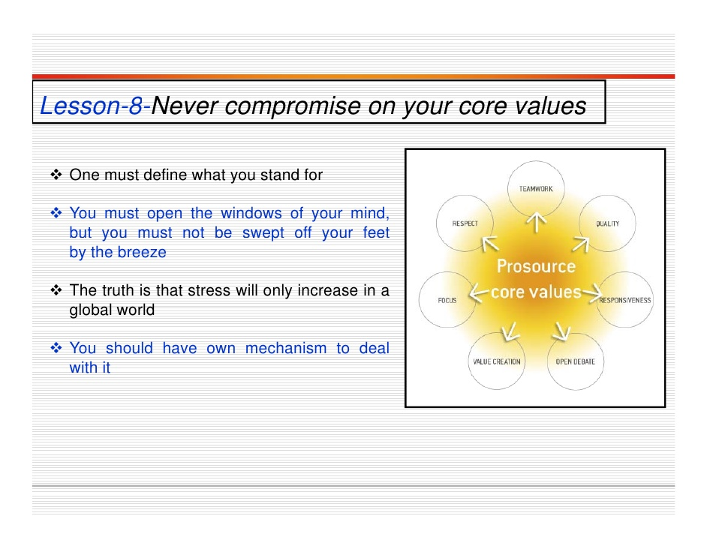

Slide 14
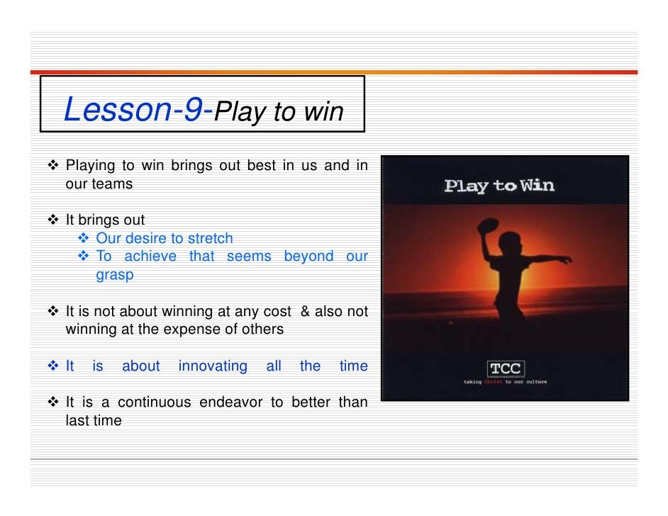

Slide 15
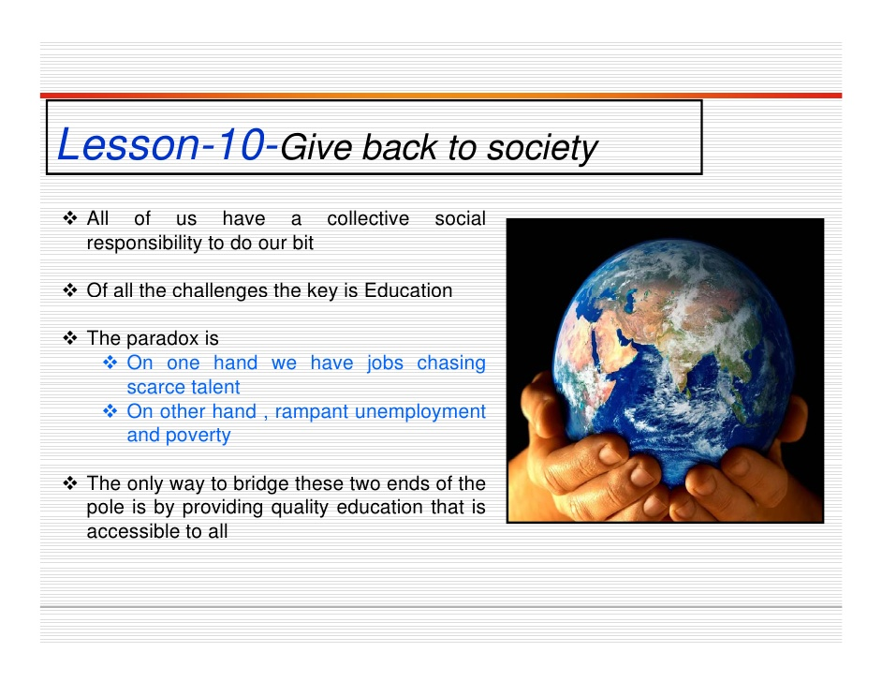

Slide 16
CONCLUSION
THANK YOU !!!
HAVE NICE DAY

