Slide 1
Body Language
Prof. Dr. Jainoddin Mulla
M.Com, M.Phill, B.Ed, G.D.C.&A.,ADCHN,CNE,NET,SET,NET-JRF, Ph.D.

Slide 2
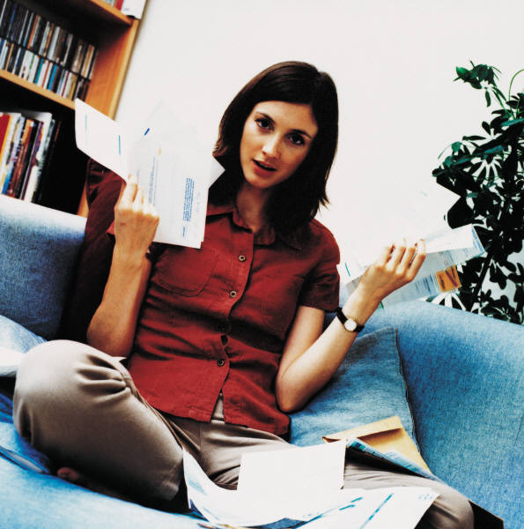
What is mean by body Language ?
"body language - noun - the process of communicating what you are feeling or thinking by the way you place and move your body rather than by words

Slide 3
BODILY SPEAKING…
According to the social anthropologist, Edward T. Hall, in a normal conversation between two persons, less than 35% of the social meanings is actually transmitted by words.
So, at least 65% of it is conveyed through the body (non-verbal channel).

Slide 4
body language warning Body language is not an exact science. No single body language sign is a reliable indicator. Understanding body language involves the interpretation of several consistent signals to support or indicate a particular conclusion.

Slide 5
Personal space
zone | distance | for
1 Personal | 45-120cm 18in-4ft | family and close friends
2 Social- consultative | 1.2-3.6m 4-12ft | non-touch interaction, social, business
3 Public | 3.6m+ 12ft+ | no interaction, ignoring

Slide 6
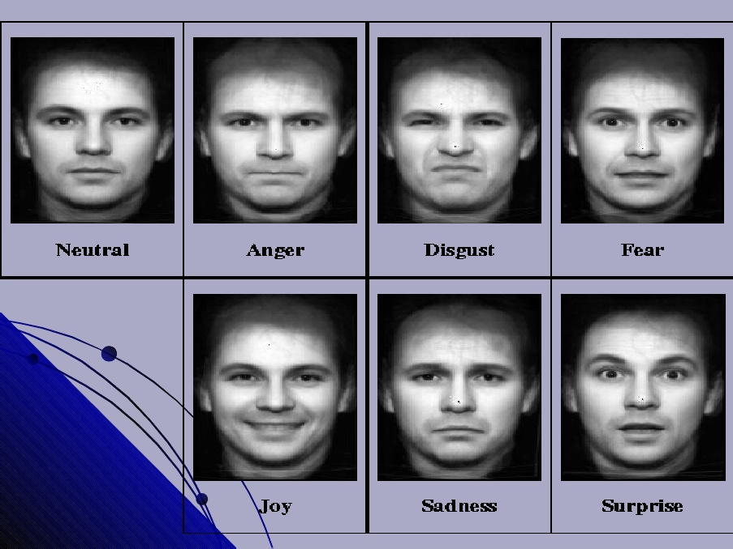
Seven universal facial expressions

Slide 7
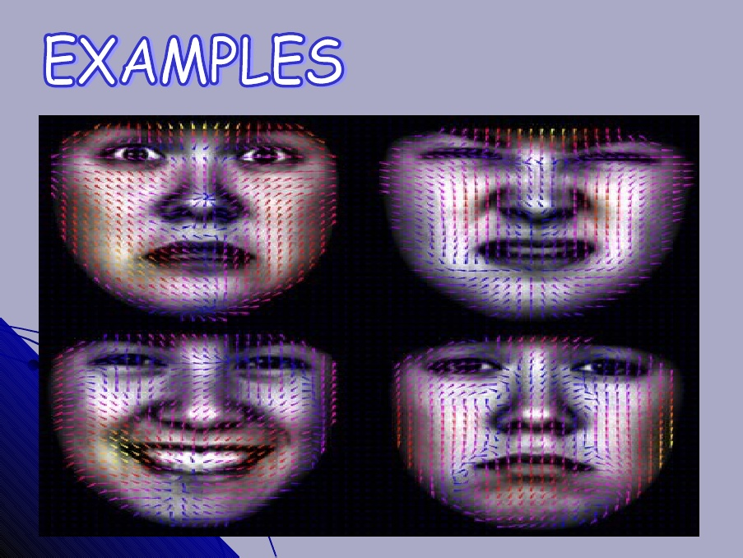

Slide 8
FACE

Slide 9

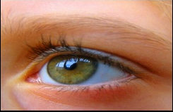

Slide 10
signal | part of body | Possible meaning(s)
Left and right are for the person giving the signals and making the movements.
looking right (generally) | eyes | creating, fabricating, guessing, lying, storytelling
looking left (generally) | eyes | recalling, remembering, retrieving 'facts'
direct eye contact (when speaking) | eyes | honesty - or faked honesty
direct eye contact (when listening) | eyes | attentiveness, interest, attraction
widening eyes | eyes | interest, appeal, invitation
rubbing eye or eyes | eyes | disbelief, upset, or tiredness
eye shrug | eyes | frustration
pupils dilated (enlarged) | eyes | attraction, desire
blinking frequently | eyes | excitement, pressure
eyebrow raising (eyebrow 'flash') | eyes | greeting, recognition, acknowledgement
winking | eyes | friendly acknowledgement, complicity (e.g., sharing a secret or joke)

Slide 11
Head - body language
signal | part of body | possible meaning(s)
head nodding | head | agreement
slow head nodding | head | attentive listening
fast head nodding | head | hurry up, impatience
head held up | head | neutrality, alertness
head held high | head | superiority, fearlessness, arrogance
head tilted to one side | head | non-threatening, submissive, thoughtfulness
head forward, upright | head / body | interest, positive reaction
head tilted downward | head | criticism, admonishment
head shaking | head | disagreement
pronounced head shaking | head | strong disagreement
head down (in response to a speaker or proposition) | head | negative, disinterested
head down (while performing an activity) | head | defeat, tiredness
chin up | head | pride, defiance, confidence
active listening | head / face | attention, interest, attraction

Slide 12
Arms - body language
signal | part of body | possible meaning(s)
crossed arms (folded arms) | arms | defensiveness, reluctance
gripping own upper arms | arms | insecurity
one arm across body clasping other arm by side (female) | arms | nervousness
arms held behind body with hands clasped | arms | confidence, authority
handbag held in front of body (female) | arms | nervousness
holding papers across chest (mainly male) | arms | nervousness
adjusting cuff, watchstrap, tie, etc., using an arm across the body | arms | nervousness
arms/hands covering genital region (male) | arms / hands | nervousness
holding a drink in front of body with both hands | arms / hands | nervousness
seated, holding drink on one side with hand from other side | arms / hands | nervousness
touching or scratching shoulder using arm across body | arms / shoulder | nervousness

Slide 13
Hands - body language
signal | part of body | possible meaning(s)
palm(s) up or open | hands | submissive, truthful, honesty, appealing
palm(s) up, fingers pointing up | hands | defensive, instruction to stop
finger pointing (at a person) | hands | aggression, threat, emphasis
hand chop | hands | emphasis - especially the last word on a matter
finger tips and thumbs touching each other on opposite hands ('steepling') | hands | thoughtfulness, looking for or explaining connections or engagement
steepled fingers pointing forward | hands | thoughtfulness and barrier
palms down moving up and down, fingers spread | hands | seeking or asking for calm, loss of control of a group or situation
interwoven clenched fingers | hands | frustration, negativity, anxiousness
index finger and thumb touching at tips | hands | satisfaction, 'OK'
thumb(s) up | hands | positive approval, agreement, all well
thumbs down | hands | disapproval, failure
thumb(s) clenched inside fist(s) | hands | self-comforting, frustration, insecurity
hand held horizontally and rocked from side to side | hands | undecided, in the balance
rubbing hands together | hands | anticipation, relish
hand(s) clamped over mouth | hands / mouth | suppression, shock
two-fingered V-sign, palm outward | hands fingers | victory, peace

Slide 14
Hands & Face - body language
signal | part of body | possible meaning(s)
touching nose, while speaking | hands / nose | lying or exaggeration
scratching nose, while speaking | hands / nose | lying or exaggeration
pinching or rubbing nose, while listening | hands / nose | thoughtfulness, suppressing comment
picking nose | hands / nose | day-dreaming, inattentive, socially disconnected, stress
pinching bridge of nose | hands / nose | negative evaluation
hand stroking chin | hands / chin | thoughtfulness
hand supporting chin or side of face | hands / chin, face | evaluation, tiredness or boredom
chin resting on thumb, index finger pointing up against face | hands / chin | evaluation
neck scratching | hands / neck | doubt, disbelief
hand clasping wrist | hands / wrist | frustration
running hands through hair | hair / hair | flirting, or vexation, exasperation
hand(s) on hip(s) | hands / arms | confidence, readiness, availability
hands in pockets | hands / arms | disinterest, boredom
removing spectacles | hands / spectacles | alerting wish to speak

Slide 15
Legs and feet - body language
signal | part of body | possible meaning(s)
leg direction, sitting - general | legs/knees | interest, attentiveness (according to direction)
uncrossed legs, sitting - general | legs | openness
parallel legs together, sitting (mainly female) | legs | properness
crossed legs, sitting - general | legs | caution, disinterest
crossing legs, sitting - specific change | legs | interest or disinterest in direction of upper crossed knee
American or figure-4 leg cross | legs | independent, stubborn
American or figure-4 leg cross with hand clamp | legs / arm / hand | resistant, stubborn
ankle lock, sitting | legs | defensiveness
splayed legs, standing | legs | aggression, ready for action
standing 'at attention' | legs / body | respectful
legs crossed, standing (scissor stance) | legs | insecurity or submission or engagement
knee buckle, standing | legs / knees | under pressure
foot forward, standing | feet | directed towards dominant group member
shoe-play (female) | feet | relaxation, flirting

Slide 16
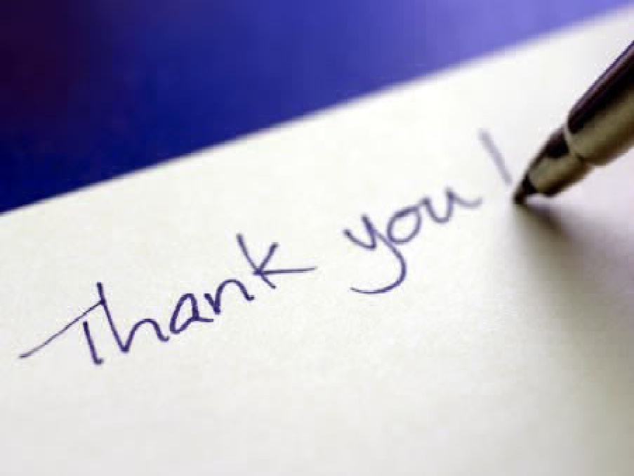
Thank You
YOUR
  thoughts
  experiences
  questions

