Slide 1
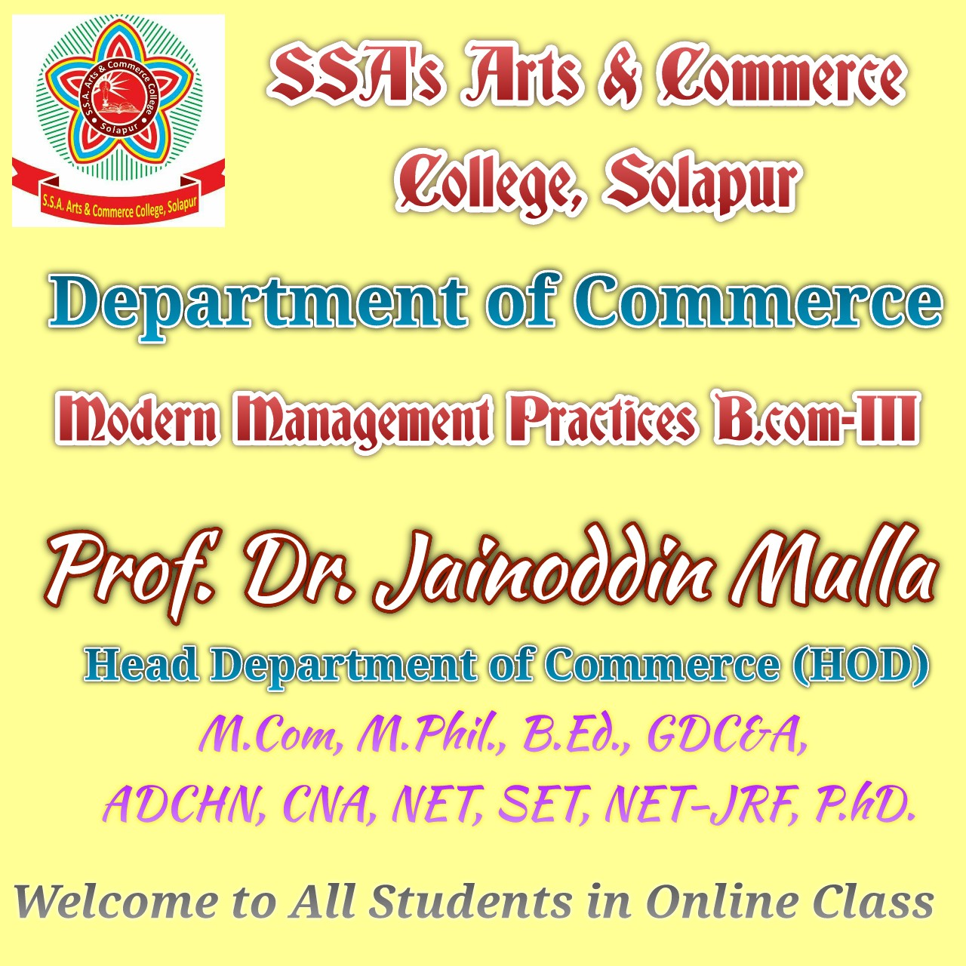

Slide 2
Types of Strategies
Presented By
Prof. Dr. Jainoddin K. Mulla,
M.Com., M.Phil., B.Ed., G.D.C&A, ADCHN, CNA, NET, SET, NET-JRF, Ph.D.
Head Department of Commerce,
SSA’s Arts and Commerce College, Solapur.

Slide 3
Levels of Strategies/ Types of Strategies
Corporate level strategy.
Business Unit Level strategy.
Functional level strategy.
Operation level strategy.

Slide 4
Example
Corporate Level | Business level | Functional level
Tata sons | Tata Salt, Tata Tea, Tata motors, TCS etc..... | Production/Marketing/HRM/Finance/Account etc... any functional department of any business unit........
Aditya Birla Group | Birla cement, Idea Network, Peter England, Pantaloon etc...... | Production/Marketing/HRM/Finance/Account etc... any functional department of any business unit........
Reliance Industries | Reliance Petroleum, JIO Network, Mayur Fashion etc........ | Production/Marketing/HRM/Finance/Account etc... any functional department of any business unit........

Slide 5
Strategy hierarchy
Corporate strategy:
1) growth strategy,
2) stability strategy,
3) retrenchment strategy.
Business unit strategy:
1) cost leadership,
2) differentiation,
3) focus,
4) mixed.
3. Functional strategy.

Slide 6
Types of Strategies
Corporate
Level
A Large Company
Business Unit Level
Functional Level
Operational Level

Slide 7
Corporate Level strategies
Top level management formulate for overall organization
The question at the corporate level we should answer when design strategies: In what industry should we be operating?
It depends on the outcome of SWOT analysis.

Slide 8
Corporate Level strategies

Slide 9
I. Stability Strategies /Status-quo Strategies
A stability strategy is adopted by those companies who don’t want to expand their business but they want to maintain their business. It is less risky type of strategy.
Stability strategy is the preferred in following situation.
a) When the environment is relatively stable.
b) When expansion is perused by the organization as being threatening.
c) When consolidation is to be sought through stabilizing after a period of rapid expansion.
d) When the performance of business is satisfactory.
e) When organization want to concentrate particular area of a market.
f) When organization is unable for allocating resources for expansion.

Slide 10
The stability strategy of the two forms
i) Maintenance of status-quo:-
An organization designing to adopt this strategy tries to maintain same level of operation. They do not intent to adopt growth.
ii) Sustainable Growth:-
The organization adopting this strategy attempt for a slow, gradual & sustainable growth for their business.

Slide 11
II. Growth / Expansion Strategy
Expansion strategy is followed by those organisations which aim high growth by broadening the scope of their businesses. Expansion or growth strategy is most popular because growth is the way of life & almost all organization planned to make growth through the expansion strategy.

Slide 12
II.1 Centralization strategy/ Focus / Concentration

Slide 13
II.2. Vertical Integration
Expansion through integration is adopted through vertical or horizontal integration or both.
When an organization starts making new products for its own needs vertical integration takes place. Thus when an organization undertakes any new activity with the purpose of either supplying inputs to the organization or for serving the customers of the organization, vertical integration takes place.
Vertical Integration has two types.
i) Forward Integration:-
ii) Backward Integration:-

Slide 14
II. 2. Vertical Integration
i. Forward Integration
Example
General Motors is acquiring 10% of its dealers.
Forward Integration
Defined
Gaining ownership or increased control over distributors or retailers

Slide 15
II.2. i. Forward Integration
Guidelines for Forward Integration
  Present distributors are expensive, unreliable, or incapable of meeting firm’s needs
  Availability of quality distributors is limited
  When firm competes in an industry that is expected to grow markedly
  Advantages of stable production are high
  Present distributor have high profit margins

Slide 16
II. 2. ii.Backward Integration
Backward Integration
Example
Furniture manufacturer acquired a Plywood factory
Defined
Seeking ownership or increased control of a firm’s suppliers

Slide 17
II. 2. ii.Backward Integration
Guidelines for Backward Integration
  When present suppliers are expensive, unreliable, or incapable of meeting needs
  Number of suppliers is small and number of competitors large
  High growth in industry sector
  Firm has both capital and human resources to manage new business
  Advantages of stable prices are important
  Present supplies have high profit margins

Slide 18
II. 3. Diversification Strategy
Diversification strategy is exactly opposite to the centralized strategy. In centralized strategy, concentration on the particular business or product is given but in the diversification strategy, diversification of products, creating new products, going for the new business etc. is considered.
Why Diversification strategy ?
a) To minimize risk by spreading organizational resources over several businesses.
b) To capitalized on organizational strength.
c) As a way out when growth in existing business is blocked up due to regulatory environment.
Diversification is of two types.
i) Concentric Diversification -Concentric diversification takes place when an organization takes up new activities which are related to its existing business.
ii) Conglomerate Diversification -When an organization on the other hand takes up those new activities which are unrelated to its existing business is called conglomerate diversification.

Slide 19
II.4.Strategic Alliance Strategy
Two or more organization unit to pursue a set of goals that remain independent subsequent to the formation of the alliance.
The partner organization shares the benefit of the alliance & control over the performance of assigned task.
The partner organization contributes on a continuing basis in one or more by strategic area.
Licensing
Franchising
Consortia
Contract Manufacturing

Slide 20
II.5. Joint Venture Strategy
Joint ventures are a special case of consolidated where two or more companies form a temporary partnership or consortium for a specified purpose. It can be formed for the manufacturing a new product, Reduction in cost of production, Implementation of new technology, Capturing of new market, Reducing the competition etc.
Factor to be consider in the joint venture.
The vision of the partners should be the same.
Selection of the best partner.
Detailed and clear contract of joint venture.
The time period of joint venture.
There should be agreement regarding managerial control.
There should be benefit to the each partner.
Proportion in the value chain.

Slide 21
II.5. Joint Venture Strategy
Joint Venture
Example
Lucent Technologies and Philips Electronic NV formed Philips Consumer Communications to make and sell telephones.
Defined
Two or more sponsoring firms forming a separate organization for cooperative purposes

Slide 22
III. Retrenchment Strategy
When the position of the organization is disappointing or at the extreme when the survival of the organization is at stake, then it should follow retrenchment strategy.
Disinvestment / Investment Reduction Strategy:
Turn Around Strategy
Liquidation Strategy

Slide 23
III. 1.Disinvestment / Investment Reduction Strategy
Disinvestment strategy deals with organization spins off sale out one of its business unit which is performing poorly or is not fit in the company strategic profile.
Disinvestment strategy is one of the strategies which are adopted by the management in the critical situation.
In the following conditions Disinvestment strategy is adopted.
Poor economic conditions & depressionary pressure.
Competitive pressure causing the organization to curtail their operations.
The organization is doing poorly.
The organization cannot adopt latest technology.
There are better opportunities in other business areas.
Legal Complications.
Good price in the market for the business.
Concentration on the expert field.
Insolvency.

Slide 24
III.2. Turnaround
Retrenchment
(turnaround)
Example
A company sold off a land and 4 apartments to raise cash needed. It introduce expense effective control system.
Defined
Regrouping through cost and asset reduction to reverse declining sales and profit. Sometimes it is called turnaround or reorganizational strategy.

Slide 25
III.2. Turnaround
Guidelines for Ternaround
  Firm has failed to meet its objectives and goals consistently over time but has distinctive competencies
  Firm is one of the weaker competitors
  Inefficiency, low profitability, poor employee morale, and pressure from stockholders to improve performance.
  When an organization’s strategic managers have failed
  Very quick growth to large organization where a major internal reorganization is needed.

Slide 26
III. 3. Liquidation
Liquidation
Example
El-Ameer Block factory sold all its assets and ceased business.
Defined
Selling all of a company’s assets, in parts, for their tangible worth

Slide 27
III. 3. Liquidation
Guidelines for Liquidation
  When both retrenchment and divestiture have been pursued unsuccessfully
  If the only alternative is bankruptcy, liquidation is an orderly alternative
  When stockholders can minimize their losses by selling the firm’s assets

Slide 28
IV. Combination Strategy
This strategy is combination of stability, expansion & retrenchment strategies. It involves implementation of two or more strategies. It is also called as Corporate Portfolio Restructuring Strategies.

Slide 29
Business Level Strategies or Competitive Strategies
At the business level the highest level of competitive interaction occurs & the competitive advantage is ultimately won or lost. This type of strategy is developed for competition, overcome with the problems, go ahead in the race and become superior in the market.
According to Michel Porter, There are three basic business levels or competitive strategies.
Cost leadership Strategy.
Differentiation Strategy.
Focused Strategy.

Slide 30
Competitive Strategies given By Michael Porter’s
Cost Leadership Strategies
(Low-Cost & Best-Value)
Differentiation Strategies
Focus Strategies
(Low-Cost Focus &
Best-Value Focus)

Slide 31
Business Level Strategies or Competitive Strategies

Slide 32
Cost Leadership --
  Low-cost competitive strategy
  Broad mass market
  Efficient-scale facilities
  Cost reductions
  Cost minimization

Slide 33
Cost leadership
Striving to be the low-cost producer in an industry can be especially effective when the market is composed of many price-sensitive buyers, when there are few ways to achieve product differentiation, when buyers do not care much about differences from brand to brand, or when there are a large number of buyers with significant bargaining power.

Slide 34
Cost leadership
The basic idea behind a cost leadership strategy is to underprice competitors or offer a better value and thereby gain market share and sales, driving some competitors out of the market entirely.
5. To successfully employ a cost leadership strategy, firms must ensure that total costs across the value chain are lower than that of the competition. This can be accomplished by:
a. performing value chain activities more efficiently than competition, and
b. eliminating some cost-producing activities in the value chain.

Slide 35
Differentiation –
  Broad mass market
  Unique product/service
  Premiums charged
  Less price sensitivity

Slide 36
Differentiation
Differentiation is aimed at producing products that are considered unique. This strategy is most powerful with the source of differentiation is especially relevant to the target market

Slide 37
Differentiation
A successful differentiation strategy allows a firm to charge higher prices for its products to gain customer loyalty because consumers may become strongly attached to the differentiation features.
3. A risk of pursuing a differentiation strategy is that the unique product may not be valued highly enough by customers to justify the higher price.

Slide 38
Differentiation
Common organizational requirements for a successful differentiation strategy include strong coordination among the R&D and marketing functions and substantial amenities to attract scientists and creative people.

Slide 39
Focus
1. Focus means producing products and services that fulfill the needs of small groups of consumers.
2. There are two types of focus strategies.
a. A low-cost focus strategy offers products or services to a small range (niche) of customers at the lowest price available on the market.
b. A best-value focus strategy offers products to a small range of customers at the best price-value available on the market. This is sometimes called focused differentiation.

Slide 40
Focus
Focus strategies are most effective when the niche is profitable and growing, when industry leaders are uninterested in the niche, when industry leaders feel pursuing the niche is too costly or difficult, when the industry offers several niches, and when there is little competition in the niche segment.

Slide 41
Cost-Focus –
  Low-cost competitive strategy
  Focus on market segment
  Niche focused
  Cost advantage in market segment

Slide 42
Differentiation Focus –
  Specific group or geographic market focus
  Differentiation in target market
  Special needs of narrow target market

Slide 43
Level of Strategy
Functional/operational Strategies:
Concern with org. internal resources and processes which effectively deliver the corporate and business strategic direction.
Functional strategies are interrelated.
Functional strategies e.g.: purchasing & materials management, production, finance, R&D, HR, IT, and marketing.

